Slide 1
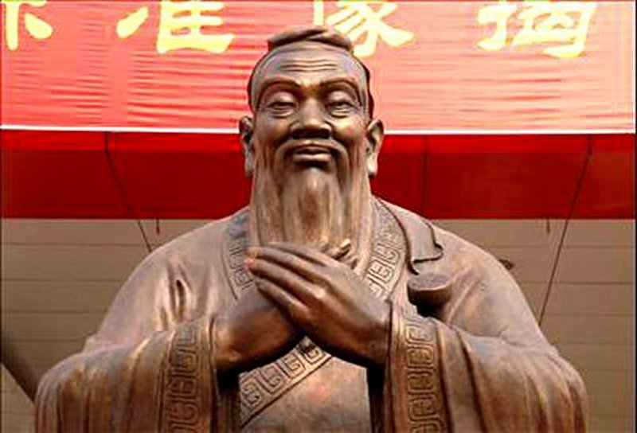
Confucius and
Confucianism

Slide 2
Цель: Расширить материал по теме «Знаменитости»
Задачи:
Ознакомить с биографией китайского мудреца Конфуция.
Ознакомить и освоить новую лексику по теме «Знаменитости»
Тренировать произносительные навыки
Развивать навыки чтения и письма

Slide 3
Plan
1. The life of Confucius
2. Confucianism:
a) Reverence (уважение) of elder
people.
b) Studying of ancient writings.
c) The bases of behavior.
3. To learn new words.

Slide 4
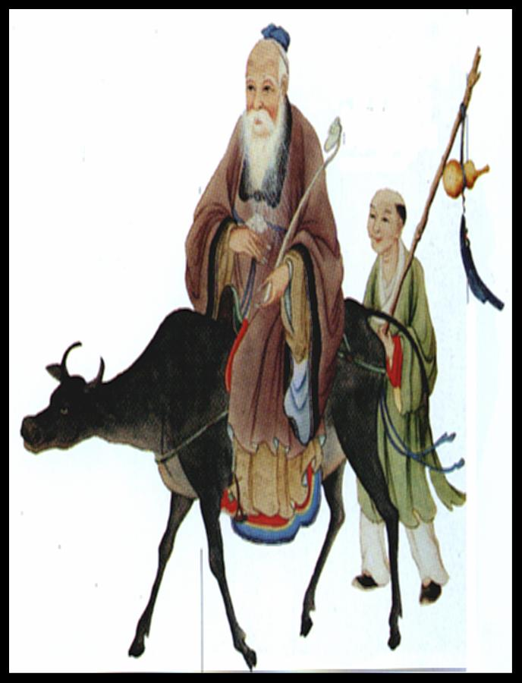
The life of Confucius .
551 BC.- he was born
531 BC.- he was a caretaker of
grasslands
525 BC.- he studied music
523 BC.- he began to teach
people.
519-484 BC.-travelling, looking
for «a justice kingdom».
481 BC- he created some
canonical books.
479 BC.- he died

Slide 5
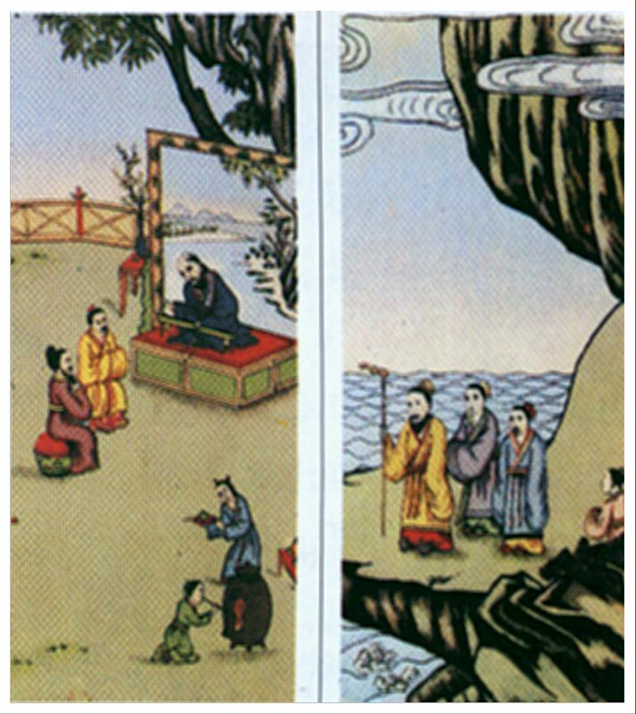
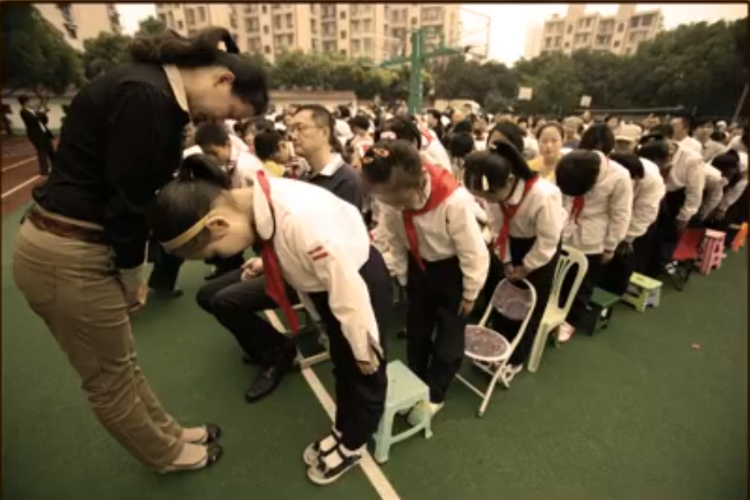
Confucianism: Reverence of elder people
Почему китайцы с таким почтением относятся к старикам?

Slide 6
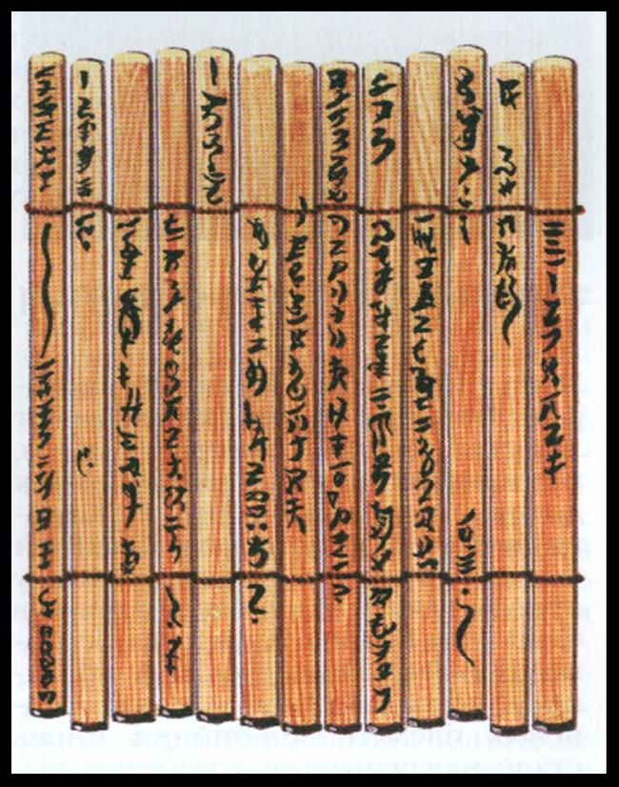
Studying of ancient writings
Confucius said wisdom is knowing of ancient books. In those days books were written on bamboo sticks. His students should learn them by heart

Slide 7
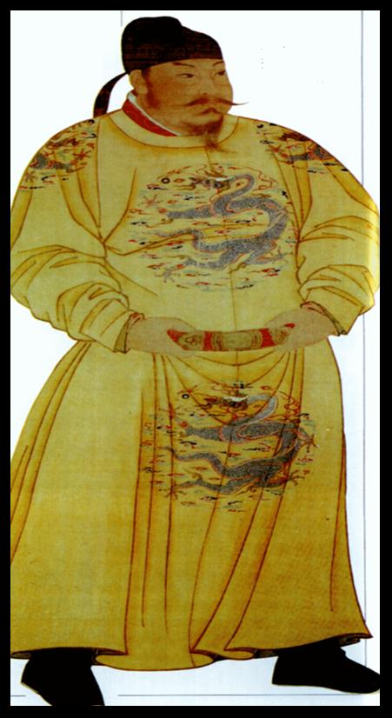
The bases of behavior Основы поведения
- To sit with your legs crossed;
-To walk on the mats without shoes ;
-To eat with 2 chopsticks;
-To put your hair in a nun;
- Clothes are always neat;
- To be polite
Don’t use bad words in your speech.

Slide 9
Let’s remember some words
brilliant [ˈbrɪlɪənt] — блестящий, восхитительный
contribution [kɒntrɪˈbjuːʃn] — 1) вклад; 2) взнос
enter [ˈentə] — 1) входить в; поступать в учебное заведение; вводить данные в компьютер
graduate [ˈgræʤʊeɪt]— оканчивать (университет)
improve [ɪmˈpruːv] — улучшать
knowledge [ˈnɒlɪʤ] — знания
opportunity [ɒpəˈtjuːnɪtɪ] —возможность
respect [ri'spekt] — уважение

Slide 10
Let’s learn new words
brilliantly [ˈbrɪlɪəntli] — блестяще, восхитительно
to contribute [kɒntrɪˈbjuːt] — внести вклад
an entrance [ˈentrəns] — вход
a graduate [ˈgræʤuət]— выпускник
an improvement [ɪmˈpruːvmənt] — улучшение
knowlegeable [ˈnɒlɪʤəbl] — знающий
respect [ri'spekt] — уважать
respected [ri'spektid] — уважаемый
respectable [ri'spektəbl ] — уважаемый

Slide 11
Complete the sentences. Use the words brilliantly, respect, contributed, respectable graduate, knowledgeable, entrance, respected
1. We all ____him for his devotion to his children.
2. My brother is one of the most ____ students in our school.
3. Tom is a very gifted actor. He plays all his roles ____.
4. My elder sister is a ____ of Moscow State University.
5. Some businessmen _____ money to rebuild the
museum.
6. I will meet you at the ____ to the cinema at 5 o’clock.
7. Mr. Green is a ____ member of his club.
8. Polly leads a perfectly _____ life.

