Slide 1
Inventions that shook the world!

Slide 2
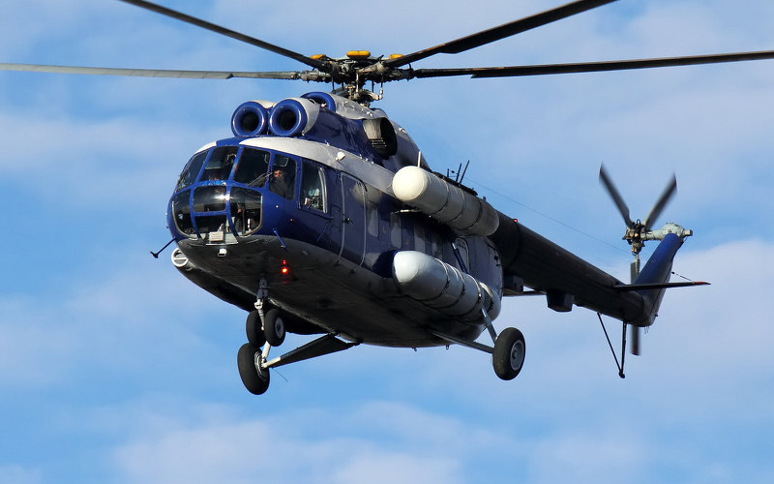
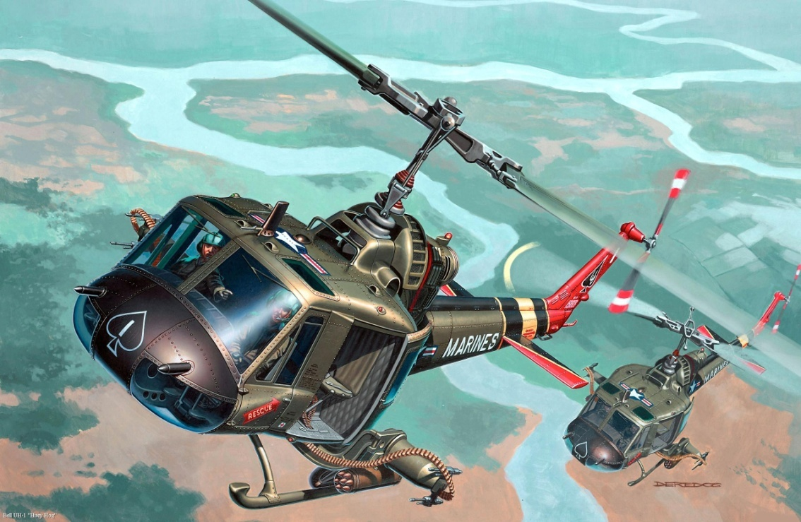
Helicopter
Helicopter was invented by I. Sykorsky in Russia, in 1939. It allows you to save time on the roads, fly long distances.

Slide 3
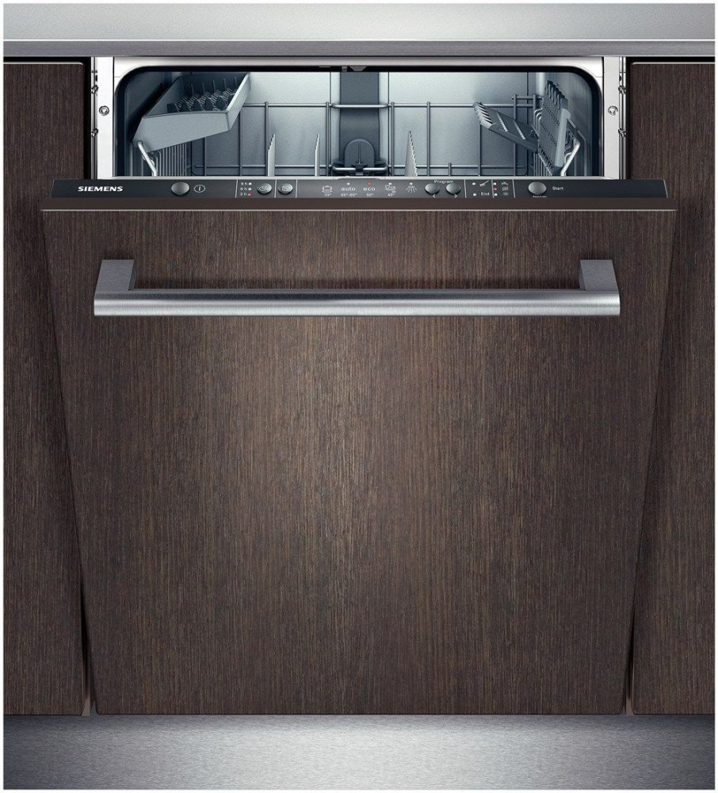
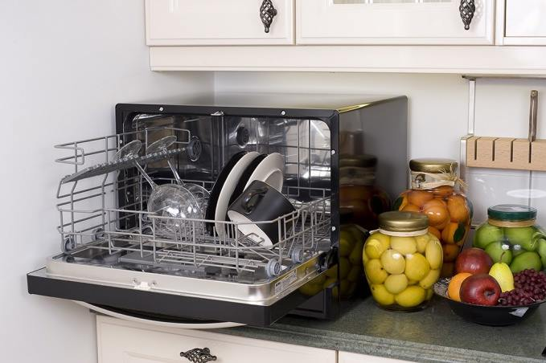
Dishwasher
The dishwasher was invented by Dzhonel Gouton in 1850. It is used for an automatic sink of ware.

Slide 4
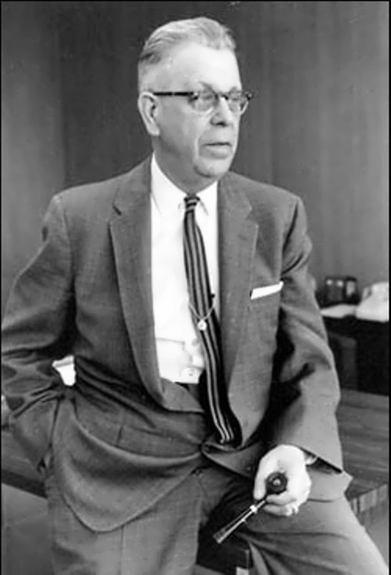
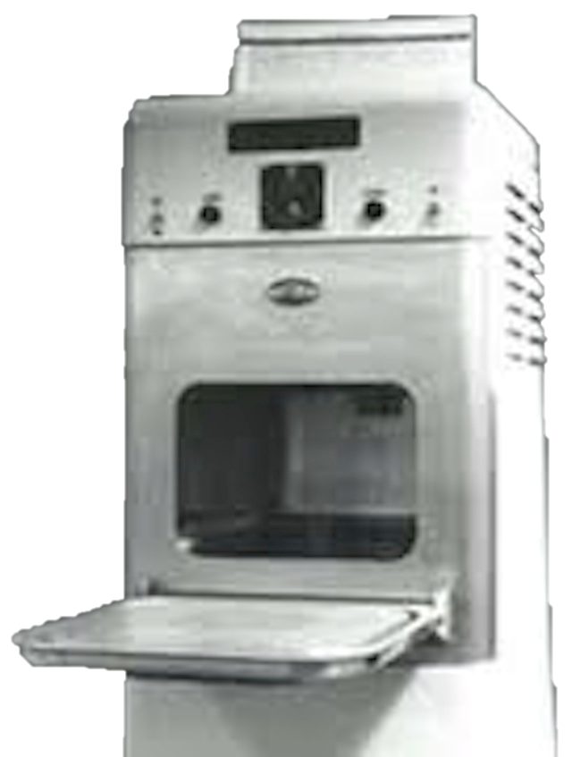
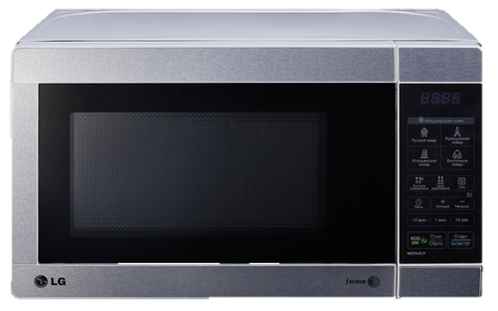
Microwave oven was made by Percy Lebaron Spencer in the USA in 1949 .
This invention is necessary for cooking, defrosting, reheating pre-cooked food.
Microwave oven

Slide 5
Bicycle
The first bicycle was constructed by the watchmaker of Nyurnber Stefan Farfler in 1685. Thanks to this invention we can ride and derive pleasure.

Slide 6
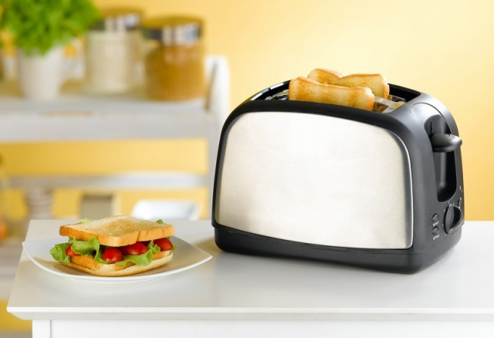
Toaster
Toaster was invented by the British company «Crompton & Co» in 1893 in England.
This device is for toasting slices of bread using radiant heat

Slide 7
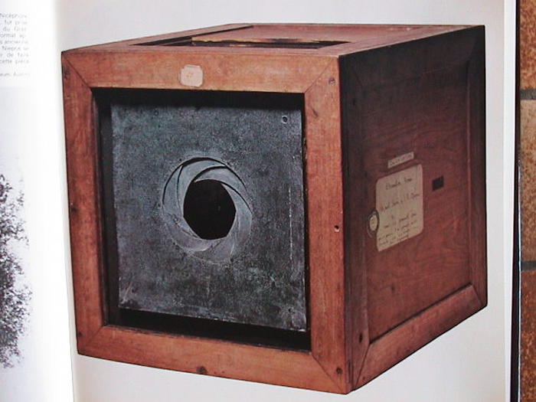
Camera
The camera was invented by Joseph Nicephore Niepce in 1826 in France.
This invention is necessary for the registration of still images (photographs).

Slide 8
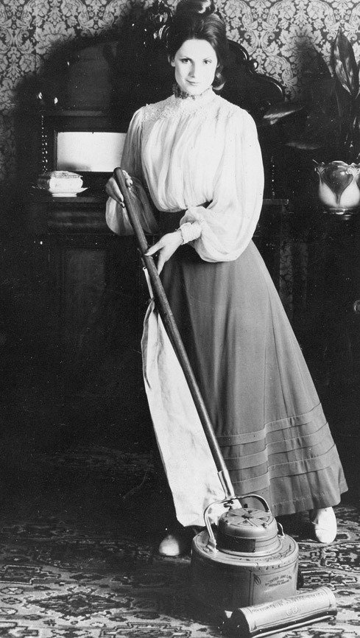
vacuum cleaner
The first vacuum cleaner was invented by James M. Spangler in 1908 in the USA. It allows to perform everyday cleaning tasks from vacuuming to cleaning up liquids, dust and waste and shampooing carpets.

Slide 9
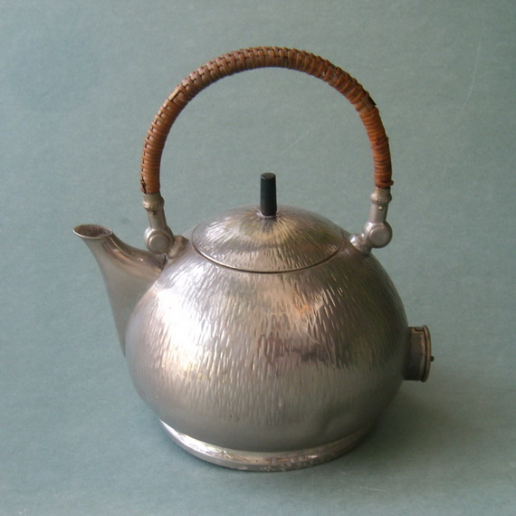
kettle
The first kettle was presented to the public in Chicago World's Fair in 1893. It was founded by Colonel Crompton. The kettle is needed to boil water.

Slide 10
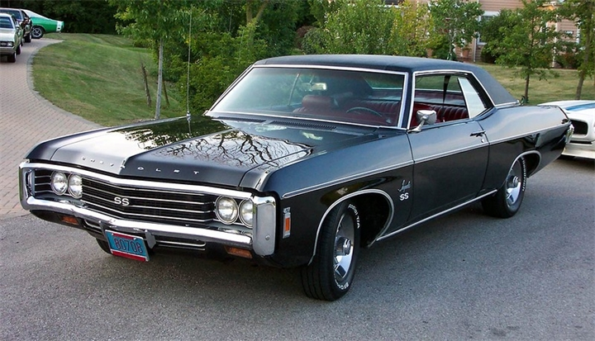
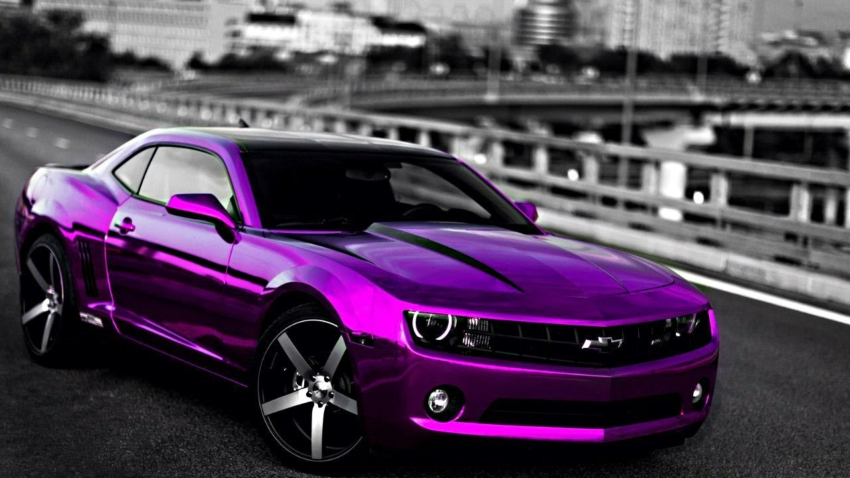
Car
It was founded by Karl Benz in 1885 year in Italy.
Vehicles are needed to move faster, to make it easier somewhere.

Slide 11
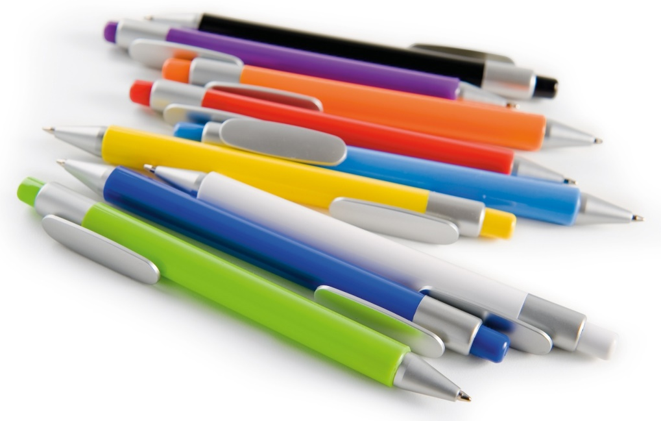
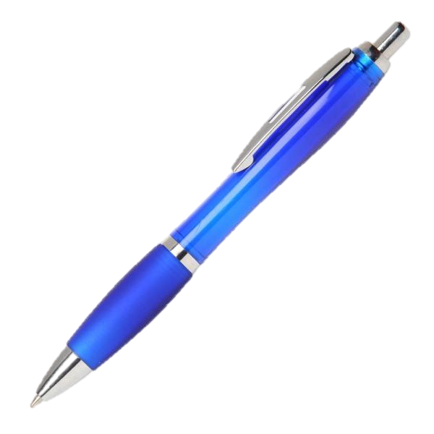
Вall pen
The ball pen was invented by John Laud in 1888 in the USA
The ball pen is needed to write any information

Slide 12
Telephone
Telephone was invented by Alexander Graham Bell in 1876 in America.
It can be used to get in touch with friends, police or ambulance. It saves time when you have a receiver at hand.

Slide 13
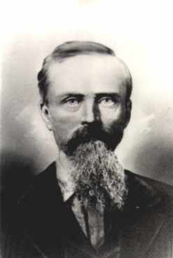
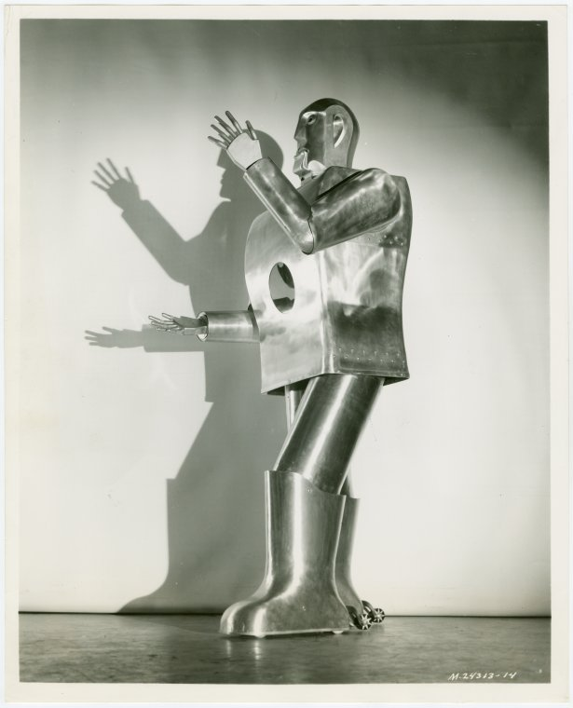
Robot
The first robot was invented by W. D. Thomas in the USA in 1925.
The first in the world robot was able to perform simple movement.

Slide 14
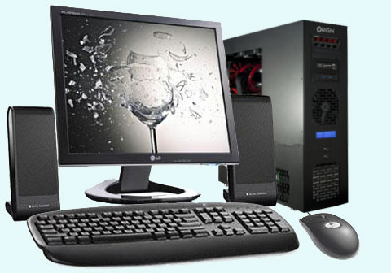
Computer
Charles Babbage invented the computer in 1946
The computer used to build graphical models, calculations, etc.

Slide 15
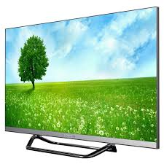
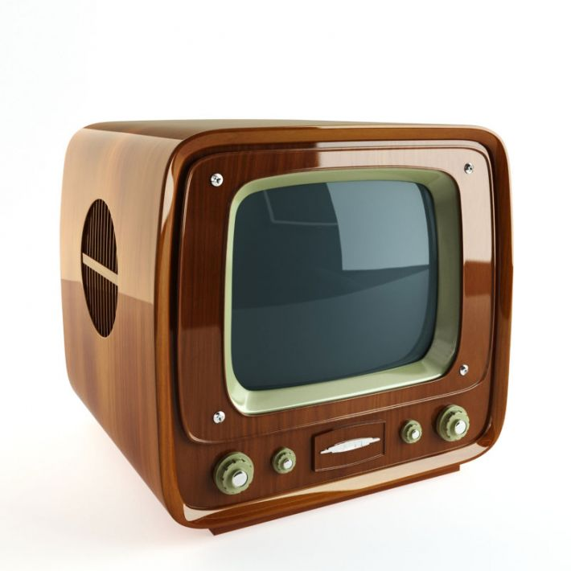
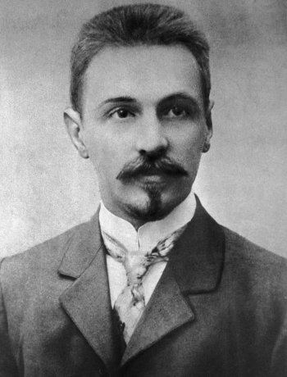
TV set
TV set was invented by Boris Rozing in 1911 in Russia. People use TV set to have fun and to entertain.

Slide 16
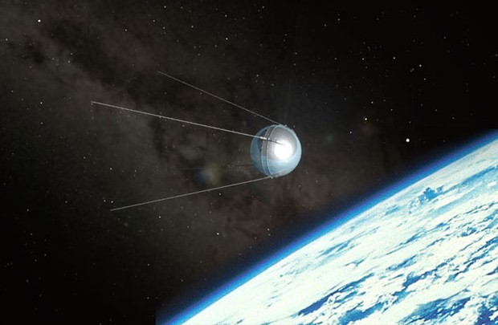
Artificial satellite
The first artificial satellite was designed by Sergei Korolev in 1957 in Russia.
Artificial satellite is used to transmit television and telephone signals, information about the weather conditions, observing all that happens on Earth, transmit the data about the state of our planet and the stars report the location of ships and aircraft and
others.

Slide 17
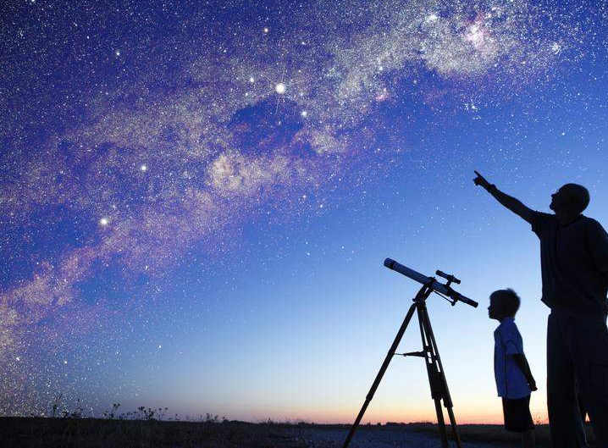
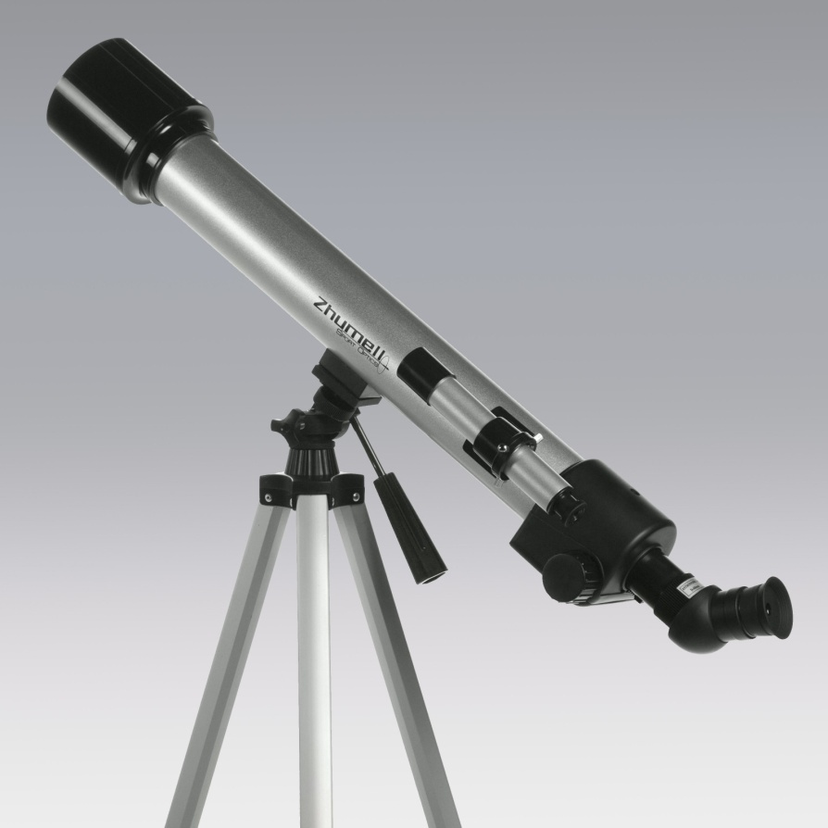
Telescope
The first telescope was invented by Calileo Calilei in 1610 in Italia. The telescope helps to watch remote subjects.

Slide 18
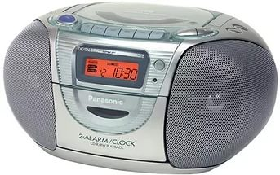
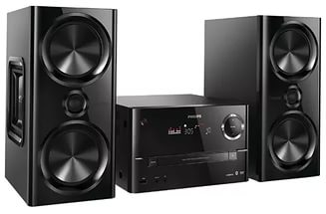
RECORD PLAYER
MUSIC CENTER
Record player was invented by Valdemar Poulsen in Denmark on the 1st of December in 1898. This device is designed for both recording and play back previously recorded on magnetic media signals.

Slide 19
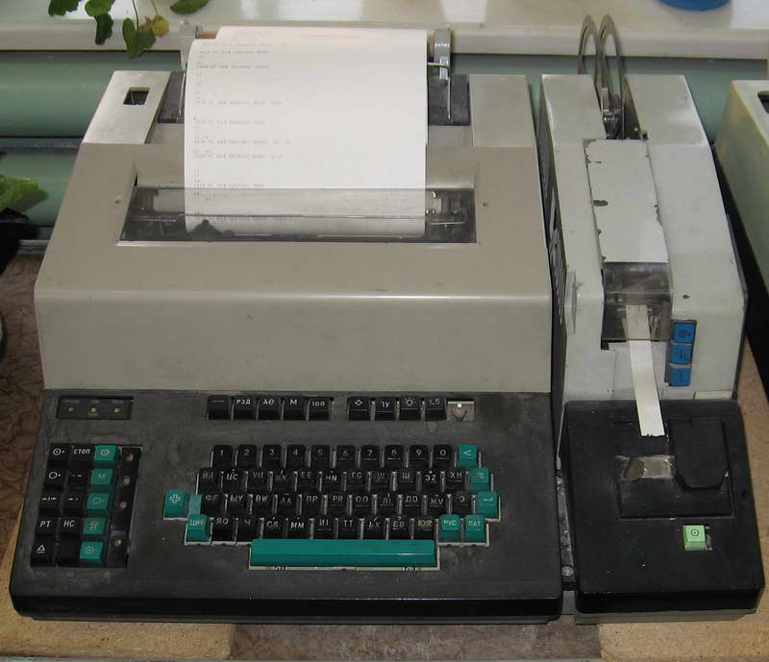
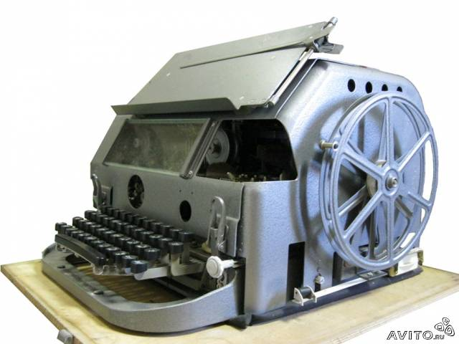
Telegraph
First telegraph office was created by scientist Lesage in 1774 in Geneva. The first electromagnetic telegraph was invented by scientists Schilling in Russia in 1832.
The telegraph can transmit signals or messages over long distances by means of wires or radio waves. Before the advent of telephones and the Internet telegraph was the main means of communication.

Slide 20
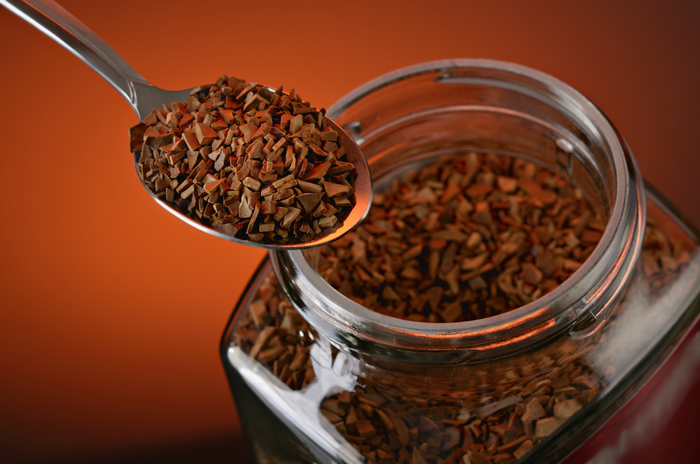
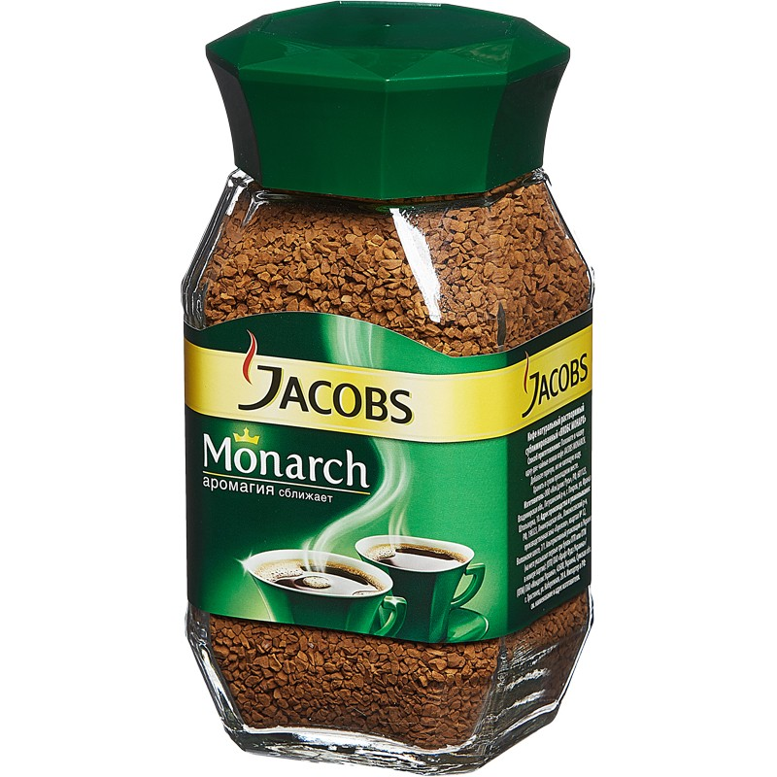
INSTANT coffee
Instant coffee was invented by David Strang in New Zealand in 1890. But there is another point of view, that coffee was invented by a Japanese scientist Satori Kato in 1901 .
Coffee is typically used to receive energy, alertness.
Jacobs Monarch is one of the firms making coffee.

Slide 21
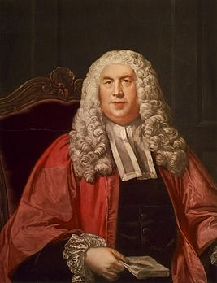
Washing machine
The washing machine was invented by William Blackstone in 1907 in England
The washing machine is needed to wash clothes

