Slide 1
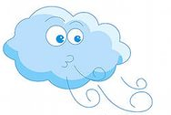
What’s the weather like?

Slide 2
Ex. 1, p. 98. Form the adjectives
Rain
Cloud
Wind
Fog
Snow
Sun
Chill
Storm
Rainy
Cloudy
Windy
Foggy
Snowy
Sunny
Chilly
Stormy

Slide 3
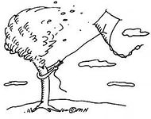
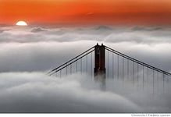
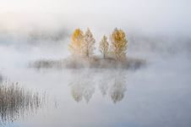
Use appropriate adjectives to complete the expressions
Wet & rainy
Cloudy & windy
Cold & snowy
Hot & sunny
Chilly & foggy

Slide 4
Look at the chart, ask & answer as in the example in your book.
London
Copenhagen
Moscow
Paris
Cairo
10
°c
- 5
°c
5
°c
8
°c
30
°c

Slide 5
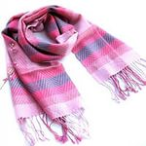
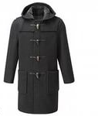
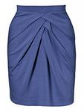
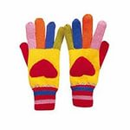
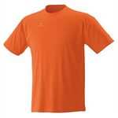
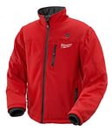
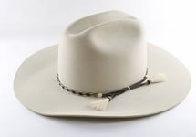
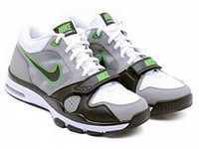
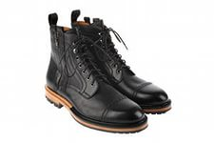
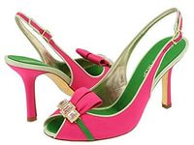
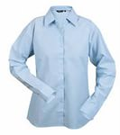
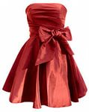
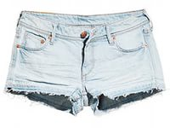
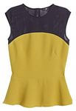
scarf
coat
raincoat
skirt
sweater
gloves
T-shirt
jacket
trainers
hat
dress
boots
shoes
shorts
top
trousers
shirt

Slide 6
It’s going to be rainy today.
I know. I’ll wear my raincoat and boots then.
Sunny
Stormy
Boiling hot
Wet
Sunny
Freezing cold

Slide 7
Kathy is meeting
Kathy is wearing
The weather is
Kathy wants to borrow
Clair wants to go
Helen.
a thin dress and sandals.
wet and cloudy.
an umbrella.
to the shop.

Slide 8
Explain these words & expressions
Soaked -
(My clothes are completely soaked.)
Borrow –
(Can I borrow your pen?)
Brand new –
( Watch this video! It’s brand new!)
completely wet
to take sth that belongs to sb else & use it with
the permission & intention of returning it.
completely new.

Slide 9
Everyday English. Asking for-Giving/refusing permission
Can I…? Could…I?
May I…?
Positive
Yes, sure./ Of course.
OK. No problem.
Yes, that’s fine.
Negative
No way!
I’m afraid you can’t because…
I’m sorry, you may not.

Slide 10
Use these phrases to act out exchanges:
borrow/jacket
drive /car
wear/red T-shirt
borrow/umbrella
take day off/tomorrow

Slide 11
Grammar
Present Continuous (future meaning). For actions we have already arranged in the near future.
I’m flying to Paris tomorrow.
To be going to…. To express plans/predictions. To make predictions based on what we see.
Look out! You are going to fall.
Future Simple (will). For on-the –spot decision.
The phone is ringing. I’ll answer it.

Slide 12
Make up sentences. Use Present Continuous. (future meaning)
What are you doing on Sunday?
Monday?
Tuesday?
Wednesday?
Thursday?
Friday?
Saturday?
EX: I am reading books on Monday.
Go to the movie
Watch TV
Go to the gym
Clean my room
Wash up
Work in the garden
Have a party

Slide 13
Well done!
Thank you for your work!

