Slide 1
Урок по английскому языку
Здоровое питание

Slide 2
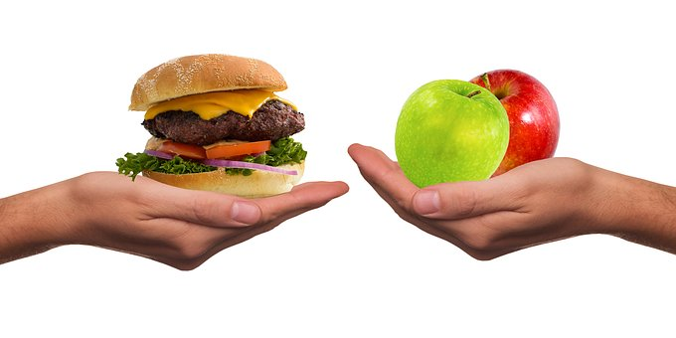
Healthy nutrition
Health is above wealth

Slide 3
Your food is the building blocks that make up your body.

Slide 4
English proverbs. An apple a day keeps the doctor away.

Slide 5
English proverbs. Не that would eat the fruit must climb the tree.

Slide 6
English proverbs. Appetite comes with eating.

Slide 7
English proverbs. All griefs are less with bread.

Slide 8
English proverbs. Live not to eat, but eat to live.

Slide 9
English proverbs. Man does not live by bread alone.

Slide 10
English proverbs. Diet cures more than lancet.

Slide 11
English proverbs. To lengthen thy life, lessen thy meals.

Slide 12
English proverbs. Gluttony kills more than sword.

Slide 13
English proverbs. Eat at pleasure, drink with measure.

Slide 14
Structure changes.
When food is cooked, its structure changes. It can change the vitamin and nutrient contents of food.

Slide 15
People feel better.
More and more people feel strongly about the way, their food is produced. Nowadays so much of the basic food we eat — meat, fish, fruit and vegetables — is grown using chemicals and additives.

Slide 16
Avoid modified products.
Buying every desired product is also risky. There are lots of products today which are genetically modified.

Slide 17
Eat dairy food.

Slide 18
Eat more fish.

Slide 19
Eat more meat

Slide 20
Eat poultry.

Slide 21
Eat more fruits and vegetables

Slide 22
Foods containing fat should be limited

Slide 23
You must eat less bread , salt , sugar or fast food.

Slide 24
Eating in a hurry can be harmful
We live in a world where people are always in a hurry and don’t have enough time to eat healthy.

Slide 25
Some people are highly allergic to a fruit.
In this case they need to cut this product out of their daily diet.

Slide 26
Eating healthy food is very important for every person.

Slide 27
Healthy Food
Dairy food
Fruits
Vegetables
Fish
Meat
Honey
Nuts
Pulses
Bread
Juice
Cereals
Eggs

Slide 28
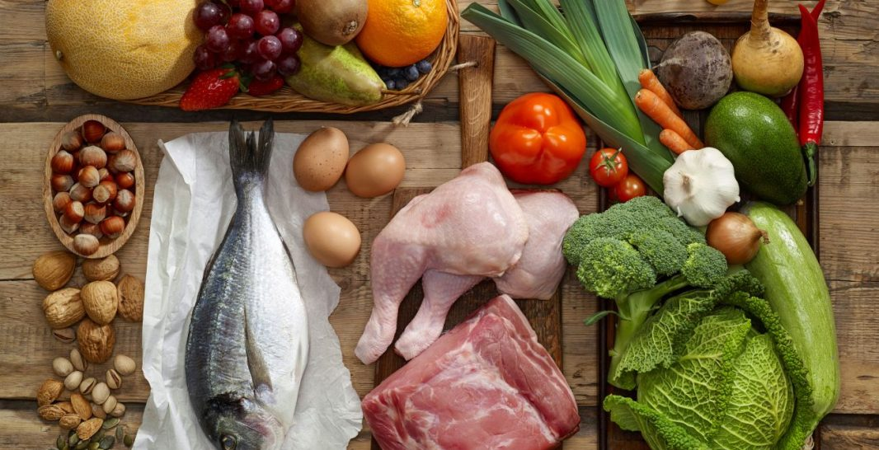
Enjoy your Food

Slide 29
Healthy food is our natural source of energy, so it’s better to choose it carefully.

Slide 30
English proverbs. Every vegetable has its season.

Slide 31
"You are what you eat."

Slide 32
English proverbs. After dinner sit a while, after supper walk a mile.

Slide 33
Home work
Ex/8-10p 113

