Slide 1
The Past Continuous Tense

Slide 2
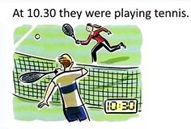
We use this tense to talk about the actions that were going on, or happening at a certain moment in the past.

Slide 3
Указатели времени:

Slide 7
Make up sentences
I Mother Father Sister We My friend My friend and I | was were | sleep… do… homework cook… watch… TV play… talk… go… home | yesterday at 6 o’clock

Slide 8
Раскройте скобки, употребляя глаголы в форме Past Continuous.
1. They (to write) the test at this time yesterday.
2. He (to work) in the garden from two till five o'clock.
3. We (to watch) television the whole evening.
4. You (to play) football at six o'clock?
5. You (to drink) tea at seven o'clock?
6. He (to draw) from three till four o'clock?
7. Who (to listen) to the radio at this time?
8. It (to rain) the whole day yesterday?
9. They (to skate) at three o'clock?
10. She (not to help) mother about the house from two till six.

Slide 12
Домашнее задание

