Slide 1
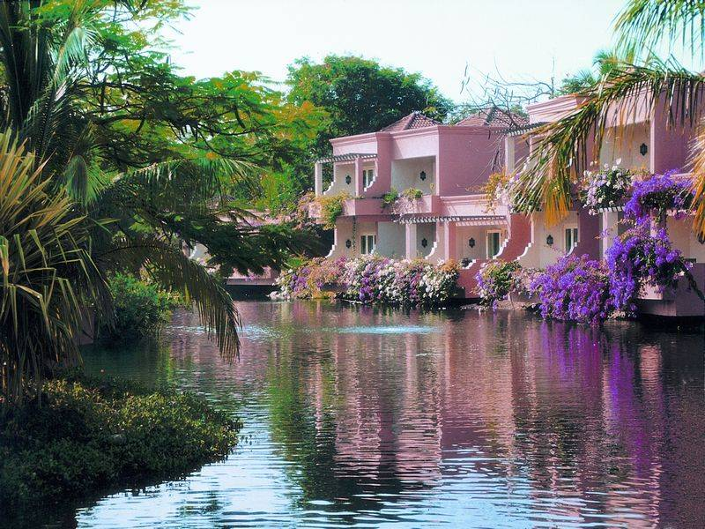
Travelling around
the world

Slide 2
So many countries all over the world, So many people and life-tales told! Different cities, languages, poems, Amazing traditions, legends and stories. We travel east, we travel west, If South is warm, North is cold, To know so much is the best, We start our trip and off we go!

Slide 3
Got bitten
Got stolen
Went on
Tried
Got caught
Made
Travelled
Caught

Slide 4
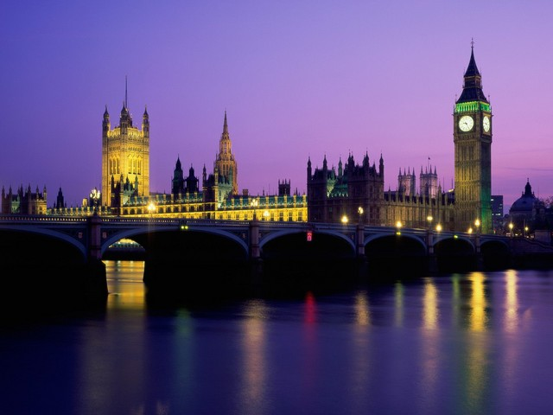
Great Britain

Slide 5
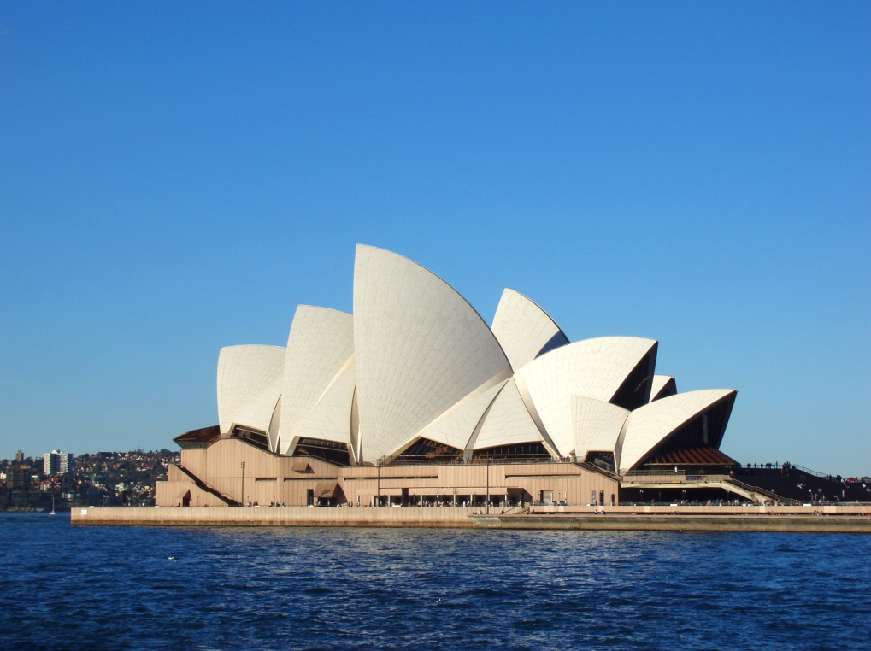
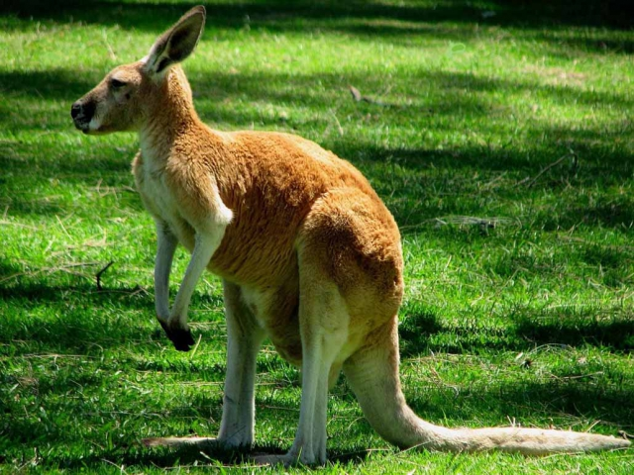
Australia

Slide 6
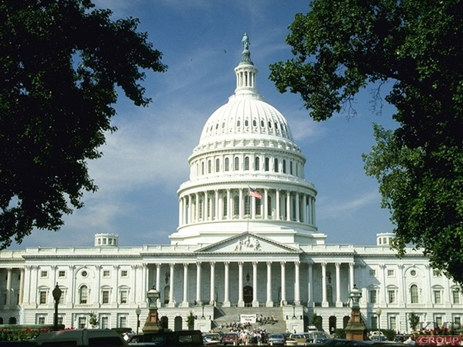
The USA

Slide 7
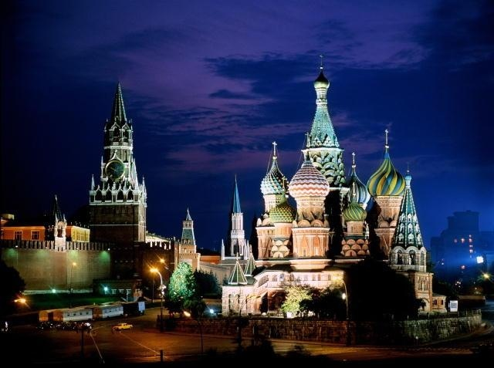
Russia

Slide 8
Plan
Transport
Landmarks
Adventure
Did you like the counry?

Slide 9
H/t: What country would you like to go? Why?
Write a letter to your friend about it.

Slide 10
Thank you!
Goodbye!

