Slide 1
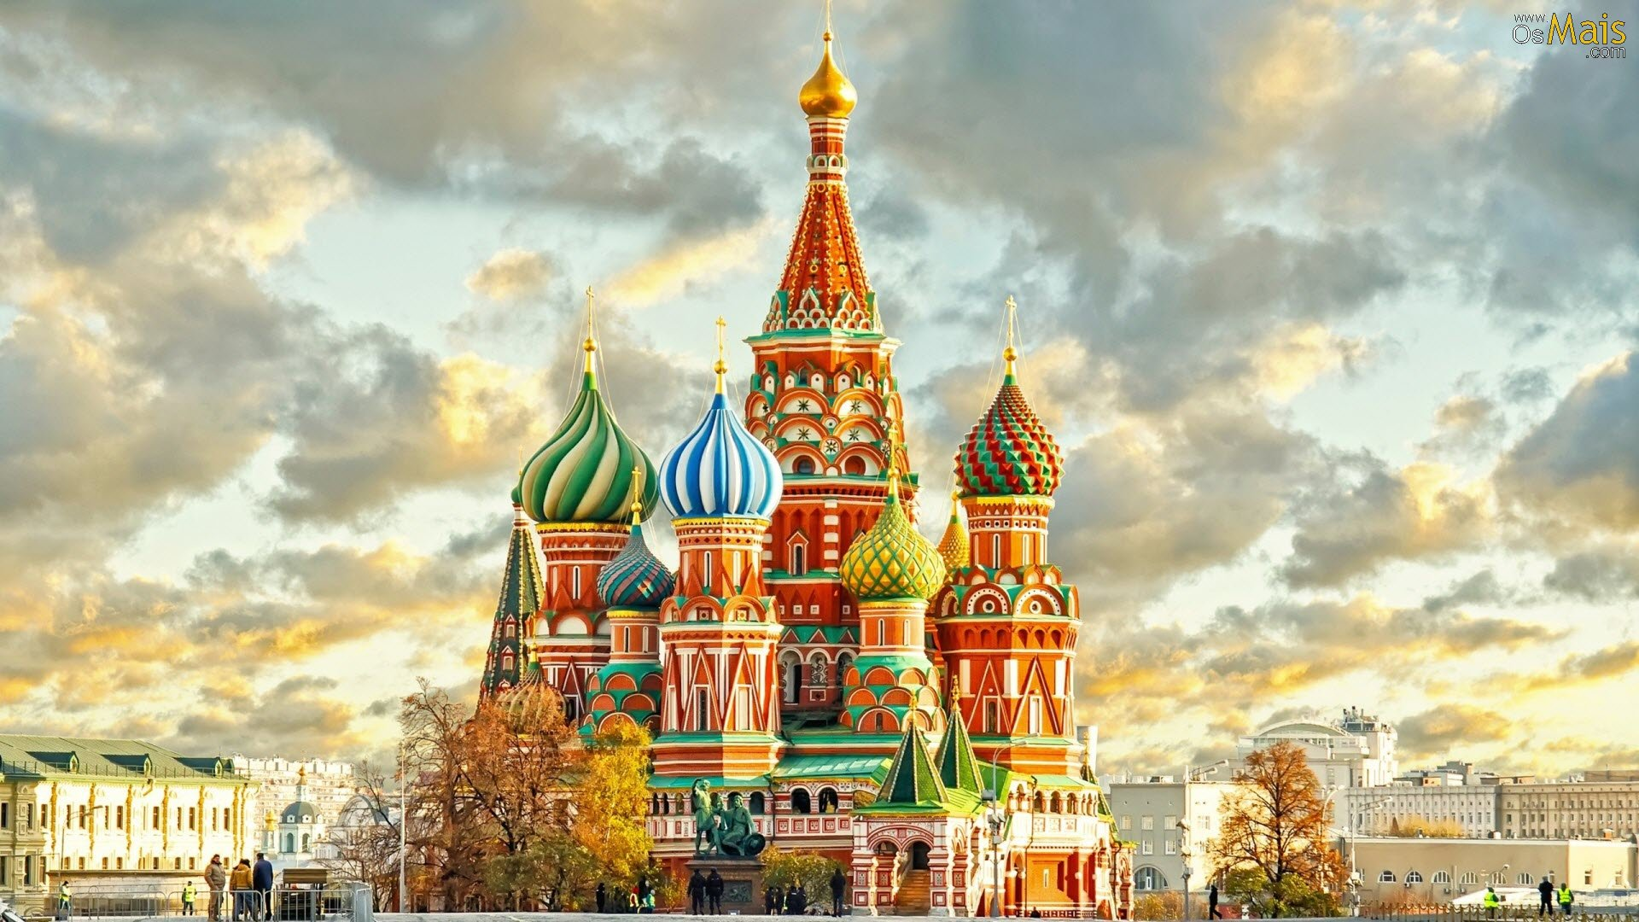
About Russia

Slide 2
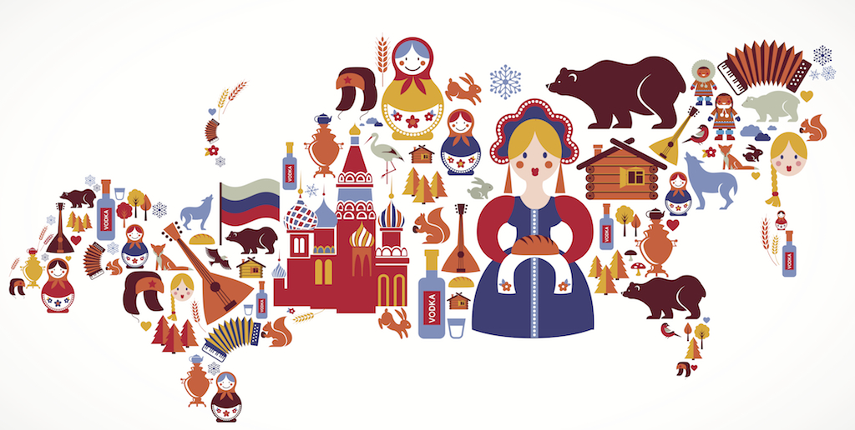
Beautiful- Beauty
Visit- Visitor
Climate
Territory
Tourist

Slide 3
Deep [diːp ]

Slide 4
Extend [ɪkˈstend]

Slide 5
Fresh [freʃ]

Slide 6
Large [lɑːdʒ]

Slide 7
Ocean [ˈoʊʃn]

Slide 8
Powerful [ˈpaʊərfl ]

Slide 9
Rich [rɪtʃ]

Slide 10
That [ðæt]

Slide 11
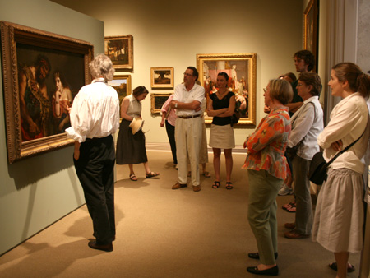
Do a city [du e ˈsɪti ]
Do a museum[du e mjuˈziːəm ]

Slide 12
Fill in the gaps with the necessary letters
D_ _ P
L _ _ _ E
R _ _ H
O _ _ _ N
P _ _ _ _ FUL
FR _ _ H
EX _ _ _ D
TH _ T
BE _ _ _ Y
VIS _ _ _ R
CLI _ _ _ E
TO_ _ _ST
TE _ _ _ TORY

Slide 13
Homework
Ex. 4 p. 93
Ex. 6 p. 94 выписать и выучить слова

