Slide 1
English
Language.

Slide 2
A brief history of the formation of the English language.
The history of the English language begins with the appearance of the islands of the Germanic tribes (Angles, Saxons, and Utah), which won Britain during the five century BC.
Scientists distinguish three periods in the history of the formation of the English language:
Old English (450 - 1100 AD.) Middle English (1100 - 1500 g.) New (modern) English (1500 - present)

Slide 3
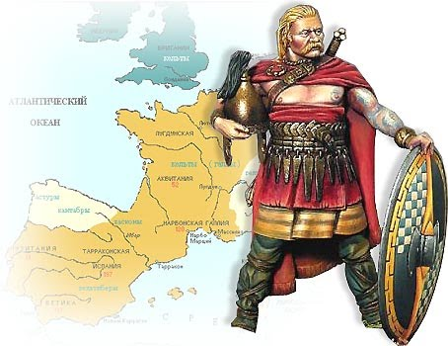
Old English period (450 - 1100 AD.)
Conquer Britain Germanic tribes spoke virtually the same language, which gave rise to the formation of the ancient English. This language was not like the modern English language. However, about half of the most common words in a modern language are ancient roots. Old English was also influenced by the Scandinavian dialects. Romanization of language was a result of the spread of Christianity in this area in England. In 8-9 centuries in the language is changed to Latin.

Slide 4
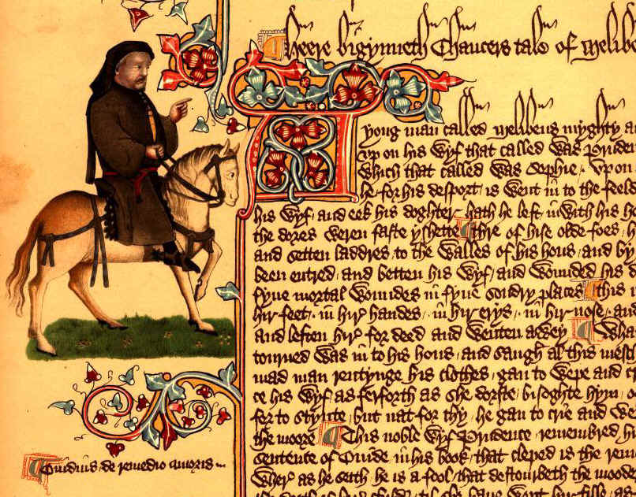
Middle English period (1100 - 1500 years.)
In 1066, William the Conqueror invaded and conquered England. The Normans brought with him to the French state, which became the language of the Royal Court. In this period, in the language of class differences existed when the lower classes spoke English and spoke French to know language. In the 14th century English became the main language in Britain again, but it entered the vocabulary of so many words of French origin.
English grammar is developed independently. London dialect, the official state language and the fundamentals of the modern literary language was formed in the 15th century.

Slide 5
New (modern) English period (1500 - present)
Since the late Middle Ages began a significant change in the pronunciation of the English language, when the vowels become shorter and shorter. From the 16th century, many new words and phrases entered the language system. Typography promote the standardization of the English language. Pronunciation and grammar become resistant and the London dialect became the standard. In 1604 it was published the first English dictionary. Later, the main differences between the early and late medieval English Modern English were visible in the dictionary.

Slide 6
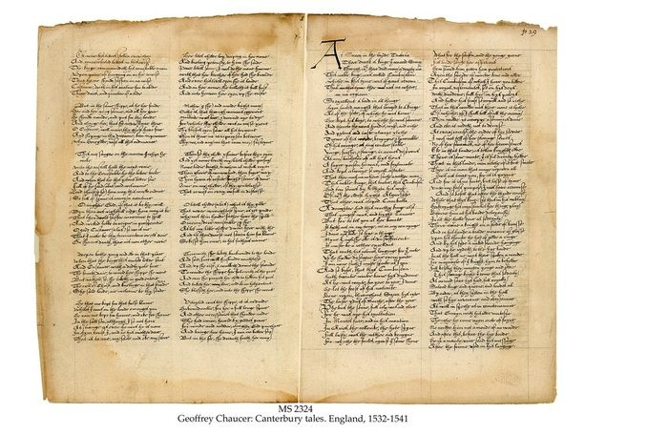
Options Modern English
Net:
British English
American English
Australian English
Canadian English
Hybrid:
Pidgin English
Beach-la-Mar
Kroo English

Slide 7
Countries closest to the classic English language
Australia
New Zealand
These countries due to geographical isolation unexposed strong influence of other languages ​​and cultures.

Slide 8
English is the native language in
Canada
Great Britain
USA
Australia
New Zealand

Slide 9
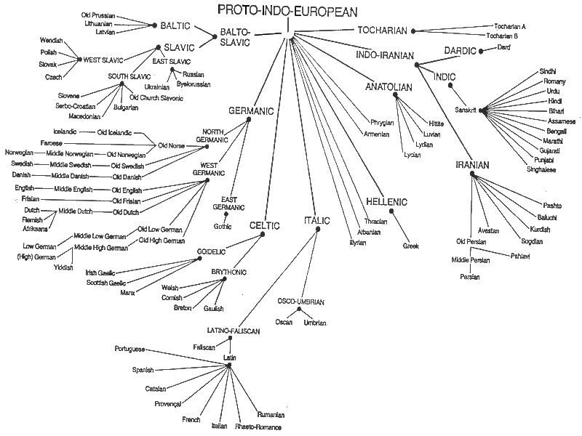

Slide 10
Borrowed words in the English language:
Anglo-Saxons
plaid
Butter - Масло
mother - мама
brother- брат
father- отец
man- человек
Celts
slogan
Castra (лагерь)
lancaster
Latin
manchester
streta
street
улицы
Vikings
vallum
wall
стена
call- вызов, cast - бросать, die- умирать, take- брать, ugly- безобразный, ill - больно, they- они, their - их
vinum
wine
вино

Slide 11
The percentage of loans
Originally the English word
Drawing

Slide 12
Borrowing from the Romans

Slide 13
Borrowing from the Romans

Slide 14
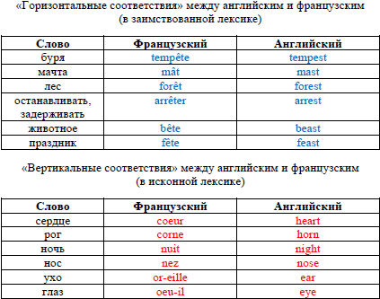
"Horizontal matching" between English and French (borrowings in vocabulary)
"Horizontal matching" between English and French (borrowings in vocabulary)

Slide 15
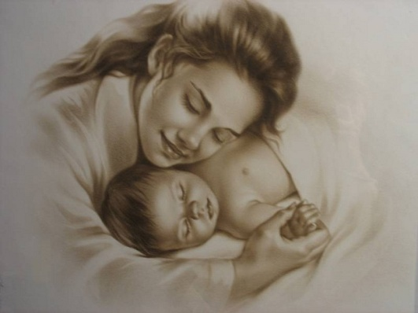
The word mother in different languages

