Slide 1
In Harmony with Myself.

Slide 2
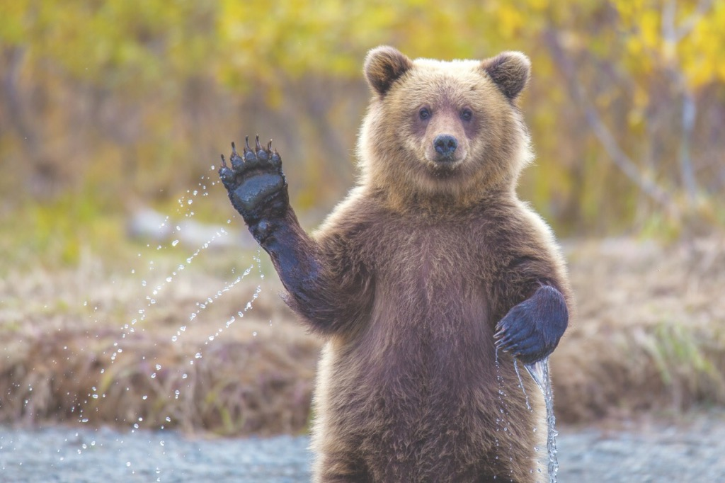
Introduction.
Hello. My name is Naumov Victor. I was born in 2001. I live in the village Koshki. Now I will tell you five important things about me.

Slide 3
Five important things about me.

Slide 4
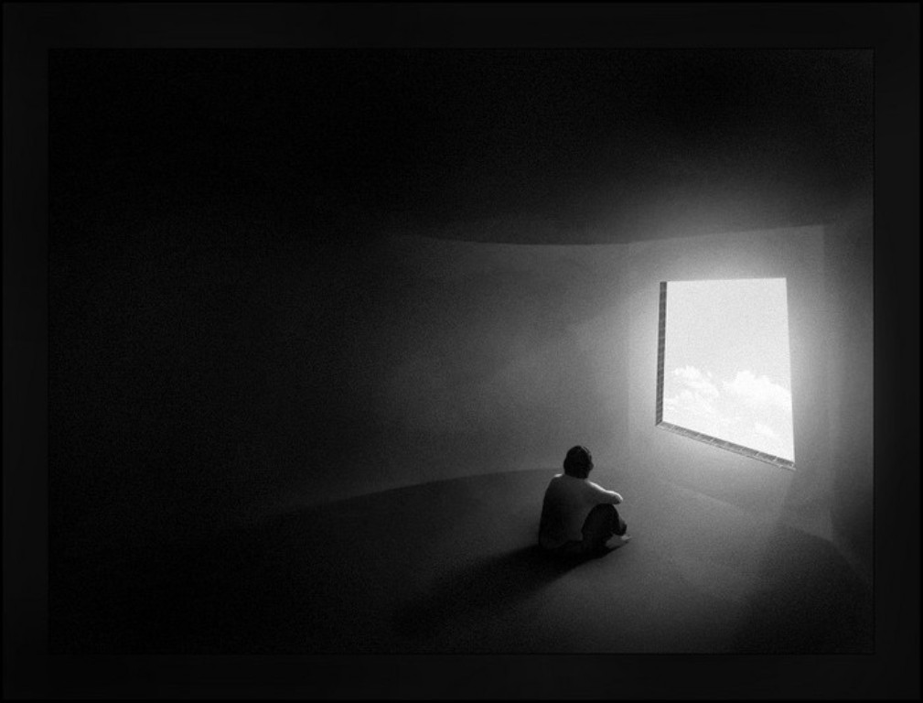
The first important thing about me.
I love solitude. It helps me to collect my thoughts and much rethinking. I feel insecure and uncomfortable when I am in bog companies.

Slide 5
The second important thing about me.
I try to lead a healthy lifestyle. Smoking,alcohol and drug use are destroying human health. And these bad habits require a lot of money.

Slide 6
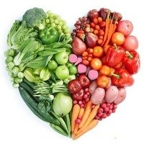
The third important thing about me
I am a vegetarian. I do not eat meat because I can not stand him. As well as eating vegetables and fruit is are good for the body.

Slide 7
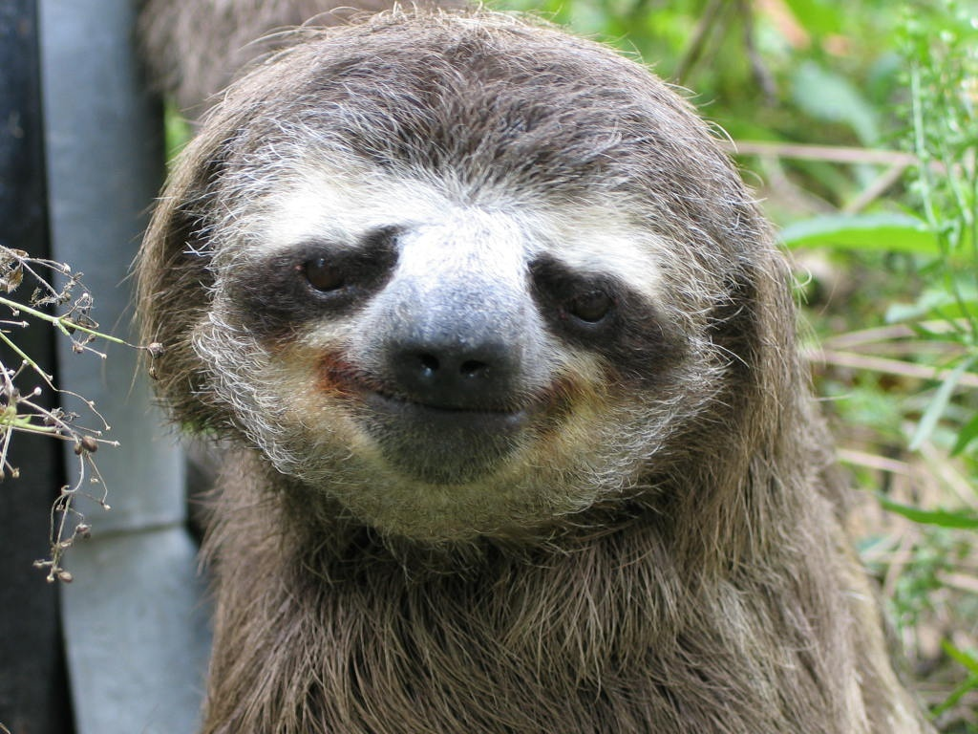
The four important thing about me.
I am very lazy. I like to sit still and do nothing. But I can beat her, when I need to do some work.

Slide 8
The fifth important thing about me.
I like to read books. They help to learn a lot of new and interesting things. As well as books enhance vocabulary and make it more competent.

Slide 9
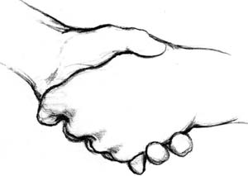
What I do to be my own best mate.
I should be wise,good-natured and sociable to be my own best friend.

Slide 10
Conclusion.
Harmony is very important in everyone's life. It makes people happy and helps to fully control their lives.

Slide 11
Thank you for attention.

