Slide 1
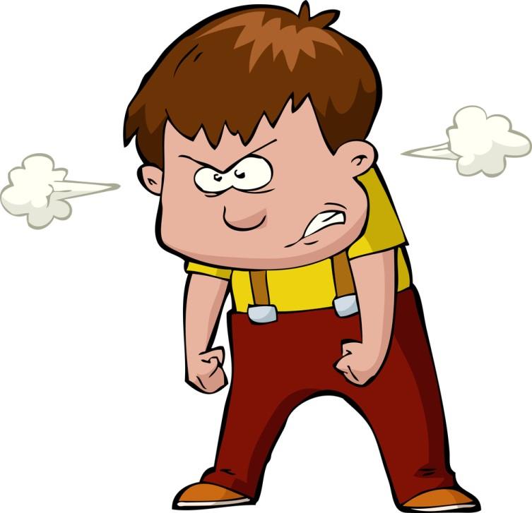
A
a

Slide 2
angry
ant
apple

Slide 3
apple
ant
angry

Slide 4
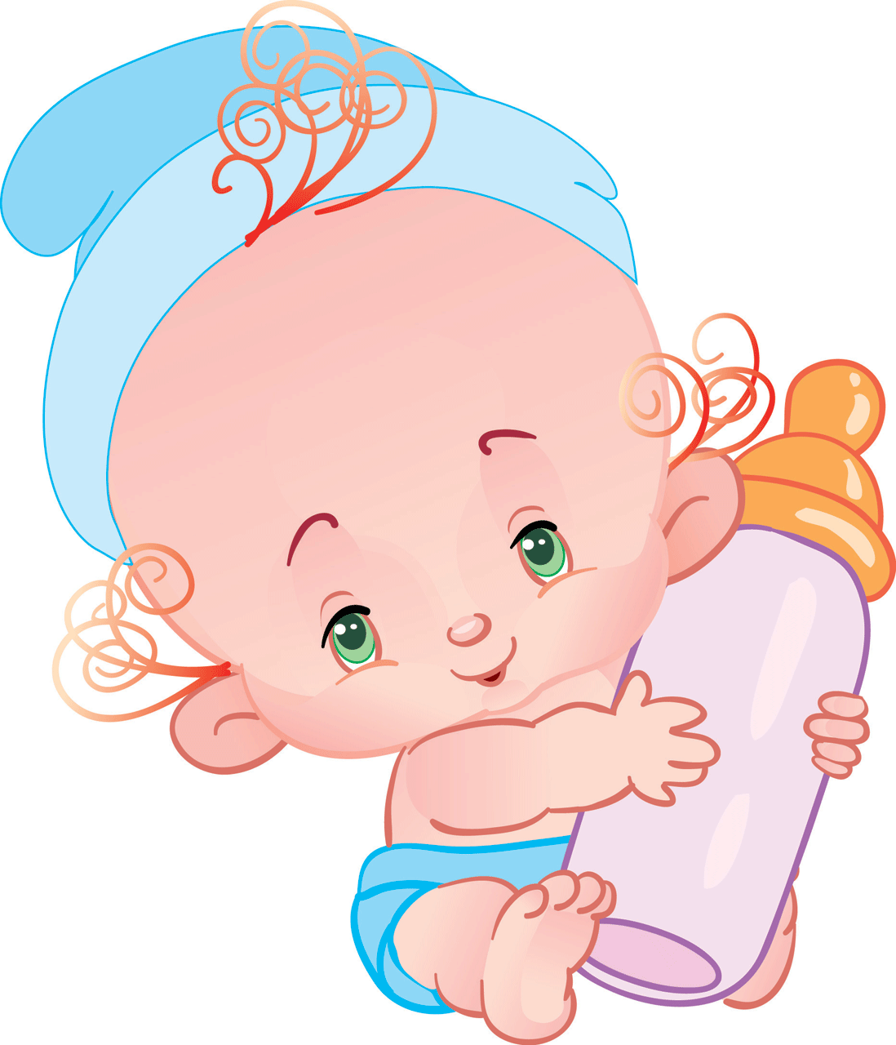
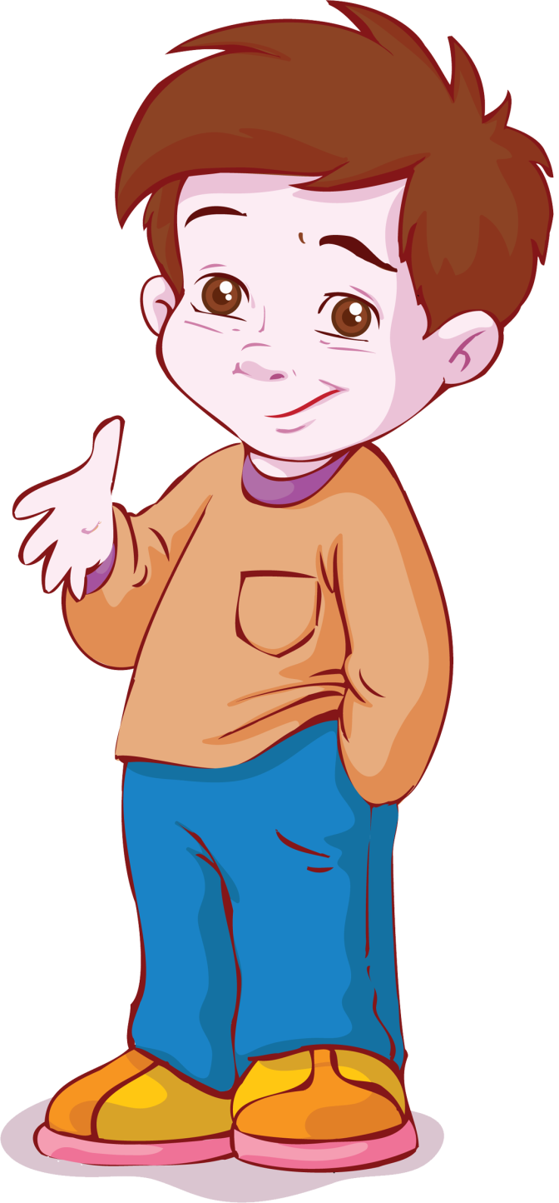
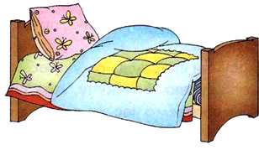
B
b

Slide 5
boy
baby
bed

Slide 6
boy
baby
bed

Slide 8
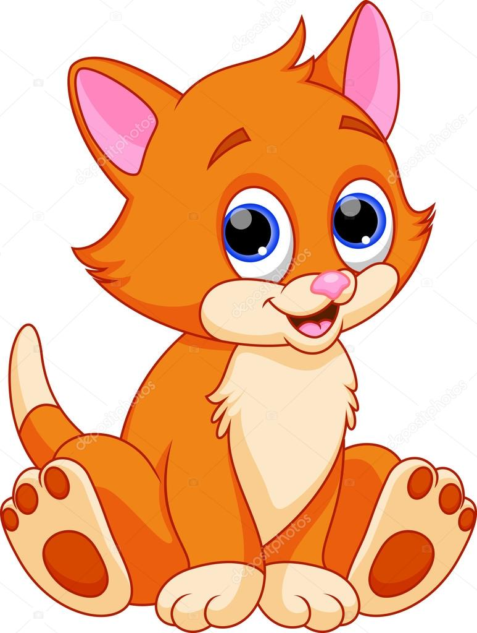
C
c

Slide 9
car
cat
cake

Slide 10
cat
cake
car

Slide 11
act
keca
cra

Slide 12
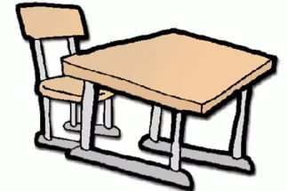
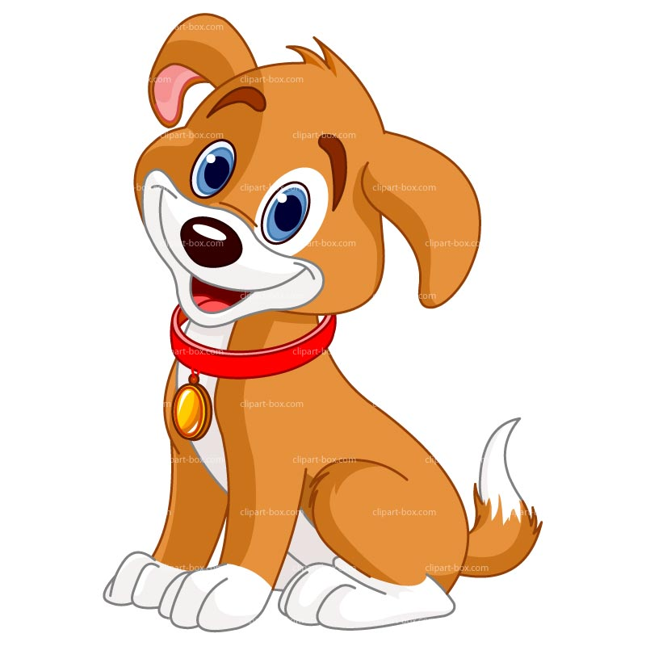
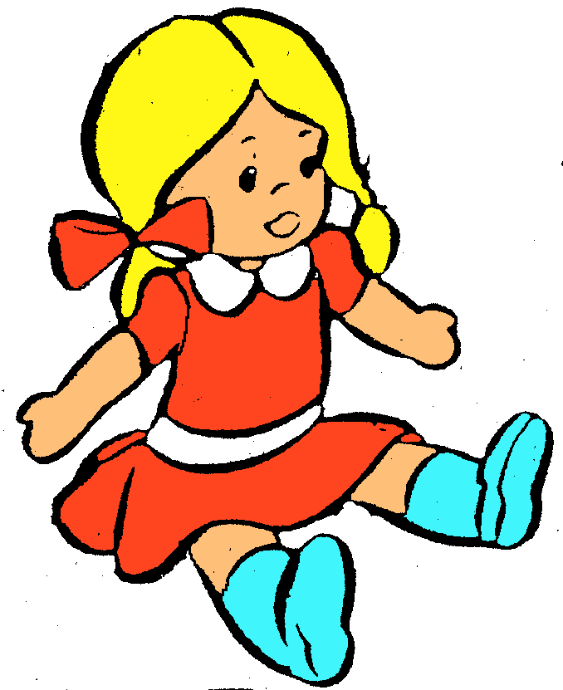
D
d

Slide 13
desk
doll
dog

Slide 14
doll
dog
desk

Slide 15
ldlo
ogd
o
esdk

Slide 16
aaadollccccc
babacatobaba
ookkcarkko
cccdeskoooo
ocoocakeccco
cacadoglll

Slide 18
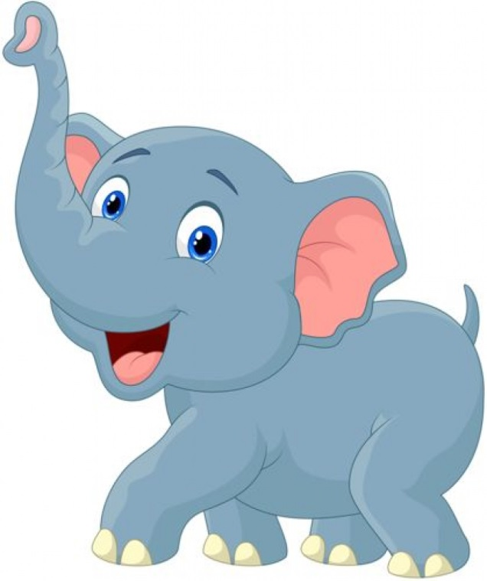
E
e

Slide 19
eagle
elephant
egg

Slide 20
eagle
egg
elephant

Slide 21
aeleg
geg
leeapnht

Slide 22
F
f

Slide 23
frog
flag
fox

Slide 24
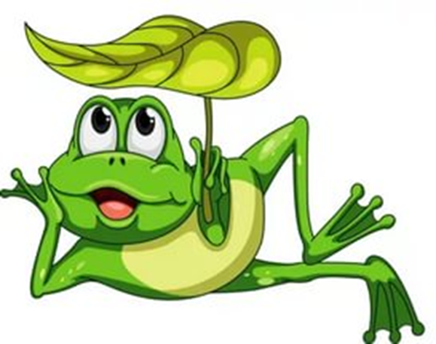
fox
flag
frog

Slide 25
ofx
lfga
rfog

Slide 26
gfgfgfoxhdhd
gagageagle
aaaddfrogdd
aacccaelephant
fdfdeggdada
bdbdbdflag

Slide 27
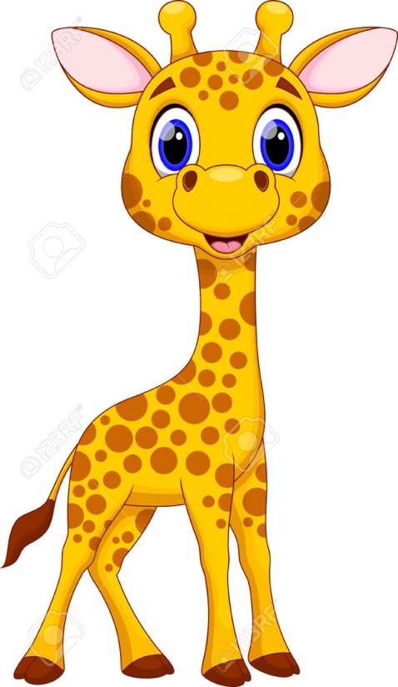
G
g

Slide 28
girl
glass
giraffe

Slide 29
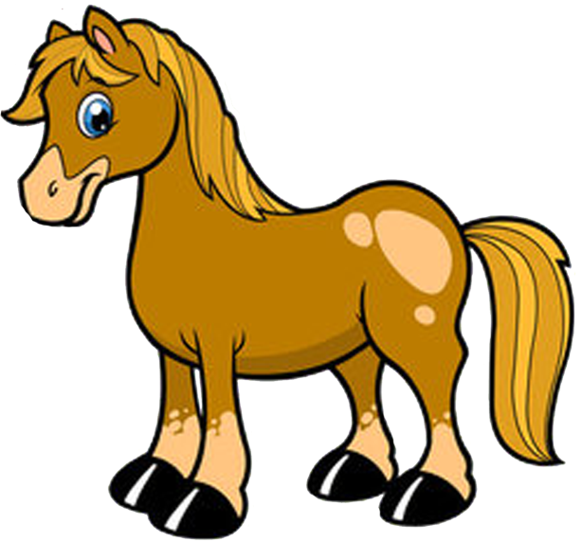
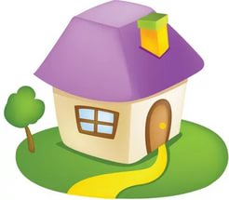
H
h

Slide 30
horse
hat
house

Slide 31
Ii
ink

Slide 32
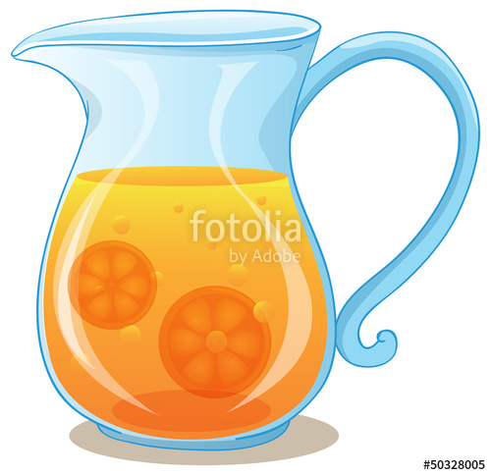
jug
J
j

Slide 33
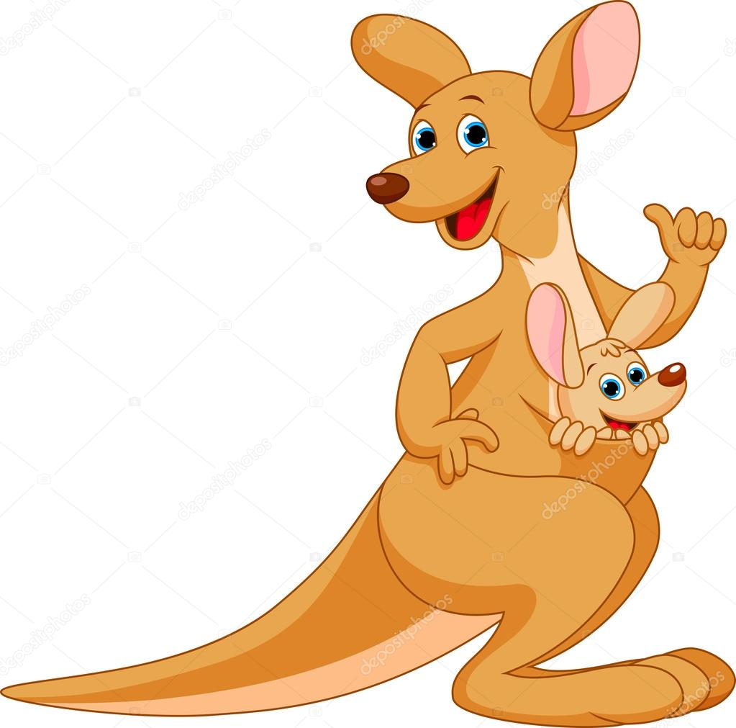
K k
kangaroo

Slide 35
L l
lamp

Slide 36
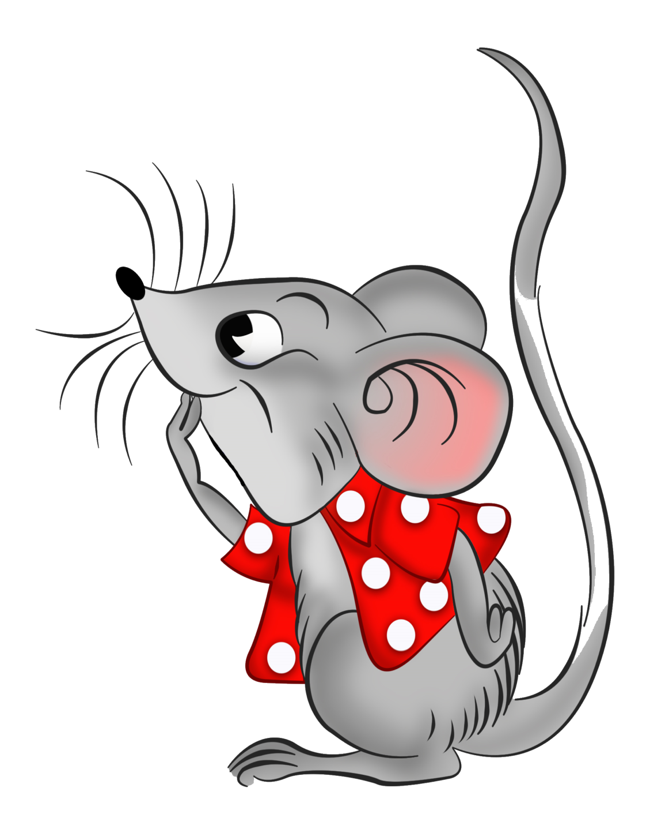
mouse
M
m

Slide 37
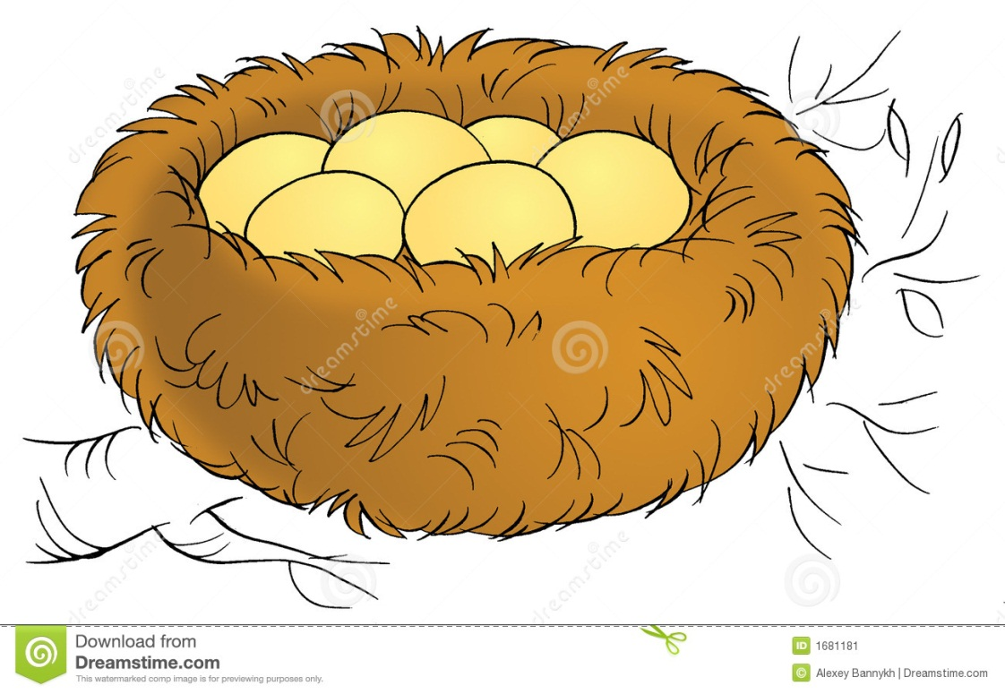
nest
Nn

Slide 38
O o
orange

Slide 39
Pp
pin

Slide 40
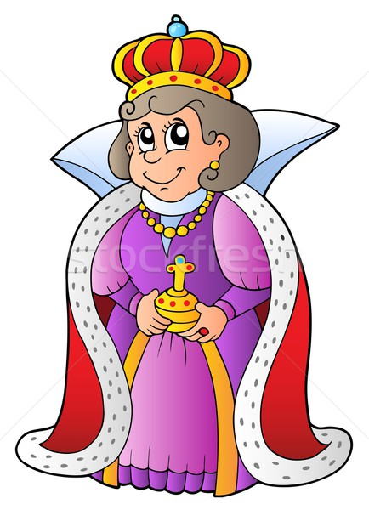
queen
Qq

Slide 41
dvfjugbfbf
vdxfdskangaroo
nbjgkpinvbcbgf
mohmohbhjink
hohohqueenkfkfkf
lampcdvxdbfx
dvxdvxmouse

Slide 42
a | n | t | d | o
p | b | a | s | g
p | e | c | d | a
l | d | c | f | l
e | s | r | o | h

Slide 43
a | n | t | d | o
p | b | a | s | g
p | e | c | d | a
l | d | c | f | l
e | s | r | o | h

Slide 44
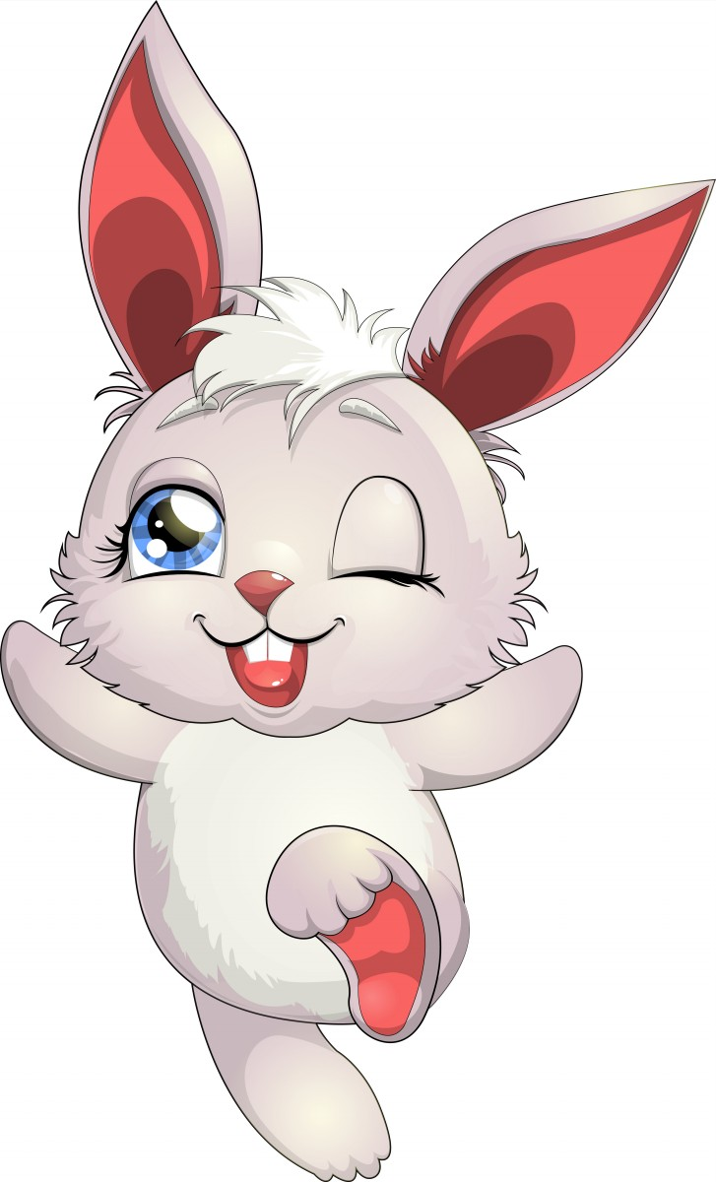
rabbit
Rr

Slide 45
snake
Ss

Slide 46
tree
Tt

Slide 47
umbrella
Uu

Slide 48
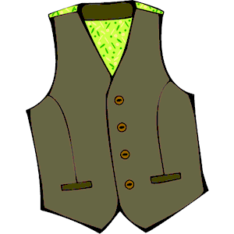
vest
Vv

Slide 49
Ww
window

Slide 50
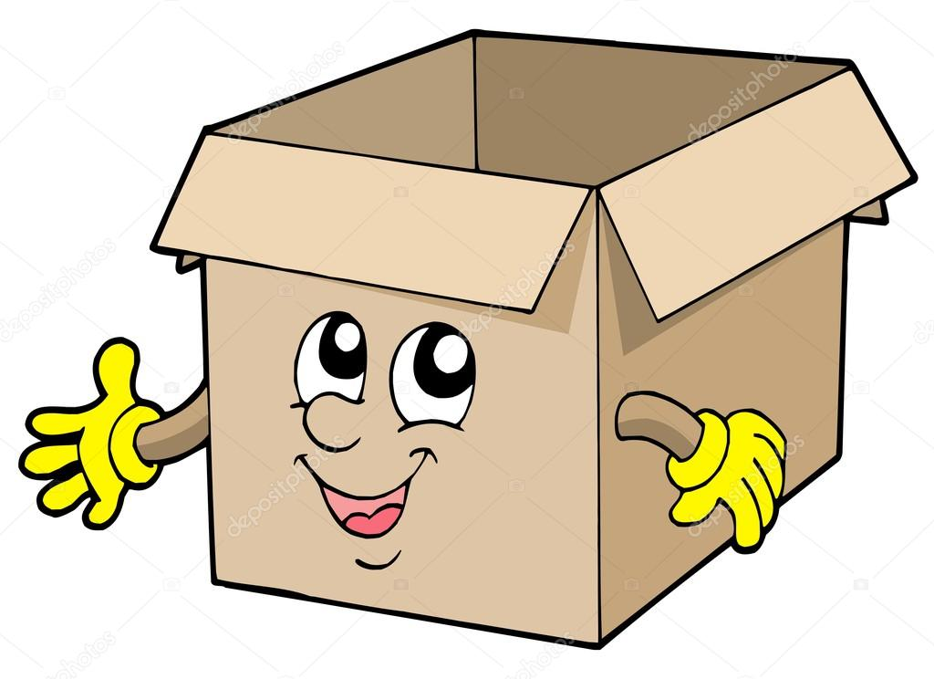
box
Xx

Slide 51
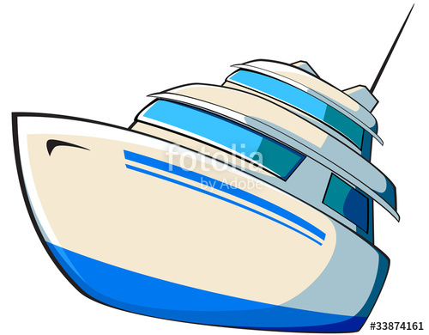
yacht
Yy

Slide 52
zip
Zz

