Slide 1
Dividing into two groups
Healthy and
unhealthy eating, Healthy and
unhealthy habits
1
2

Slide 2
the proverbs:
A. keeps a doctor away above wealth you eat but not live to eat
1. Health is…….
2. You are what. .
3. Eat to live……
4. An apple a day…. .

Slide 3
You are what you eat.
Health is above wealth.
Eat to live but not live to eat.
An apple a day keeps a doctor away.

Slide 4
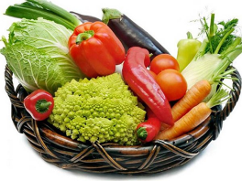
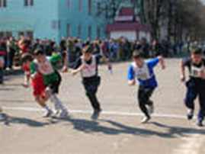
The 5 th of April
Healthy lifestyle

Slide 5
Task 1 Association
Health
Travelling
Nature
Music
Healthy eating
Sport
Clean water
Fruits Vegetables

Slide 6
obesity [әu`bi:siti] семіздік Task 2
dairy produce [`dзәri `prodju:s] сүтті тағам
skip breakfast [skip `brekfәst] таңғы асты ішпеу
eating between meals [i:tiη bi`twi:n mi:ls] негізгі ас арасында жеу
carbohydrate [`ka:bәu`haidreit] көмірқышқыл
Calcium [‘kælsiәm] кальций
healthy habit [`helθi `hǽbit] пайдалы әдет
eat healthy food [`i:t `helθi fu:d] пайдалы тамақ жеу
eat less of everything[`i:t les of `evriθiη] әр нәрсені аз жеу
fibre [faibә] талшық
to be rich in [tә `bi: `ritʃ in] б\н-ге бай
keep fit [`ki:p fit] қалыпын сақтау
cut down on fat [kʌt daun on fǽt] майлы тағам жемеу

Slide 7
1. I exercise 3 times a week.
2. I eat at McDonald's every night.
3. I eat fruit and vegetables every day.
4. I wash my hands before breakfast.
5. I watch TV 7 hours a day.
6. I listen to very loud music.
7. I go on walks regularly.
8. I drink 5 cups of coffee a day.
9. I take vitamins every day.
10. I take a shower in the morning.
11. I sit in the sun without a suntan lotion.
12. I eat food when I watch TV.
13. I drink coke with every meal.
14. I visit a doctor regularly.
15. I eat fish for dinner.

Slide 8
“Seven Deadly Health Sins“ Task 3
When the Bible set down the Seven Deadly Sins they were not meant to be taken literally. Few of us will die of pride (менменшілдік), envy (қызғаншақтық) or anger (ашу) There are, however, modern health sins which are in fact far more deadly.
Two of them – obesity* and physical inactivity* are known from ancient times. There are the modern bad habits as smoking*, drinking* too much alcohol, and the surprising ‘danger’ of sleeping too much or too little*, eating between meals* and skipping breakfast*.
Of course sleeping too much or too little, snacking and skipping breakfast are not quite as deadly as smoking, obesity and drinking. But they are indicative of dangerously chaotic lifestyles.
Regularity in life promotes your health. Sleeping seven or eight hours, getting up early, eating breakfast, a healthy diet and regular meals is really a good way to live.

Slide 9
Now make questions and
“Face to face”
Ask and answer the questions
Task 4

Slide 10
Adverbs -үстеу-наречие little –less, few-fewer (аз - азырақ) many, much – more (көп-көбірек) For example: 1.Watch less TV and do more exercises 2. Sleeping less or more is unhealthy
II. Write down. Some tips about healthy eating.
Eat _____sugar and _____fruit and vegetables.
Don’t eat ____salt.
Try to eat ____fibre, it is low fat.
Eat _____ high fat food and ____ fibre.

Slide 11
I. Complete the sentences:
1. The modern bad habits are …
2. … is really a good way to live.
3. Doctors always advice us to eat …
4. … makes people healthy and keeps them fit.
5. … dangerous for our health.
6. A healthy way of life includes …
Healthy diet, physical inactivity, obesity, sport, drinking alcohol, taking drugs, healthy eating, personal hygiene.

Slide 12
I. Answers:
1. The modern bad habits are … obesity, drinking alcohol, taking drugs
2. Healthy eating … is really a good way to live.
3. Doctors always advice us to eat … healthy eating
4. Healthy diet … makes people healthy and keeps them fit.
5. Physical inactivity … dangerous for our health.
6. A healthy way of life includes … personal hygiene

Slide 13
Smoking, getting up early, drinking, cleaning teeth, doing exercises, walking outside, cutting nails, obesity, inactivity, playing computer games
Two groups
Make a poster
Healthy and unhealthy eating
Unhealthy and
healthy habits
Hamburger, cheese, milk, fast food, fruits, vegetables, meat, apples, bananas, jam, cola, water, juice, alcohol

Slide 14
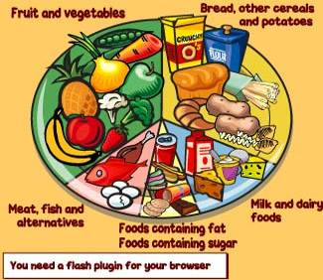
Healthy
Unhealthy

Slide 16
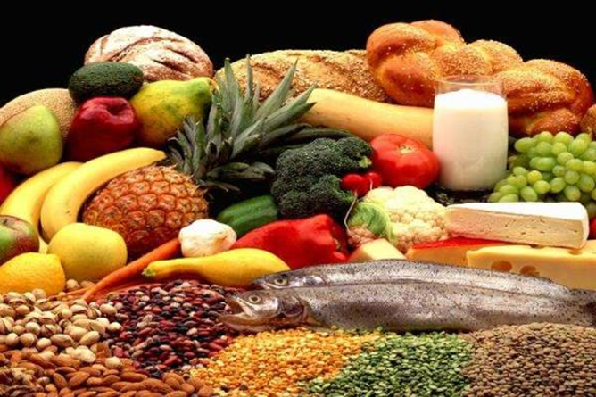

Slide 17
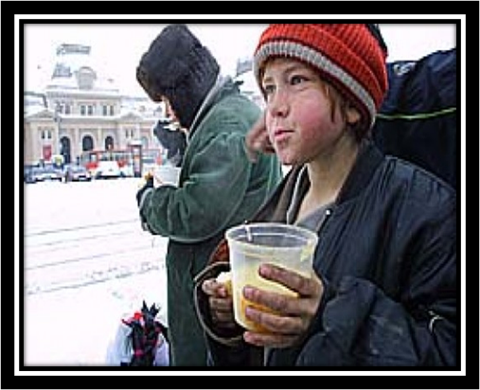
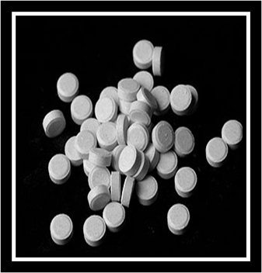
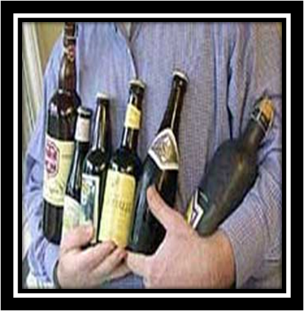

Slide 18
Too little food makes you thin.
Too much food makes you fat.
The wrong food makes you ill.
The right food makes you well.
Too many sweets are bad for you especially for your teeth.

Slide 19
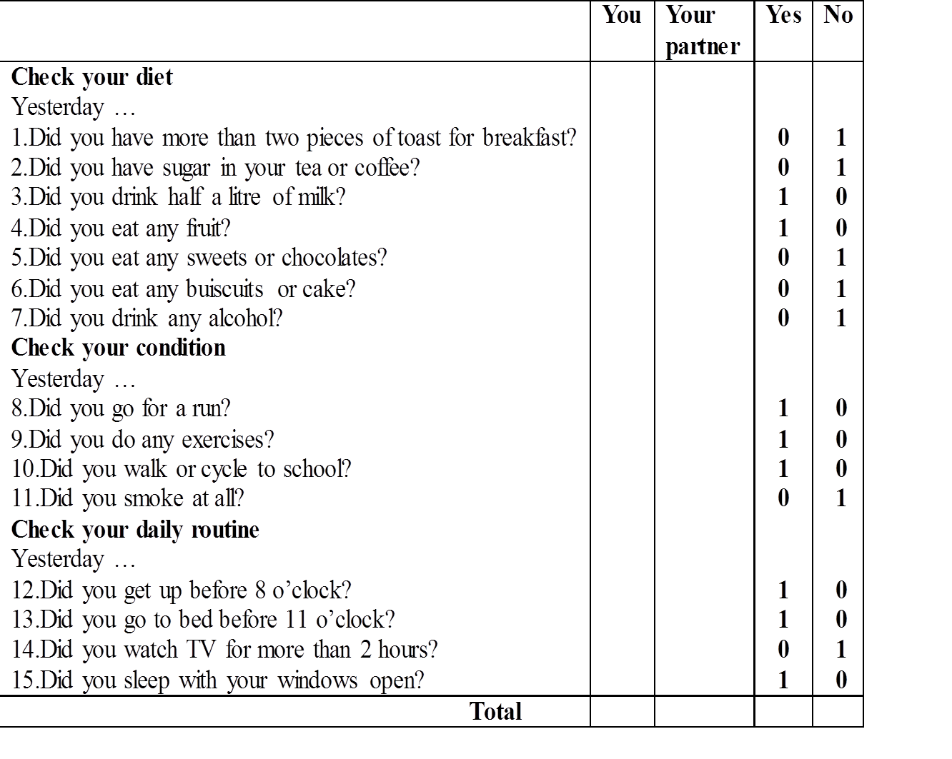

Slide 20
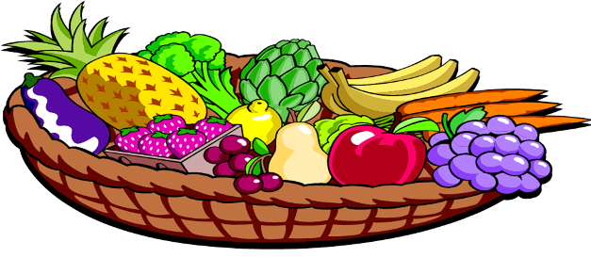

Slide 21
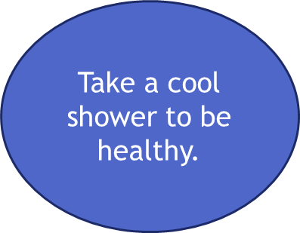
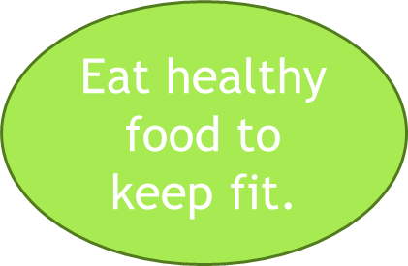
Don't smoke.
Don’t take alcohol, drugs
Don’t eat many sweets
How to
be
healthy?
Sleep 8 hours
Avoid fast food.

Slide 22
Ex.8-10 р 101-102 Give advice to the football player. Make affirmative and negative imperatives
Home work

Slide 23
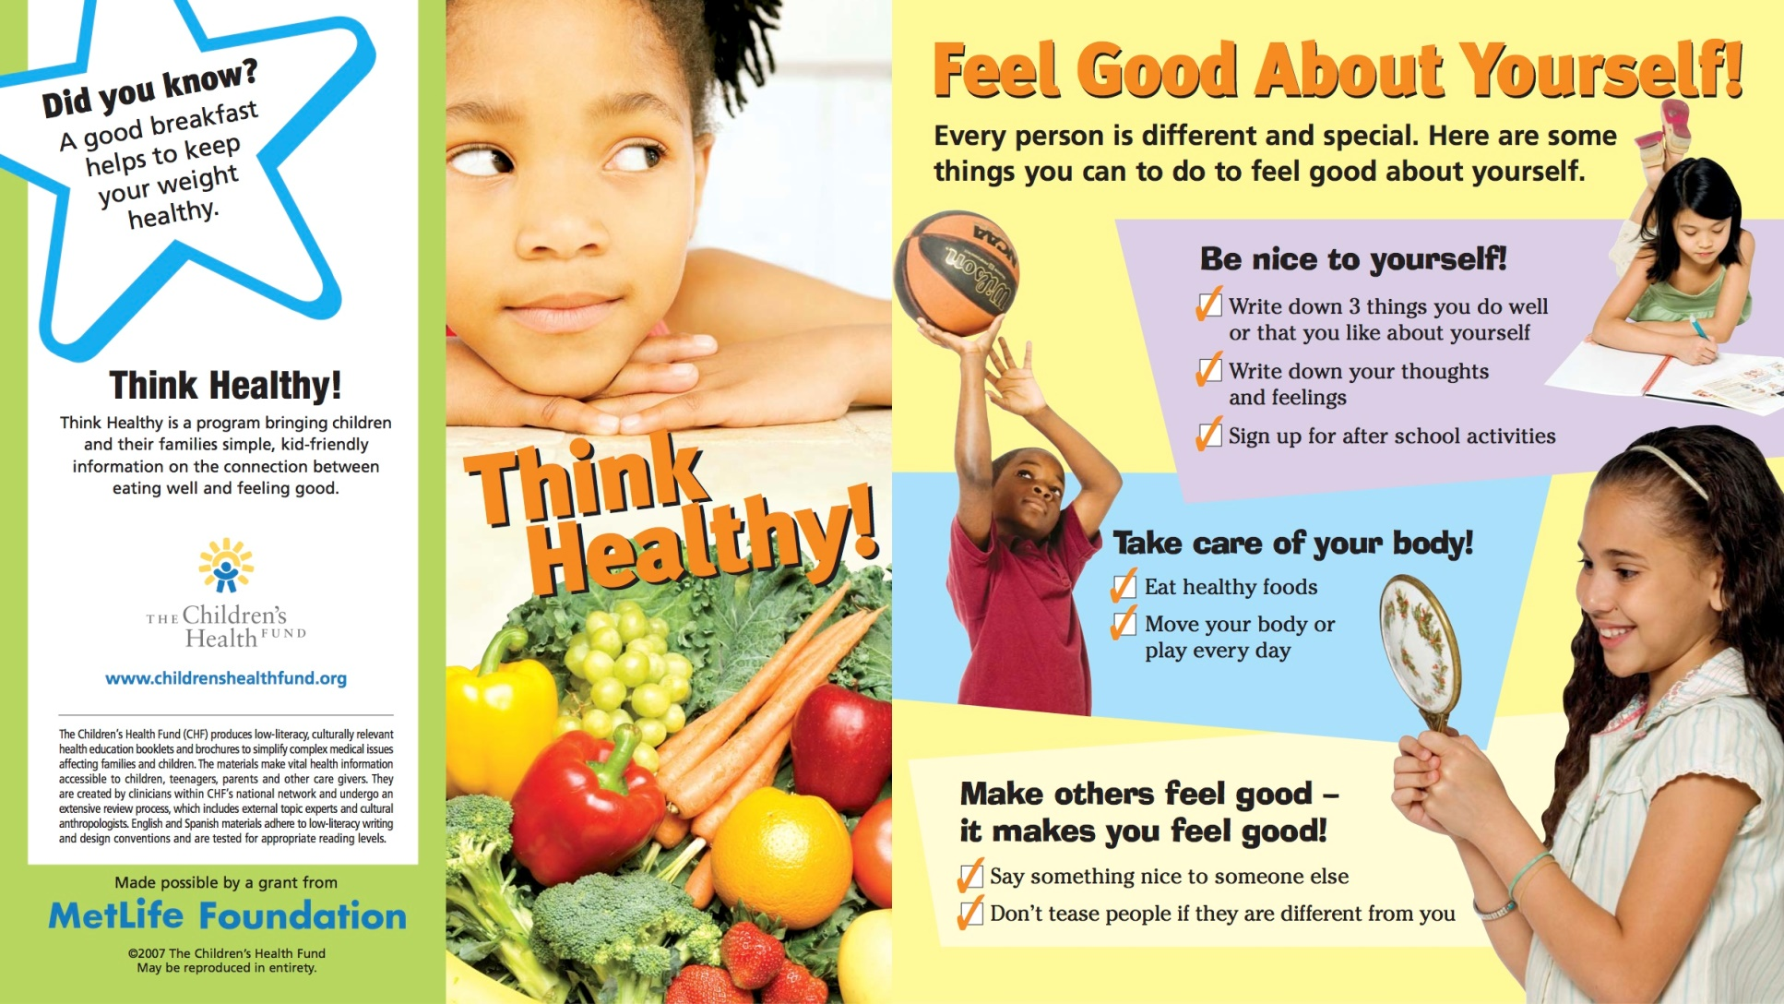
Reflection

