Slide 1
Hello!

Slide 2
1. If Peter comes to my place, we’ll go to play in the yard.
2. If Peter doesn’t come to my place, I will watch TV
3. If Frank’s parents have their holidays in summer, they’ll go to the seaside.
4. If they have their holidays in winter, they’ll stay at home.
5. If the fog thickens, Harold will put up the tent for the night.
6. When I finish my work, I’ll go to the cinema.
7. we’ll buy this book as soon as our mother gives us some money.
8. When we come to your place you’ll show us your present.
9. I’ll return you your ring when you ask me.
10. I’ll wait for my friend until he comes from the shop.

Slide 3
First Conditional
If-clause
Main clause
Present Simple
Future Simple
Possible situations in the future and their consequences

Slide 4
Imagine that it’s summer.
If it is summer, where will you go?

Slide 5
The world is the book.
And those who do not travel read only one page.

Slide 6
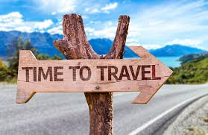
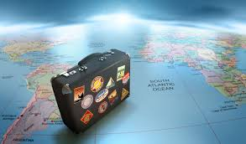
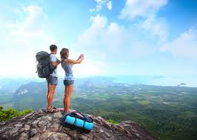
TRAVELLING

Slide 7
PLAN OF TRAVELLING
PLACE
TRANSPORT
ACTIVITIES
CLOTHES AND
OTHER STAFF

Slide 8
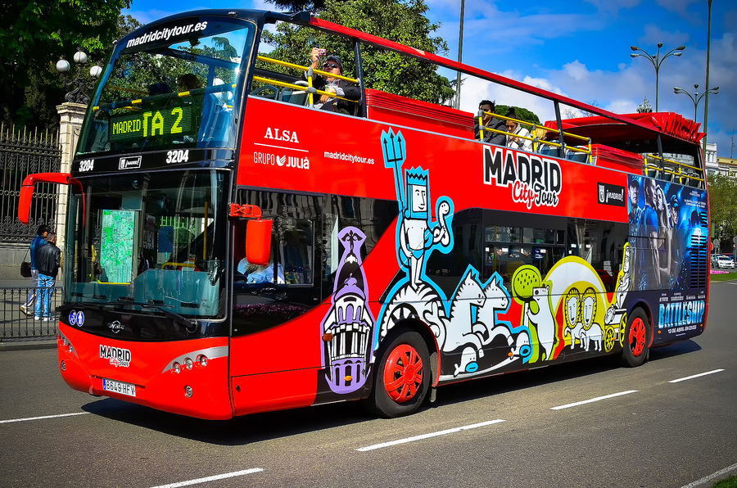
COACH

Slide 9
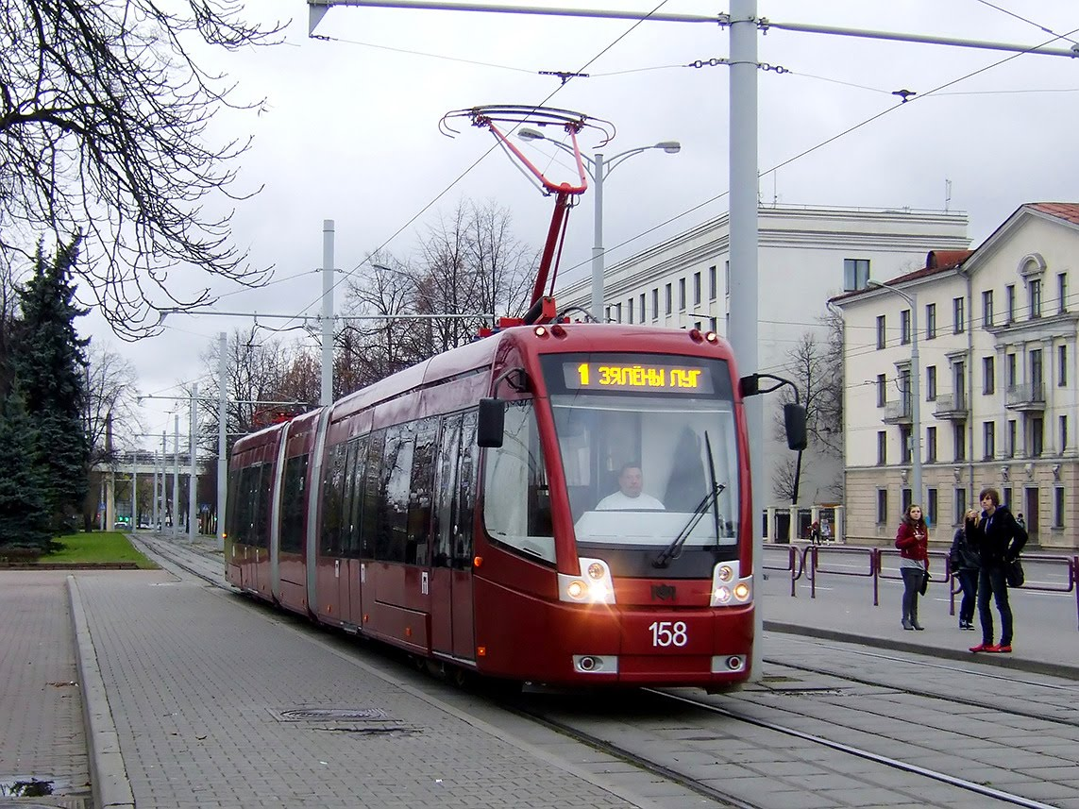
TRAM

Slide 10
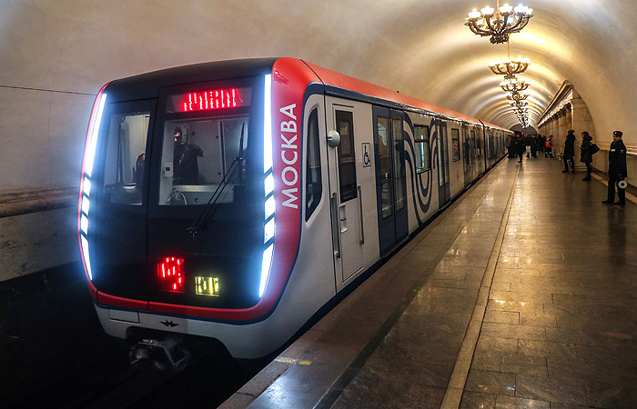
THE UNDERGROUND

Slide 11
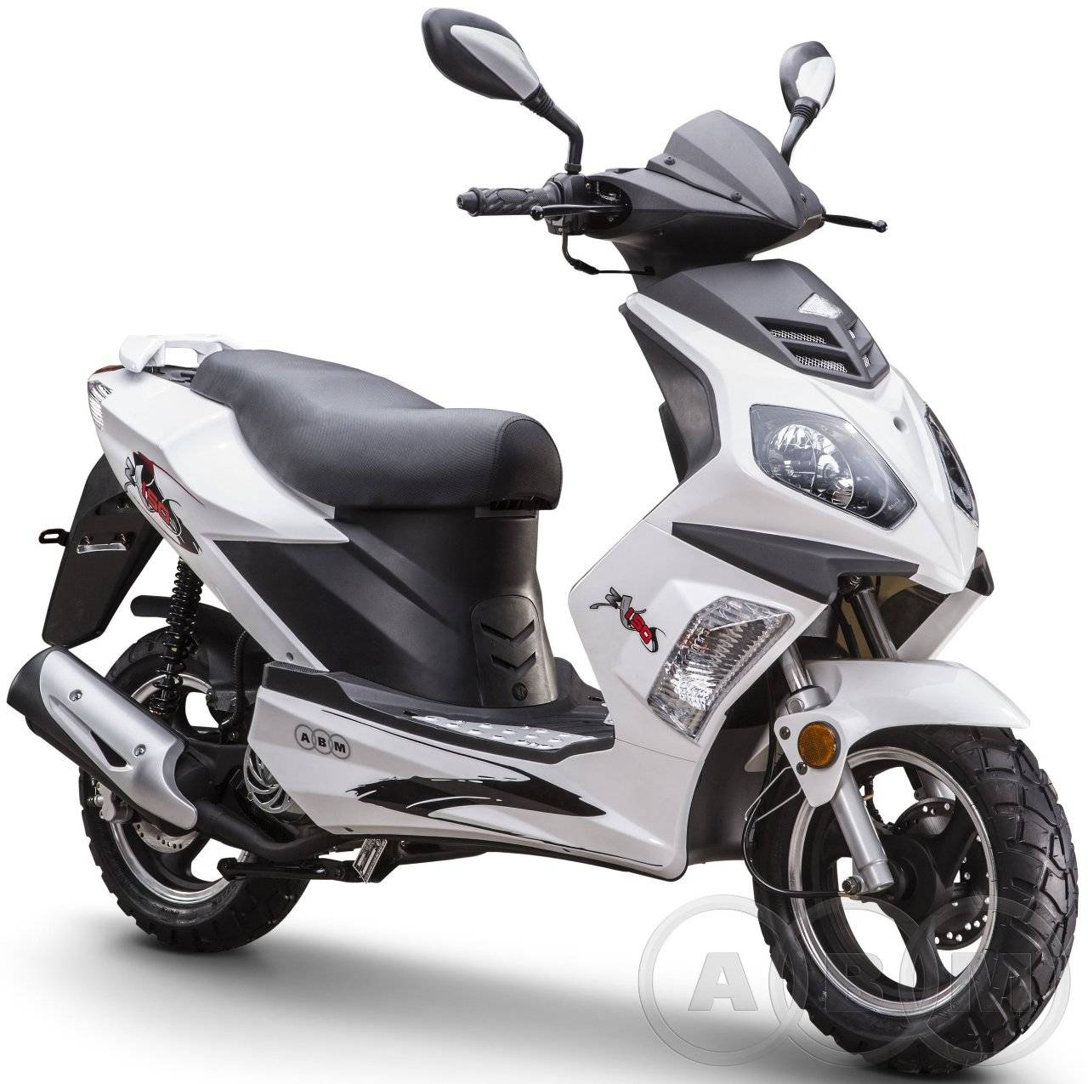
MOPED

Slide 12
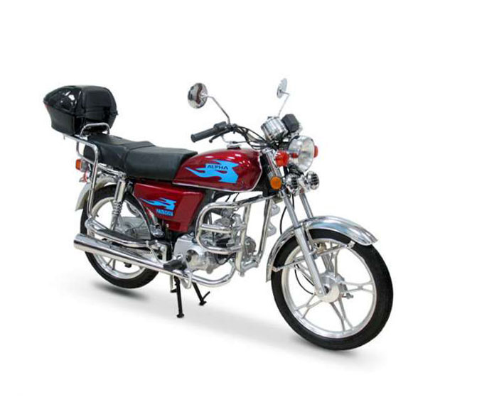
MOTORBIKE

Slide 13
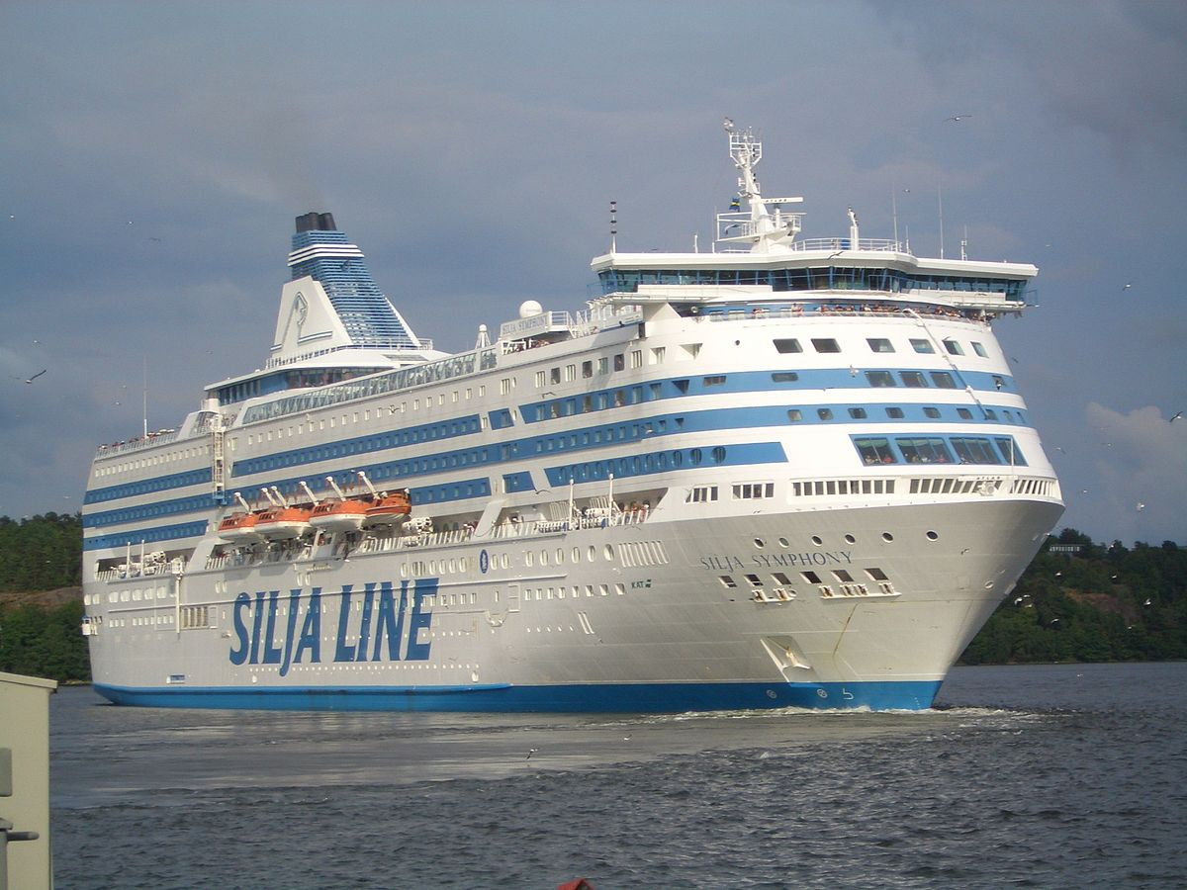
FERRY

Slide 14
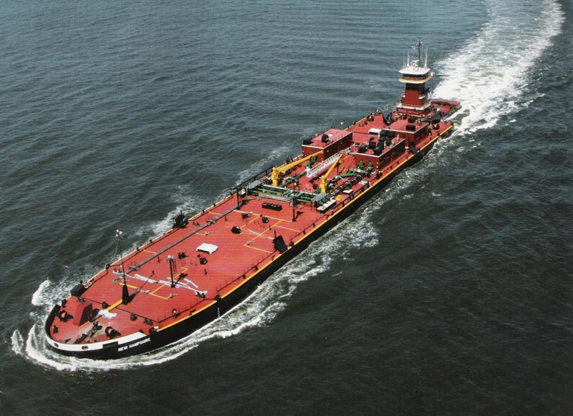
BARGE

Slide 15
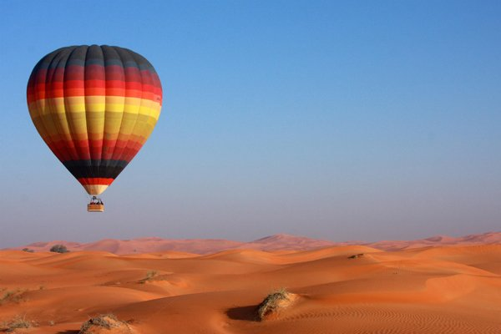
HOT-AIR BALOON

Slide 16
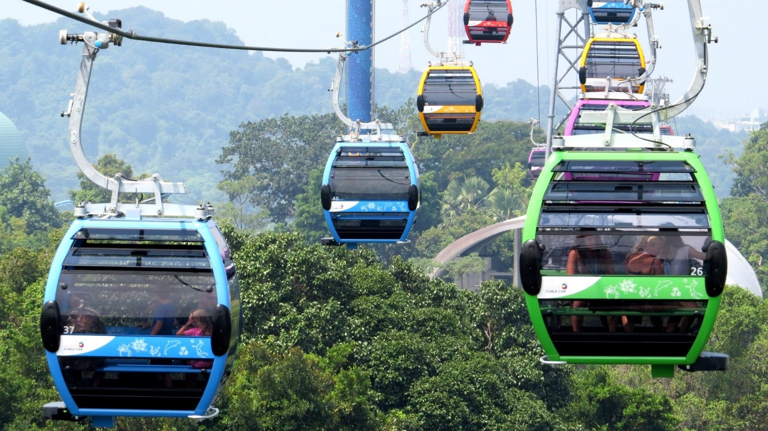
CABLE CAR

Slide 17
ON FOOT

Slide 18
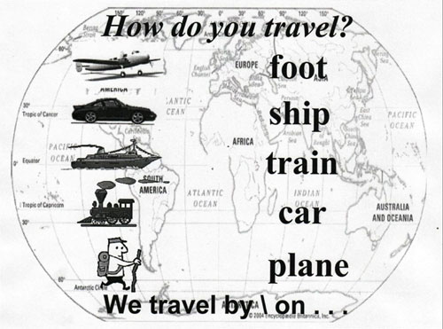
We travel by plane, but on foot

Slide 19
If I go to London, I will…

Slide 20
Checklist

