Slide 1
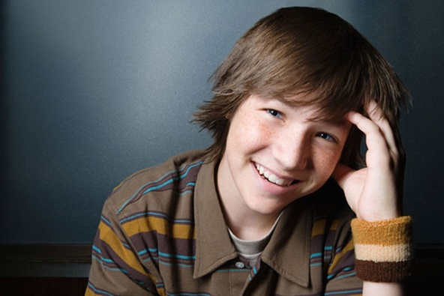
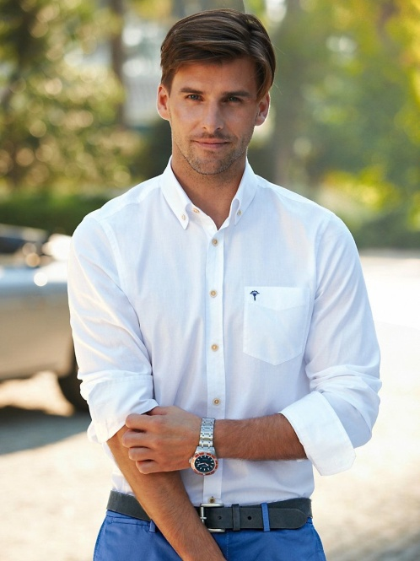
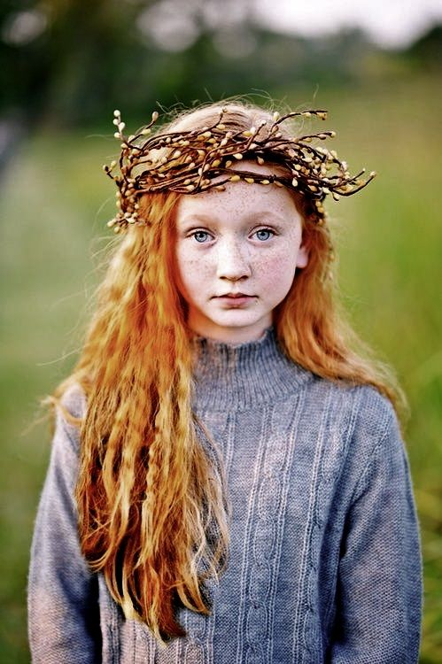
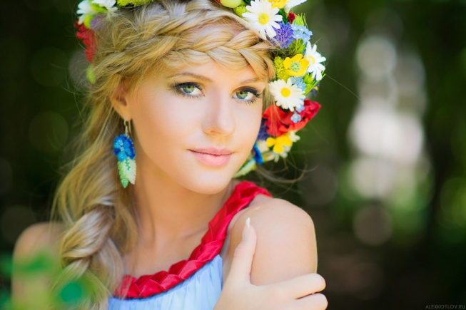
Describing appearance
Описание внешности

Slide 2
Age – возраст
Height – рост
Build – комплекция
Hair – волосы
Face – лицо
Eyes – глаза
Other - другое

Slide 3
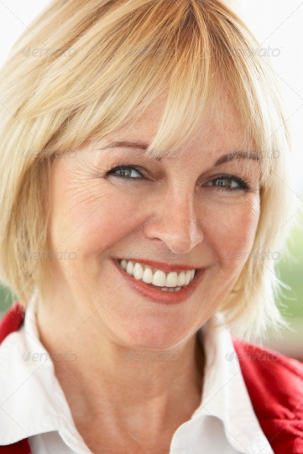
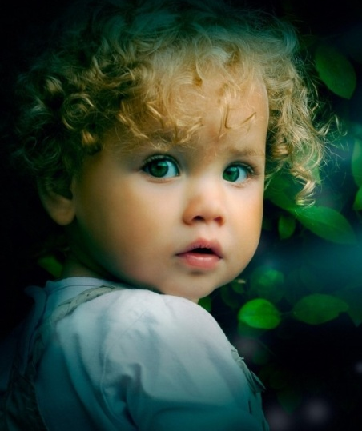
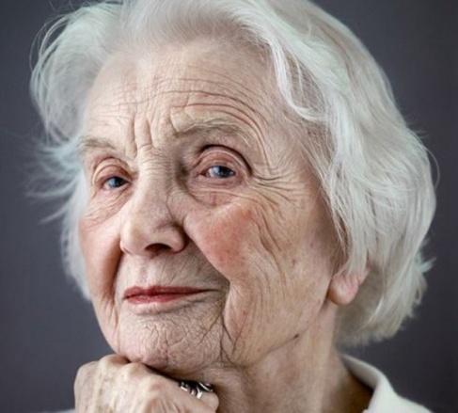
Age - возраст
Young - молодой
Middle-aged – средних лет
Elderly - взрослый
Old - старый
A child - ребенок
A teenager - подросток
In his \ her 20s\30s – двадцати \ тридцати лет

Slide 4
Описание внешности
It is a middle-aged woman.
It is an old man.
It is a young girl.
It is a young boy.
It is a teenager.
It is a child.

Slide 5
Height - рост
165 cm tall
of average \ medium height – среднего роста
tall – высокий
very tall – очень высокий
short - низкий
very short – очень низкий
He \ She is tall.

Slide 6
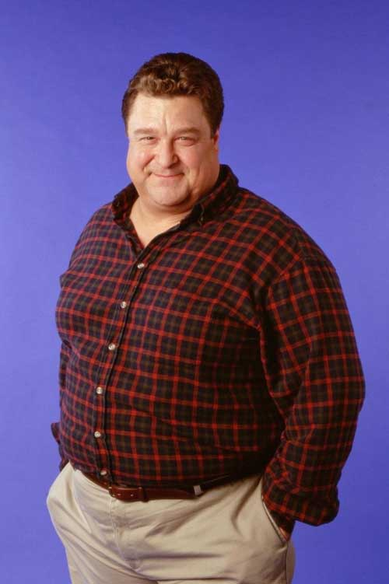
Build – комплекция
fat – толстый
overweight – с лишним весом
a bit overweight – с небольшим лишним весом
plump – полный
thin - тощий
slim - стройный
athletic – атлетического телосложения
well-built – хорошо сложенный
He is plump.
She is slim.

Slide 7
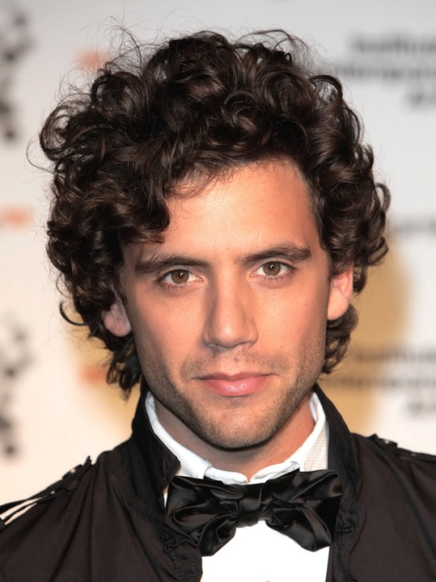
Hair – волосы
straight hair - прямые
wavy hair - волнистые
curly hair – кудрявые
She has long blond wavy hair.
He has short dark curly hair.
short hair - короткие
long hair - длинные
black hair - черные
dark hair - темные
blond hair - блондин
fair hair - светлые
grey hair - седые
red hair - рыжие

Slide 8
Face – лицо
a round face – круглое лицо
a long face – вытянутое лицо
a square face – квадратное лицо
an oval face – овальное лицо
She has an oval face.
He has a square face.

Slide 9
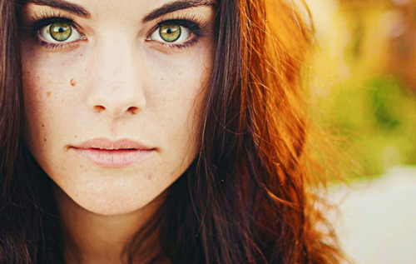
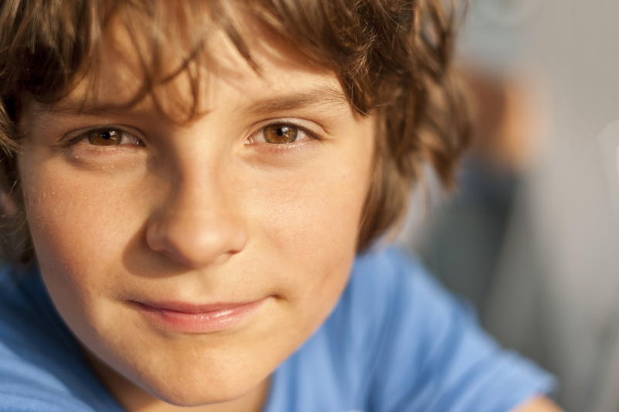
Eyes – глаза
big - большие
small - маленькие
blue – голубые, синие
green - зеленые
grey - серые
brown \ hazel - карие
dark – темные
She has big green eyes. He has small hazel eyes.

Slide 10
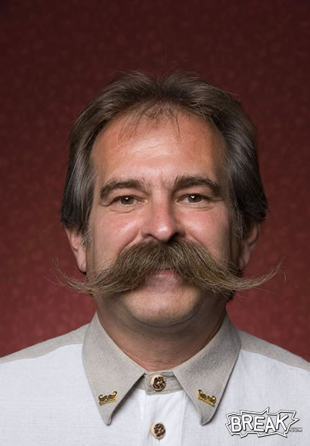
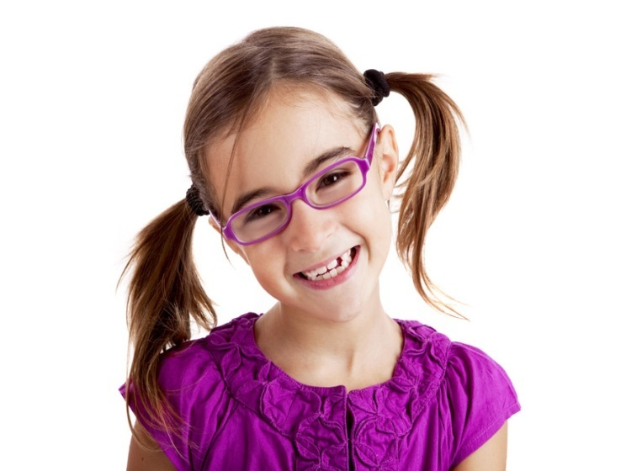
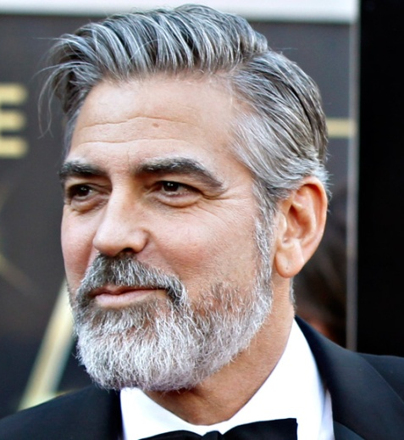
Other - другое
moustache - усы
beard - борода
glasses – очки
He has (wears) moustache.
He has (wears) short beard.
She has (wears) glasses.

Slide 11
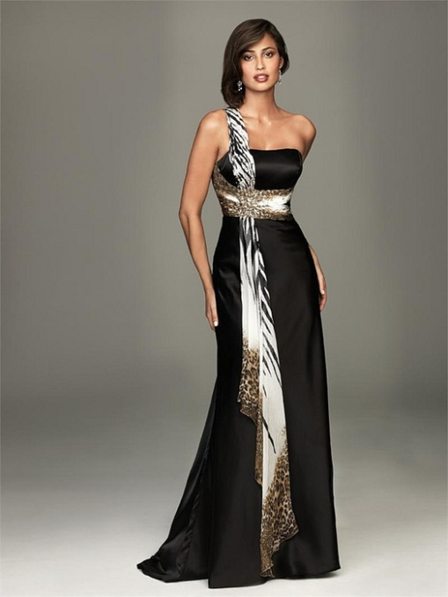
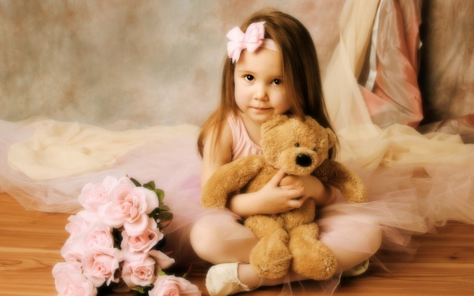
Opinion - мнение
pretty - милая
beautiful - красивая
handsome - красивый
pleasant - приятный
unpleasant - неприятный
fantastic фантастический
I think, he is a handsome man.
I think, she is a fantastic woman.
I think, she is a pretty girl.

Slide 12
Describing appearance
Check yourself

Slide 13
1, Соедини словосочетание с переводом.
long grey hair
a slim build
a middle-aged woman
a square face
big hazel eyes
short curly hair
a plump man
a) большие карие глаза
b) женщина средних лет
c) короткие кудрявые волосы
d) стройное телосложение
e) длинные седые волосы
f) полный мужчина
g) квадратное лицо

Slide 14
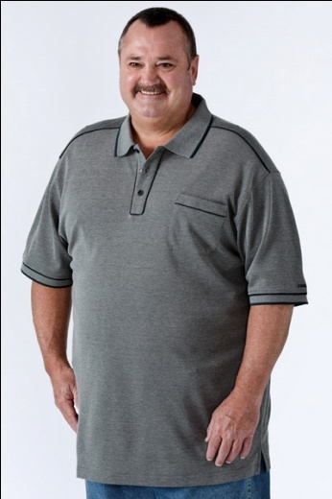
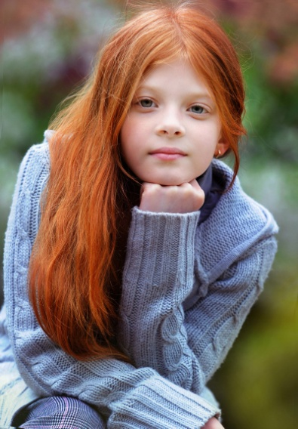
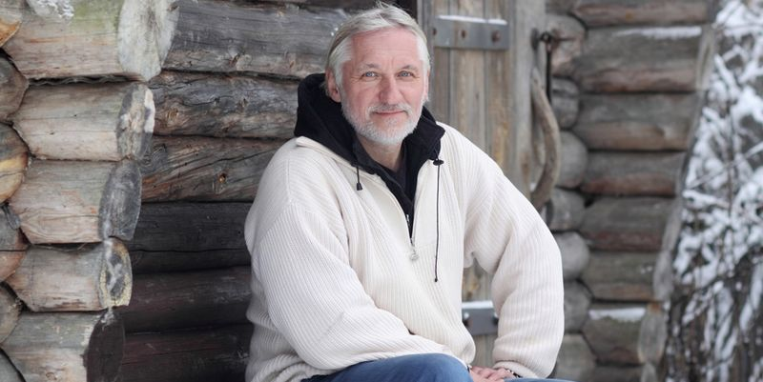
Выбери подходящее прилагательное
She is slim \ plump.
He is fat \ well-build.
She has big \ small green eyes.
He has short black straight \ curly hair
She has red \ dark hair.
He is young \ old man.

Slide 15
Расставь прилагательные в правильном порядке.
She has (wavy\ dark \ fantastic) hair.
He has (blond \ curly \ short) hair.
She has (big \ green \ beautiful) eyes.
He has (dark \ small \fantastic) eyes.
She has (straight \ long \ red) hair.

Slide 16
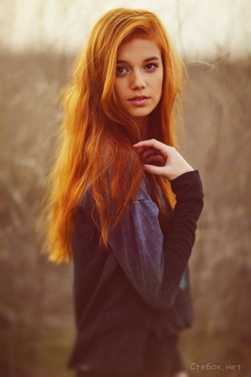
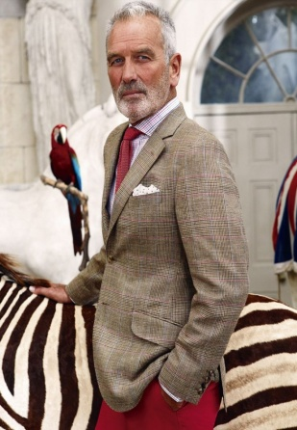
Д/З - Соедините портрет с описанием
1.
2.
She is a young woman. She is slim. She has dark wavy hair. She has hazel eyes. I think, she is a fantastic woman.
He is a middle-aged man. He is plump. He has short hair. He has small eyes. I think, he is pleasant man.
He is an old man. He is well-build and tall. He has short grey hair. He wears a short grey beard. I think, he is handsome.
She is a young girl. She is tall and slim. She has bright long red hair and beautiful hazel eyes. I think, she is very pretty.
3.
4.

