Slide 1
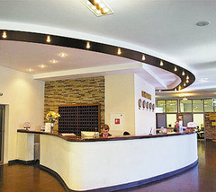
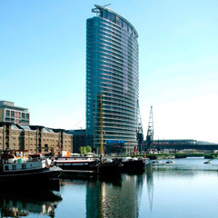
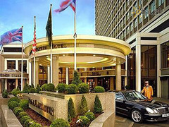
“At the hotel”

Slide 2
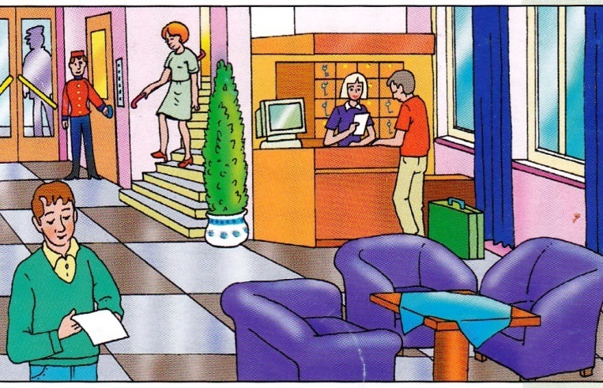
Staying in a hotel
Vocabulary

Slide 3
Exercise 1. Listen and repeat.

Slide 4
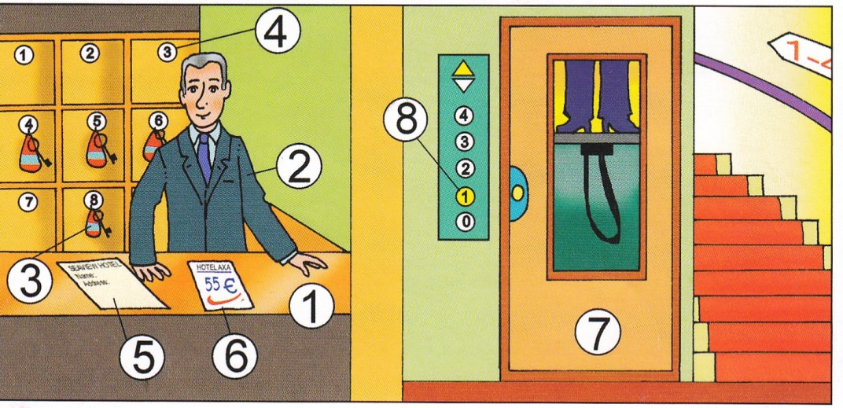
Exercise 2. Listen, repeat and show on
the picture.

Slide 5
Exercise 3. Look on the picture from exercise 2 and write down English words. Then listen to the record and check up your answer.

Slide 6
Exercise 3. Look on the picture from exercise 2 and write down English words. Then listen to the record and check up your answer.
reception
form
receptionist
bill
key
lift
number
floor

Slide 7
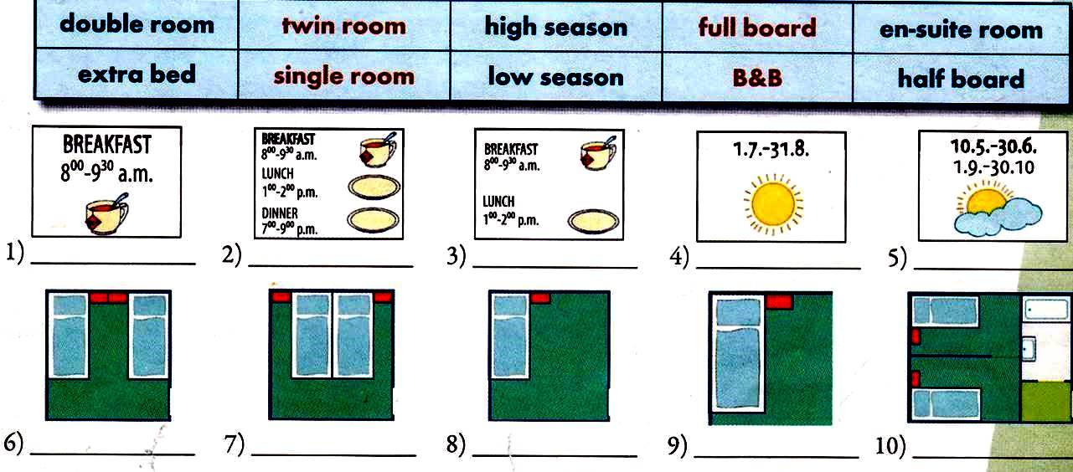
Exercise 4. Match pictures with the true word combinations. Then listen to the record and check up your answer.

Slide 8
Exercise 4. Match pictures with the true word combinations. Then listen to the record and check up your answer.
B&B
full board
half board
high season
low season
twin room
double room
single room
extra bed
en-suite room

Slide 9
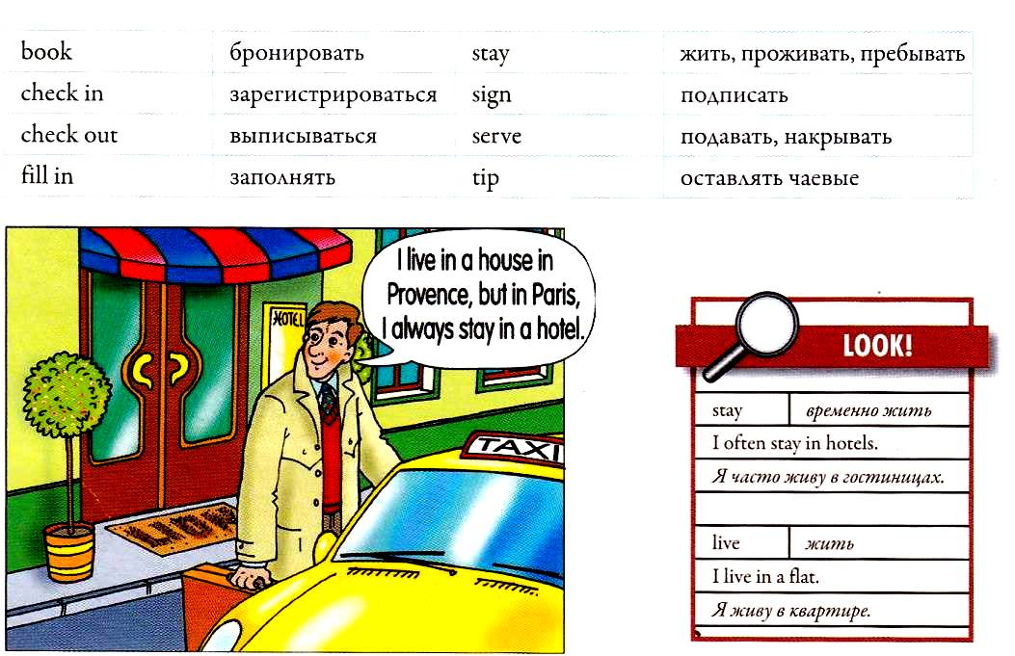
Exercise 5. Read the following verbs, then listen to them and repeat.

Slide 10
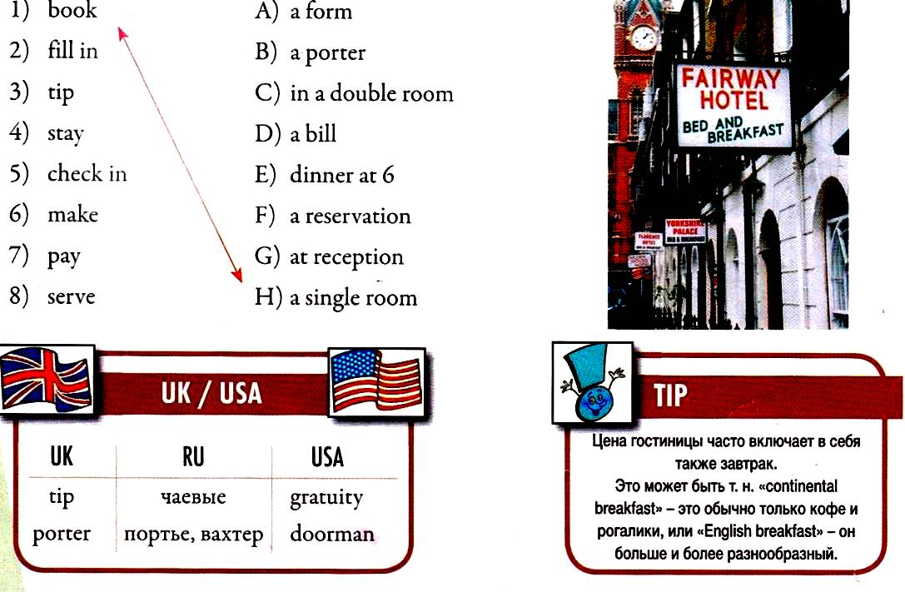
Exercise 6. Connect the appropriate expressions, then listen to the record and check up your answers.

Slide 11
Exercise 6. Connect the appropriate expressions, then listen to the record and check up your answers.

Slide 12
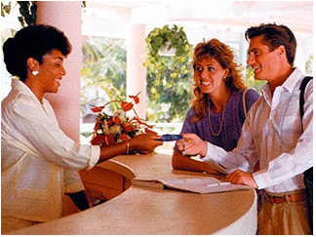
How to check in
Listening

Slide 13
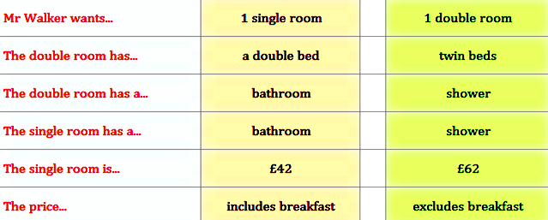
Exercise 1. Listen to the dialogue and note
the true sentences.

Slide 14
Exercise 1. Listen to the dialogue and note
the true sentences.
√
√
√
√
√
√
√

Slide 15
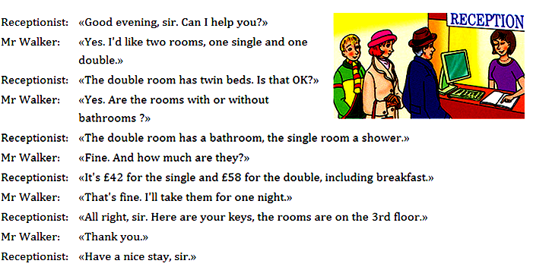
Exercise 2.Listen to the dialogue again and read the separate remarks.

Slide 16
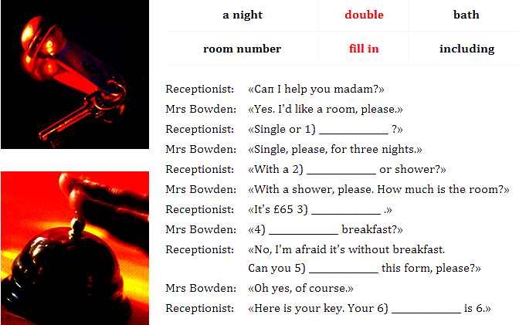
Exercise 4.Listen to the dialogue again, insert the
missing words in the text from the table.

Slide 17
Exercise 4.Listen to the dialogue again, insert the
missing words in the text from the table.
double
bath
a night
including
fill in
room
number

Slide 18
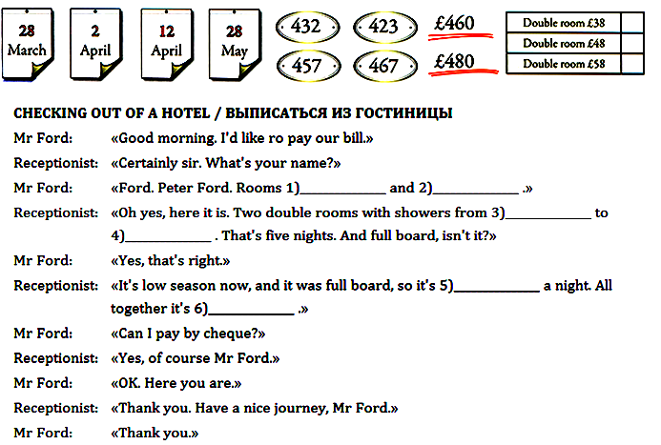
Exercise 7.Listen to the dialogue and put in the text true information.

Slide 19
Exercise 7. Listen to the dialogue and put in the text true information.
423
457
28th March
2nd April
£48
£ 480

Slide 20
Exercise 6. Read the ordinal numerals, listen and repeat.

Slide 21
Exercise 7.Read the dates, listen to the record and repeat.

Slide 23
Grammar: Modal verbs

Slide 24
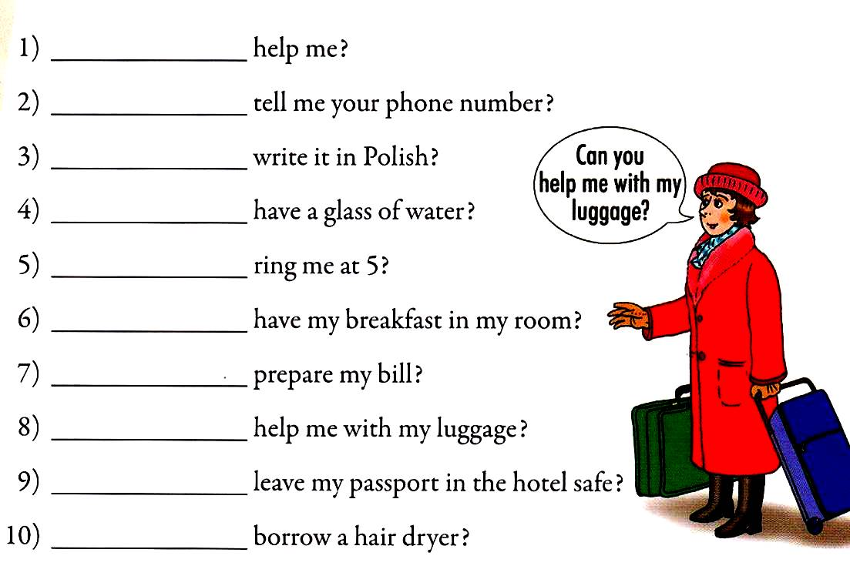
Exercise 5. Дополнить предложение выражением: can I / can you?

Slide 25
Exercise 6. Попросить следующие вещи, употребляя выражение: can I / can you?

Slide 26
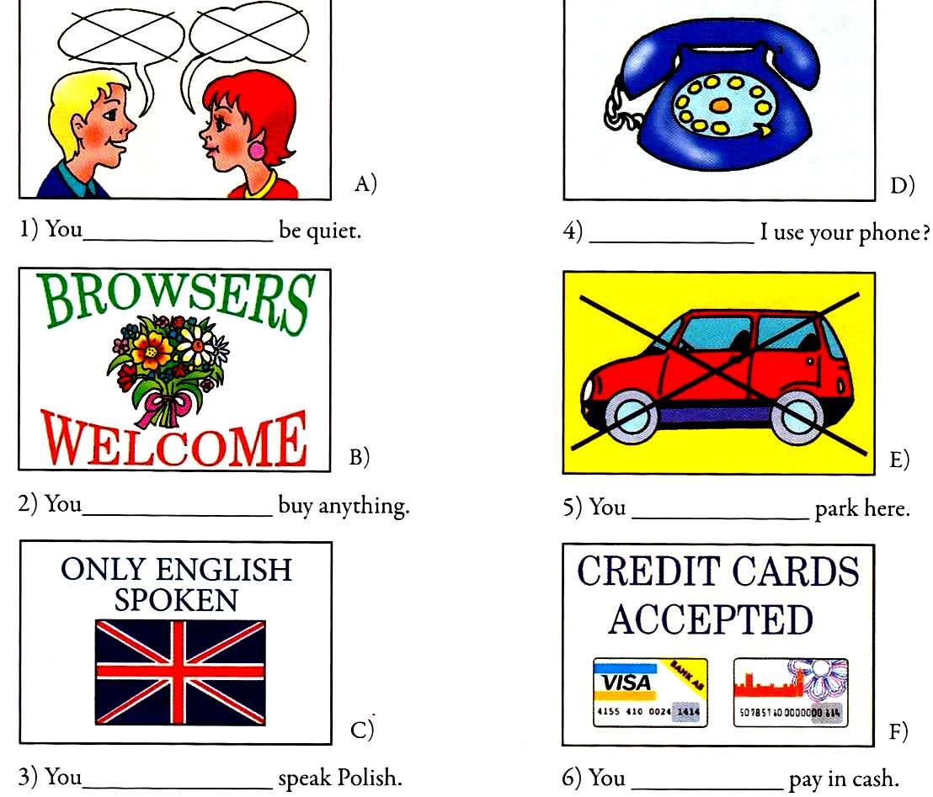
Exercise 8. Посмотрев на рисунки, дополнить предложение глаголом: must / mustn’t / needn’t / may..

Slide 27
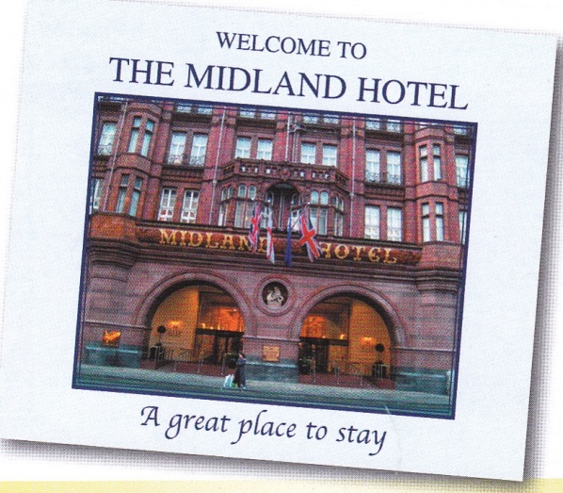
Choosing a hotel
Reading

Slide 28
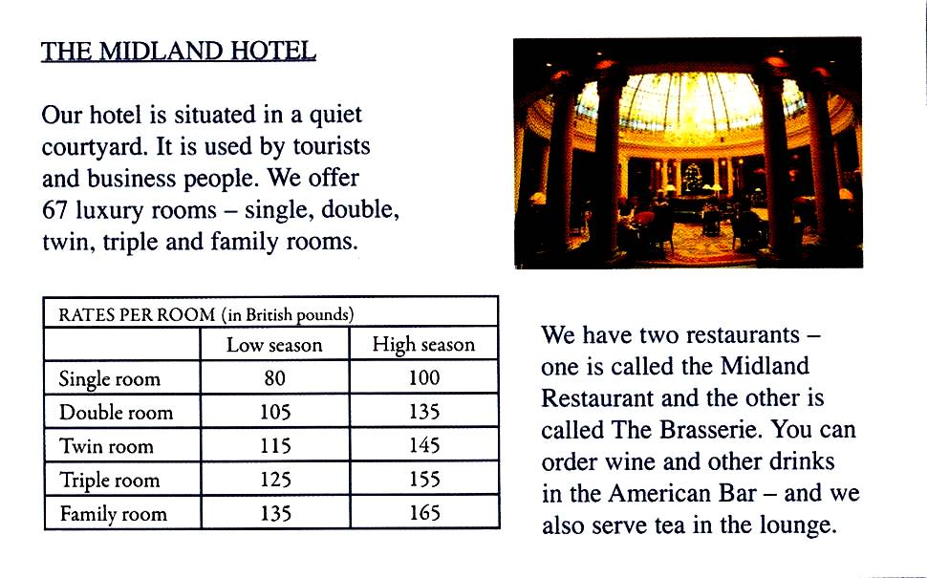
Exercise 1. Read about The Midland Hotel.

Slide 29
Exercise 2. Listen to the words from the text

Slide 30
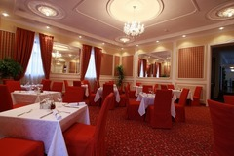
Make up the dialogues in pairs.
^{At the Airport}
^{At the Restaurant}
At the Hotel
^{At the Railway Station}

Slide 31
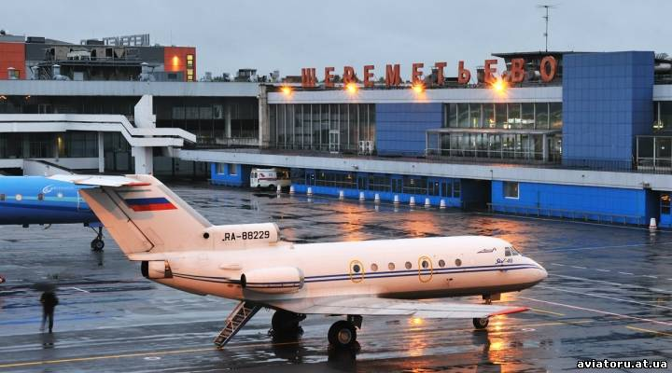
^{At the Airport}
^{At the Airport}

Slide 32
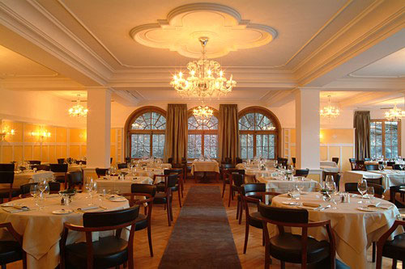
^{At the Restaurant}

Slide 33
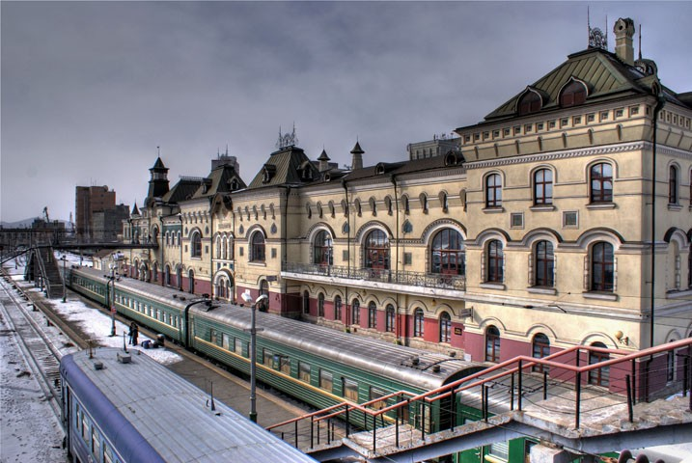
^{At the Railway Station}

Slide 34
At the Hotel

Slide 35
Home task: by heart the new words.

