Slide 1
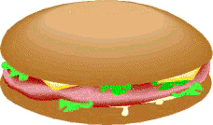
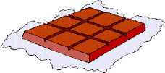
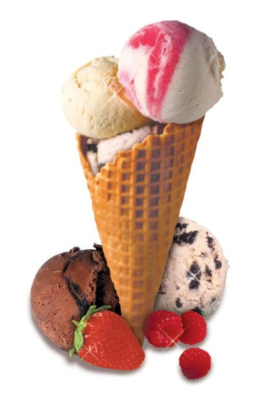
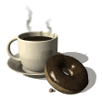
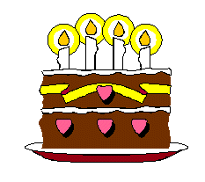
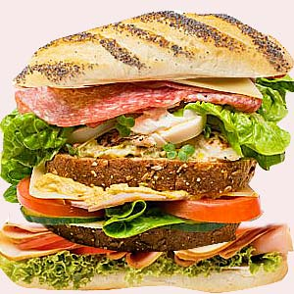
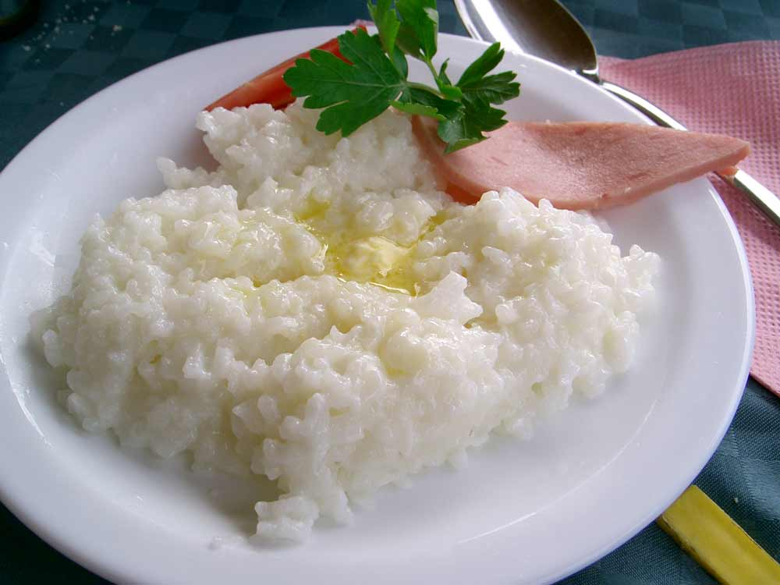
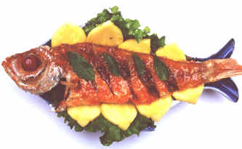
«What to do if you …»
Some diseases.
Medical problems.
Advices (советы) how to keep health.
tea, hamburgers, mushrooms, pizza, milk, apples, fish, coffee, chips, porridge, cabbage soup, potatoes, sausage, butter

Slide 2
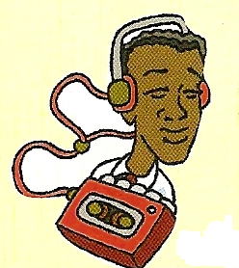
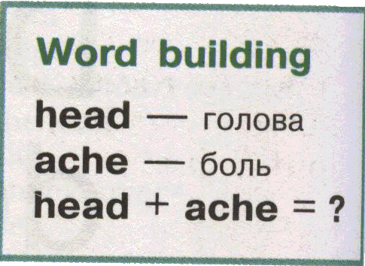
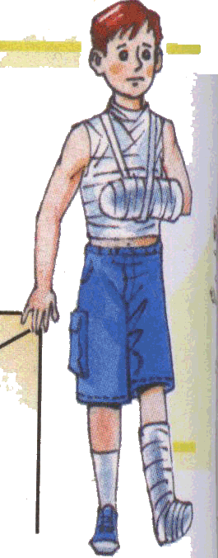
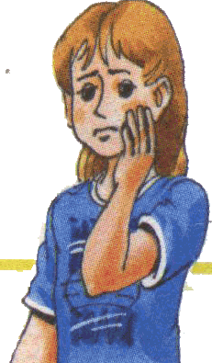
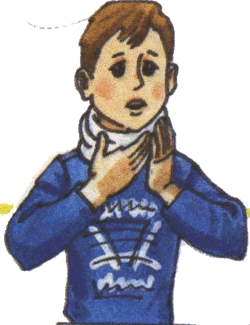
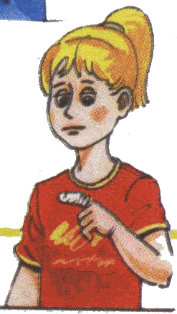
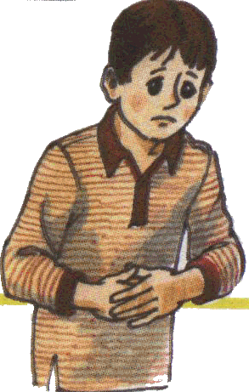
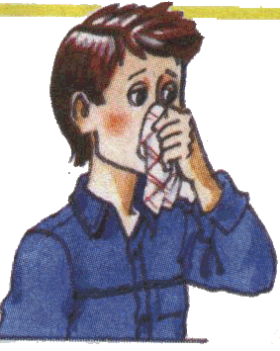
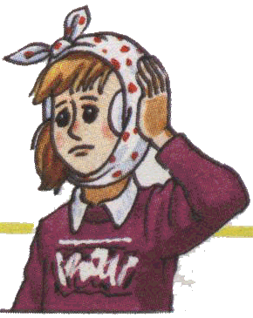
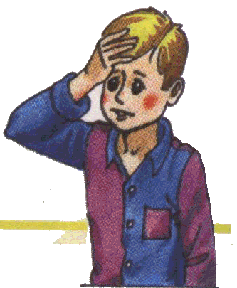
a sore throat a headache
a stomachache earache toothache a sore finger backache a runny nose a cough a cold the flu.

Slide 3
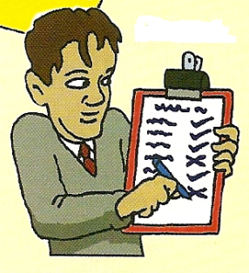
a sore throat
a backache
a toothache
a sore finger
earache
a runny nose
a headache
the flu
a cold
a stomachache

Slide 4
a backache
To express people’s feeling:
is tired
looks tired (усталым)
doesn’t feel well / fine
feels sick / ill / bad
a sore
throat
The boy feels bad, because he has a backache.
a sore
finger
a toothache
a headache
the flu
a runny nose
a cold
earache
a stomachache

Slide 5
What are the names of these children?
Which health problems do they have?

Slide 6
Two little eyes to look around,
Two little ears to hear any sound,
Two little hands to hold hands tight,
Two little feet to walk left or right.
I wiggle my fingers,
I wiggle my feet,
I wiggle my shoulders,
I wiggle my nose
Now no more wiggles are left in me.
So I will be still as can be!

Slide 7
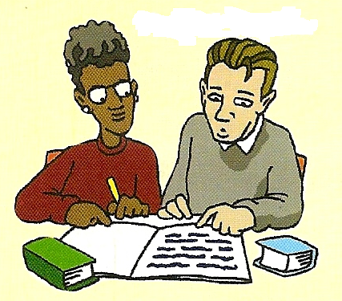
Read the dialogue ex.1 p.94 and say
What health problem has the brother got?
Why has he the health problem?

Slide 8
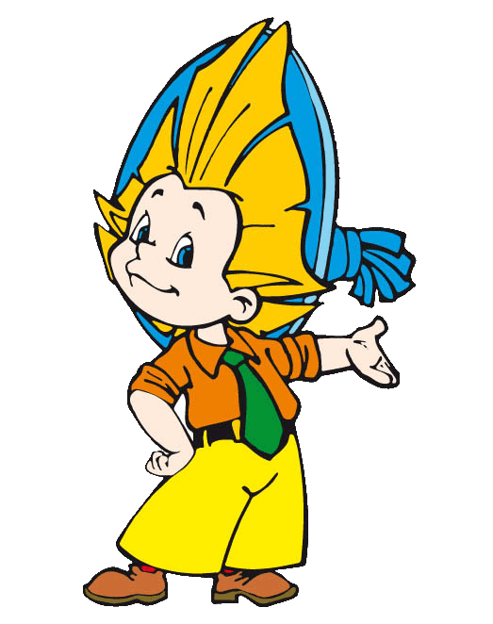
"Neznaika is a Boaster"
I am brave. I am not afraid to fall down.
I don’t eat fruit and vegetables.
I enjoy walking when it is rainy
I eat a lot of sweets and chocolate.
I eat quickly.
Neznayka, you might … … if you …
Neznayka, you might have a stomachache if you eat too fast.

Slide 9
Homework:
SB ex.8-10p.97

Slide 10
Источники:
1/ Учебник «Enjoy English» для 7 класса М.З.Биболетовой и др.
2/ Книга для учителя М.З.Биболетовой. и др.
3/ Поурочные разработки по английскому языку к УМК
М.З.Биболетовой и др. «Enjoy English 7»
4/ Учебник «English 6» В.П.Кузовлев и др.

