Slide 1
Man-the child of Nature.

Slide 2
Фонетическая зарядка
Transparent
Breeze
A light mist
To be penetrated with smth
To look glorious
Crystal clear
To be moonlit

Slide 3
Фонетическая зарядка 2
Volcano eruption
Tornado
Tsunami
Hurricane
Ban ocean dumping
Reduce
Encourage waste recycling
Protect the endangered species
Raise ecological awareness

Slide 4
Фонетическая зарядка 3
Radioactive pollution
Global warming
Climatic change
Ozone layer (destruction)
Deforestation
Endangered species
Extinction
Disruption of ecological balances

Slide 5
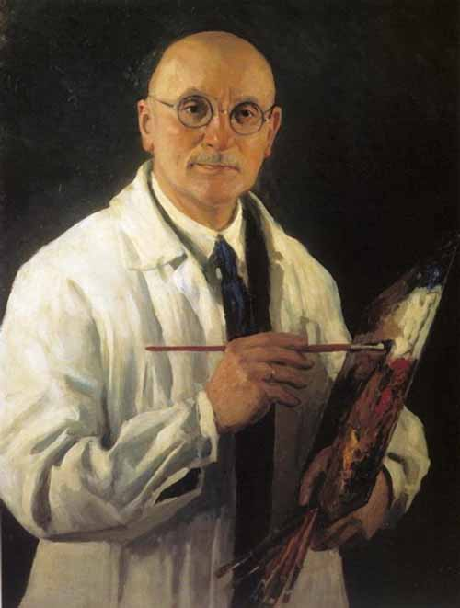
Igor Grabar

Slide 6
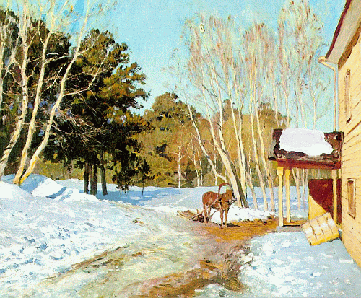

Slide 7
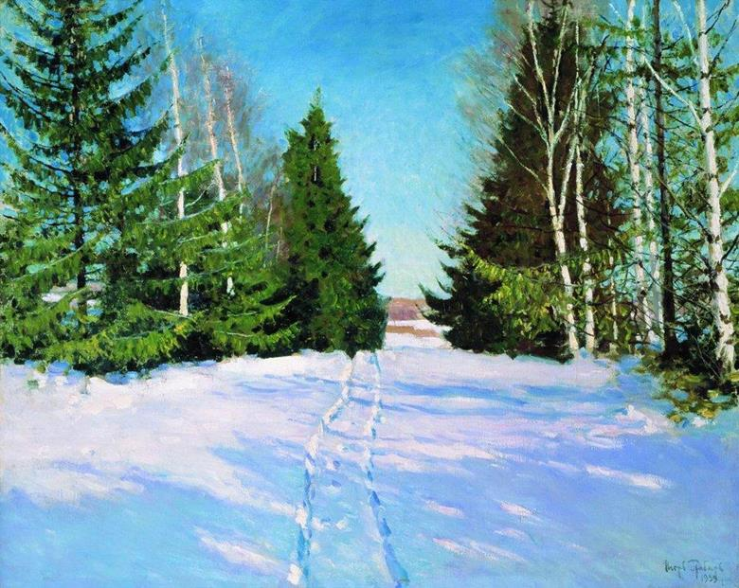
March
(I. Grabar.)

Slide 8
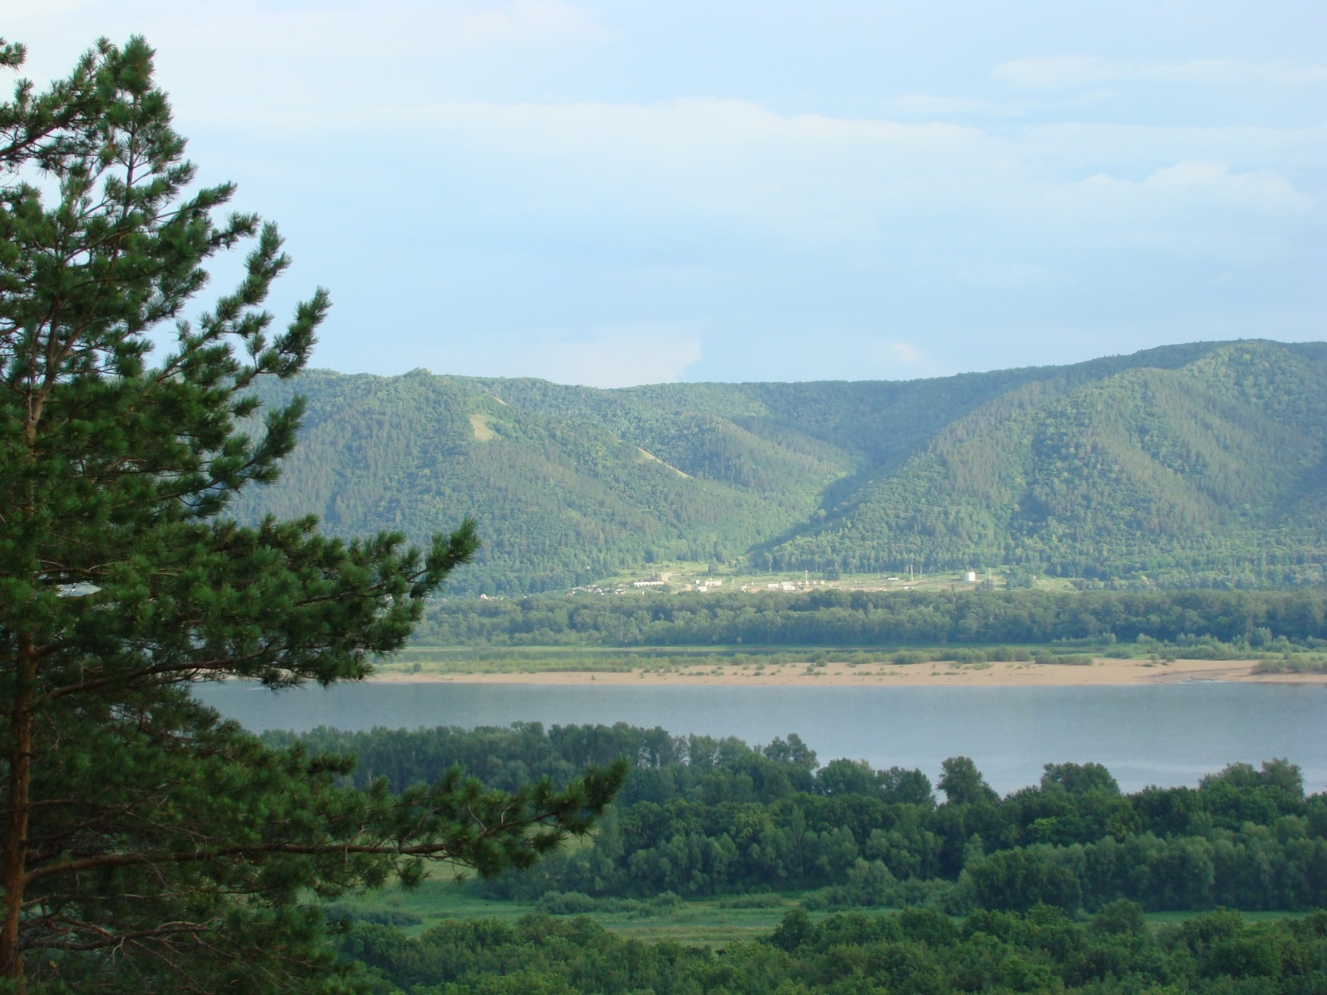
nature of Togliatti

Slide 9
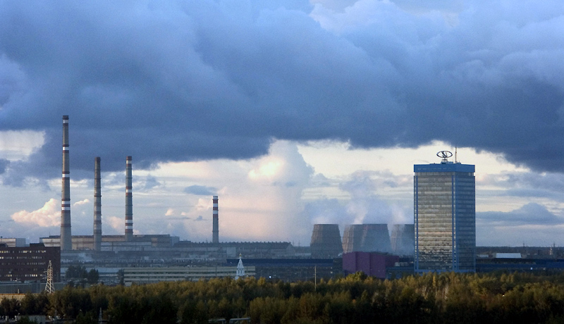
Pollution of the nature in Togliatti

Slide 10
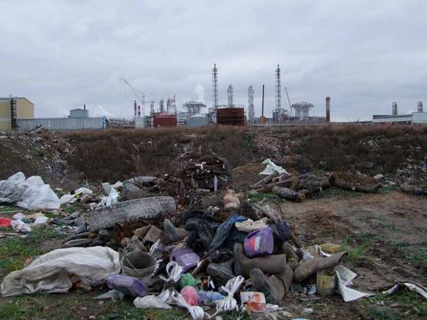
Pollution of the nature in Togliaatti

Slide 11
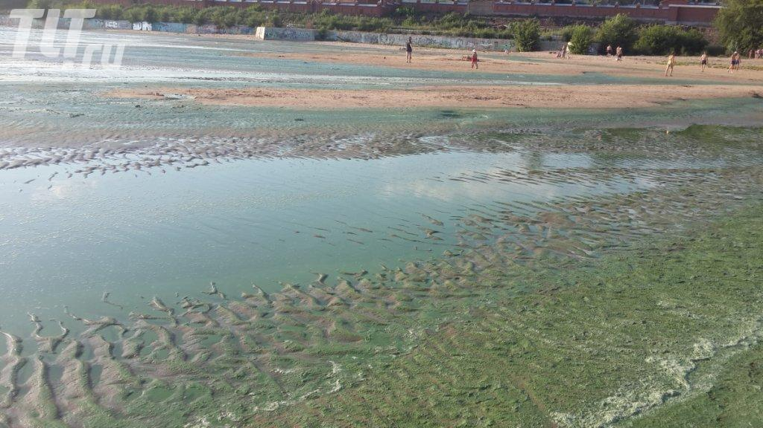
Pollution of water in Togliatti

Slide 12
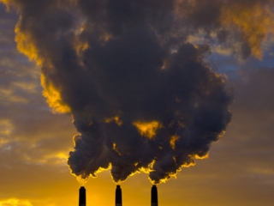
Air pollution of the town

Slide 13
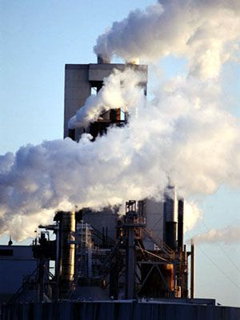
Air pollution of the city Tolyatti

Slide 14
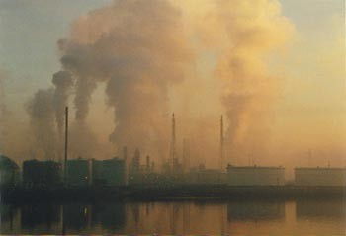
Air pollution of the town Togliatti

Slide 15
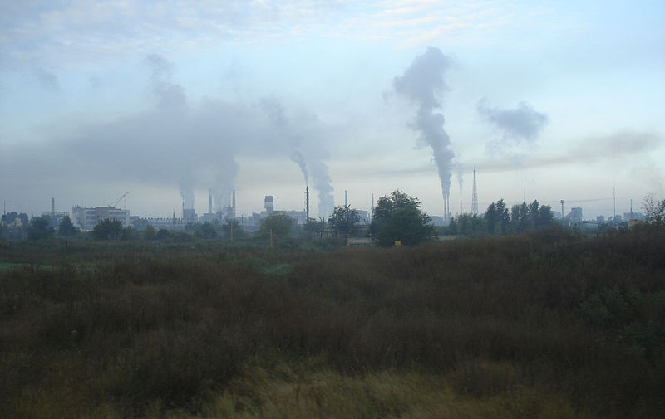
Air pollution

Slide 16
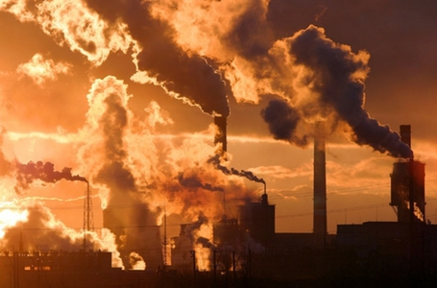
Level of pollution of the atmosphere.

Slide 17
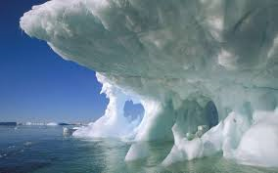
Melting of ice

Slide 18
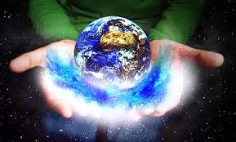
global warming

Slide 19
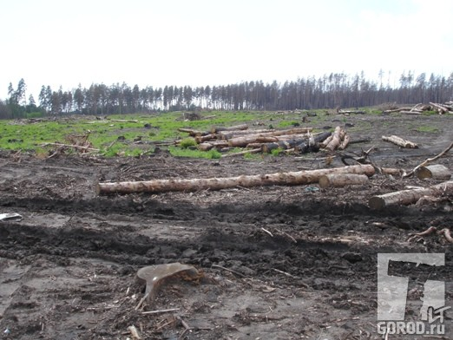
deforestation

Slide 20
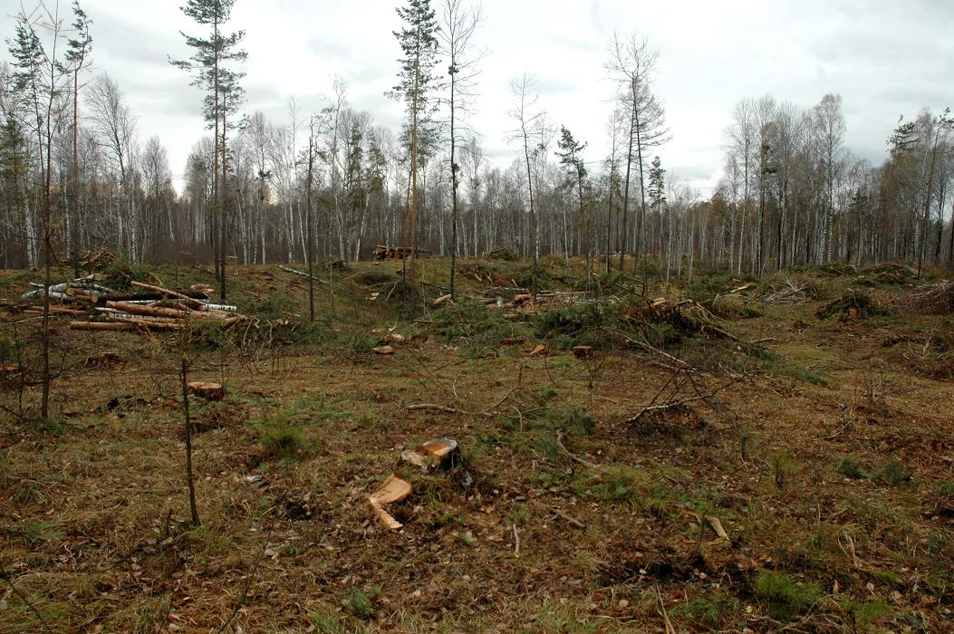
environmental problems

Slide 21
Greenpeace

Slide 22
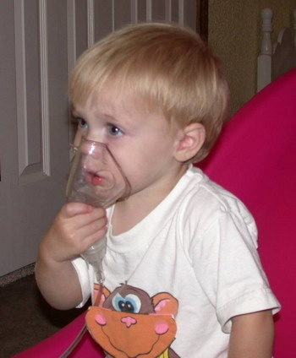
diseases because of bad ecology

Slide 23
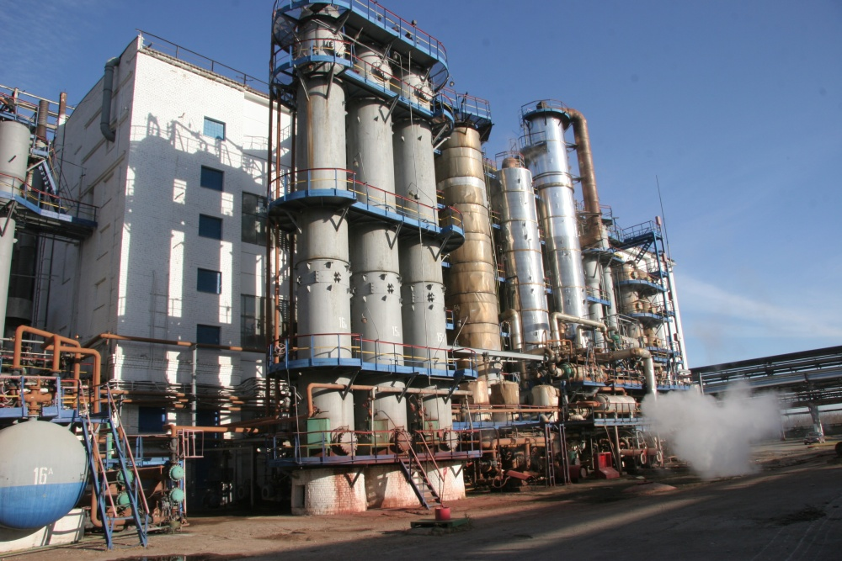
Chemica l plant of Togliatti

Slide 24
Hug the Earth
Walking along feeling free, Feeling the earth here with me, And I love her, she loves me, I hug the Earth, the Earth hugs me. She’s our friend, We’d like to be together forever. The earth is a garden, It’s a beautiful place For all living creatures, For all the human race. Helping Mother Earth, We can peacefully roam, We all deserve a place, We can call our home.

Slide 25
«Синквейн»
1 существительное
2 прилагательных
3 глагола
4 слова, выражающих собственное отношение к теме
1 слово, ассоциирующееся со словом №1
You’ve read the text and now you’re ready to create your own masterpiece – a poem.
The structure of cinquain is on the slide to help you.
You should work in pairs.
You have only 3 minutes.

Slide 26
Thank you for your Attention! Goodbye!

