Slide 1
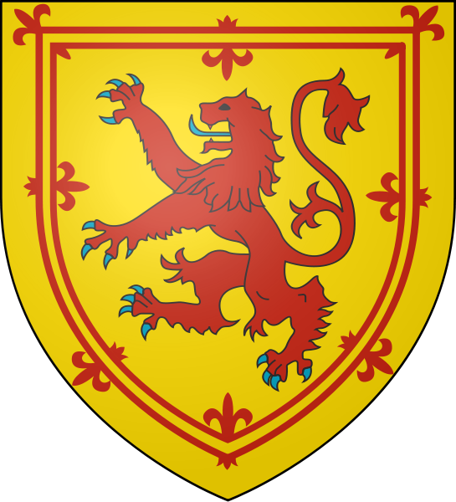
Scotland

Slide 2
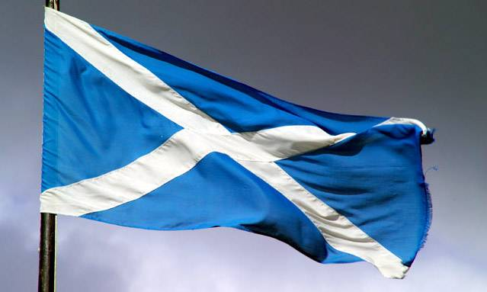
Scotland
Scotland – is a part of great Britain. Its capital is Edinburgh; its emblem is a thistle.

Slide 3
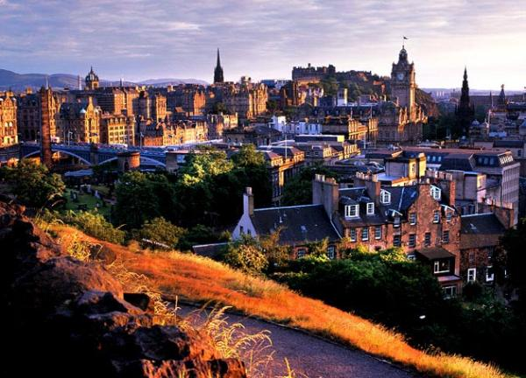
Scotland is the third part of the territory of the British Isles, its population is not very big.

Slide 4
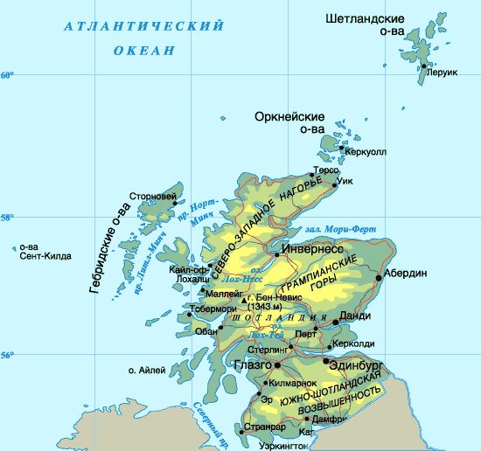
Scotland includes the Hebrides and the Orkney and Shetland Islands.

Slide 5
Scotland is divided into three regions: the Highlands, the Lowlands, the Southern Uplands.

Slide 6
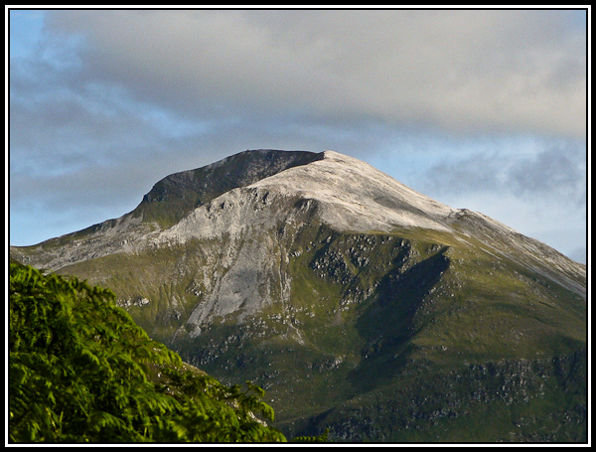
The Highlands of Scotland
The Highlands of Scotland are among the oldest mountains in the world.

Slide 7
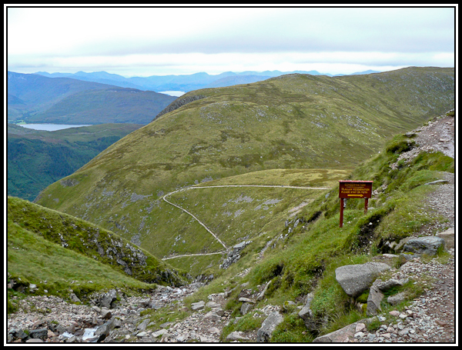
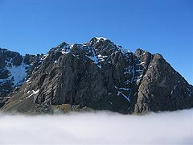
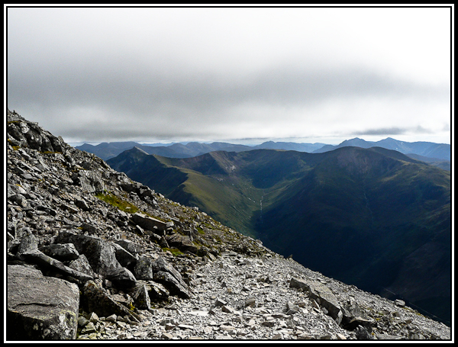
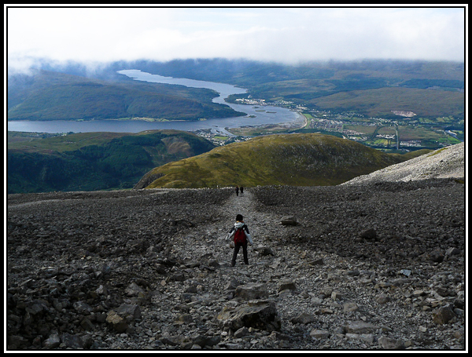

Slide 8
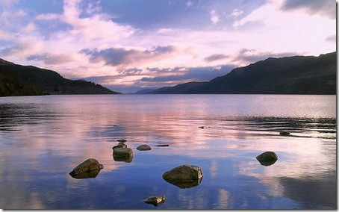
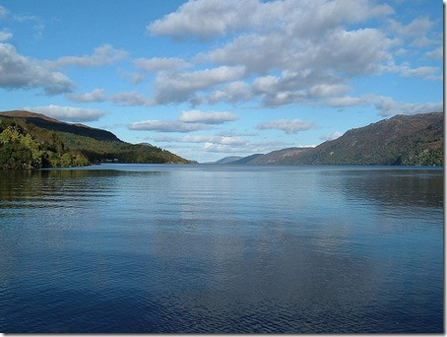
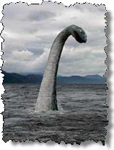
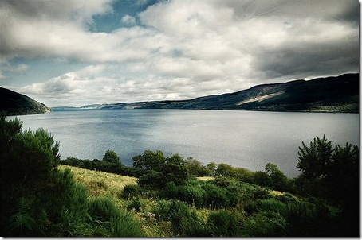
The lakes of Scotland.
There are many lakes in Scotland. The best- known is Loch Ness people think a large monster lives.

Slide 9
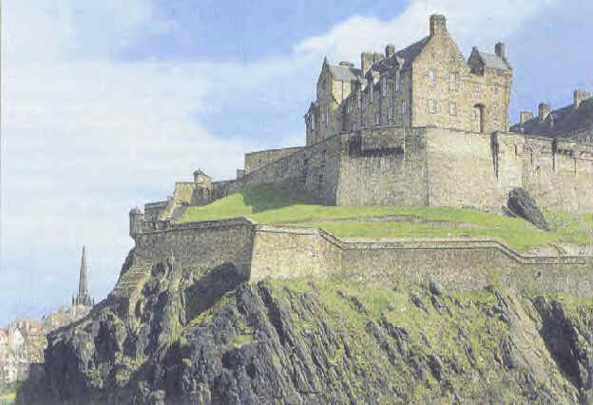
The sightseeing of Scotland. Edinburgh Castle.
Most of the population of Scotland is concentrated in the Lowlands. Here, on the Clyde, is Glasgow, Scotland’s biggest city.

Slide 10
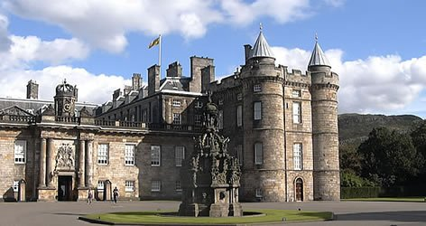
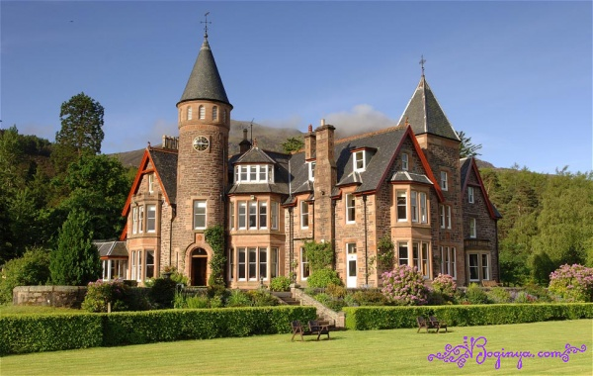
Aberdeen
Aberdeen is photo of a city one of the large cities of Scotland.

Slide 11
Joining to the UK.
In 1707 Scotland was joined to the UK, after a long struggle for its independence.

Slide 12
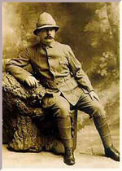
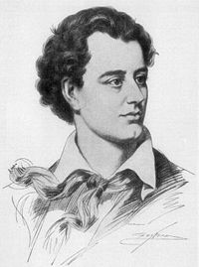
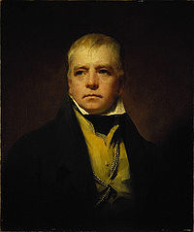
Famous Scottish.
Edinburg is the cultural centre of Scotland with the names of George Gordon Byron, Walter Scott, Robert Louis Stevenson, Robert Burns and Arthur Conan Doyle.

Slide 13
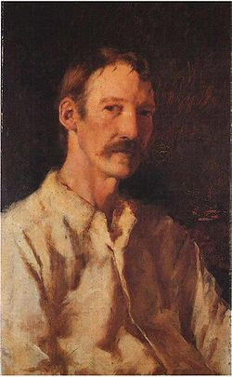
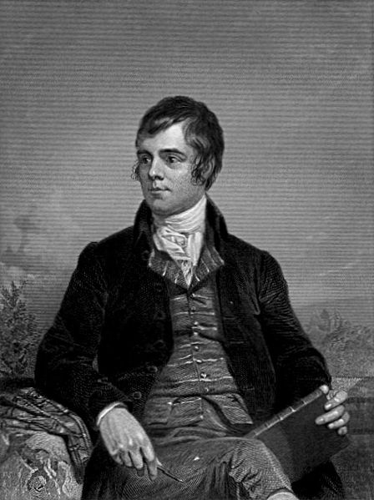

Slide 14
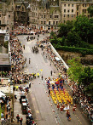
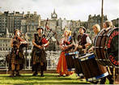
Edinburg Festival of Music and Drama.
Edinburg is a place of helding the world-famous Festival of music and drama. The first festival was in 1947.

Slide 15
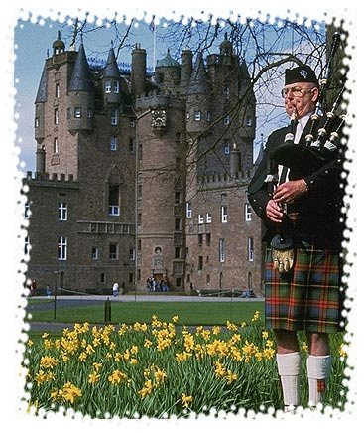
Scottish kilt.
The kilt is a relic of the time when the clan system existed in the Highlands. Everybody in the clan had the same family name, like MacDonald or MacGregor.

Slide 16
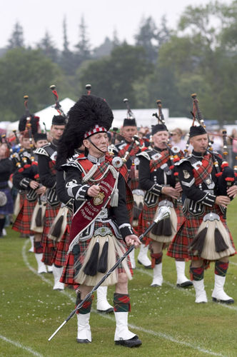
Scottish bagpiper.
Bagpipe is a Scotland’s national instrument. The Scottish piper is wearing a kilt.

Slide 17
Home Task
Прочитать и перевести на русский язык

