Slide 1
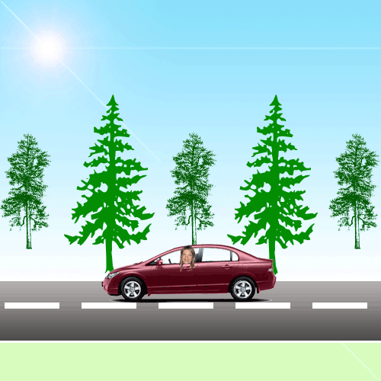
Different Kinds
of Transport

Slide 2
Plan of the lesson:
New words and words combinations
Doing some exercises
Test yourself

Slide 3
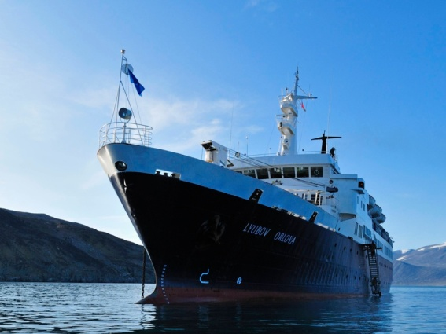
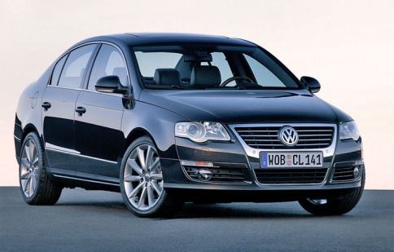
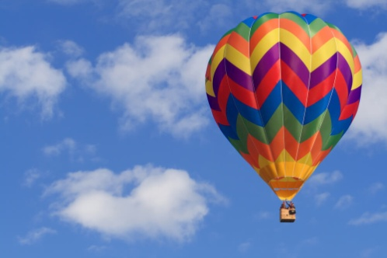
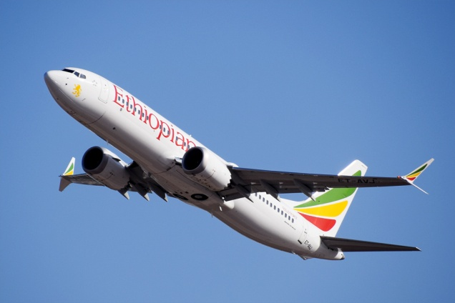
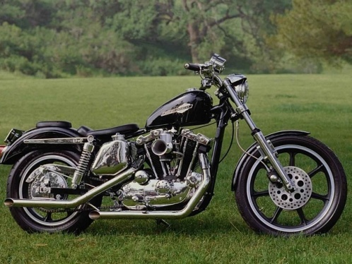
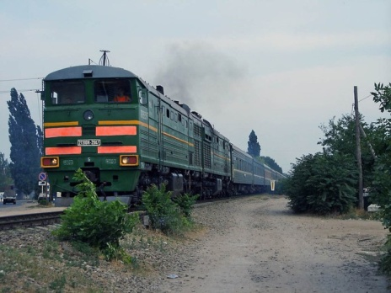
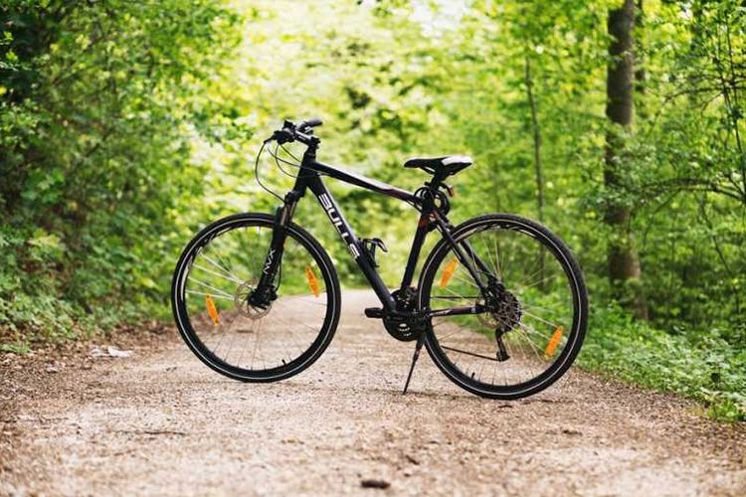
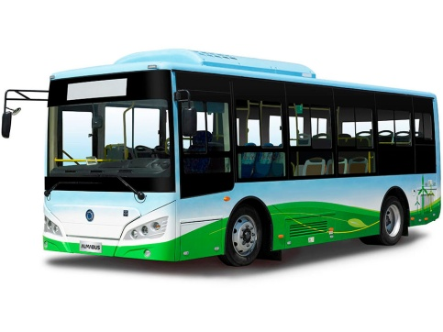
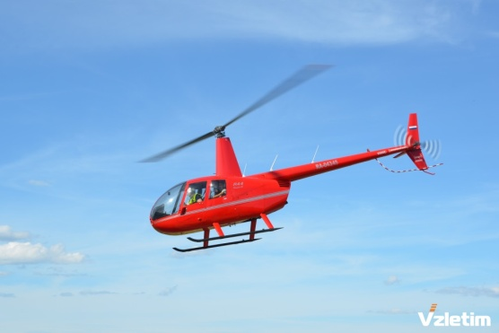

Slide 4
a bread-van

Slide 5
A car

Slide 6
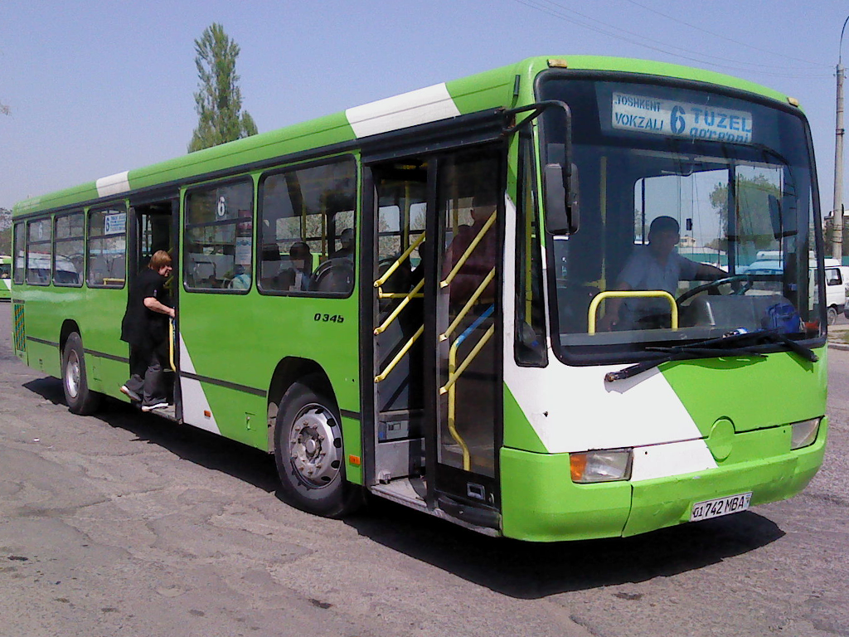
A bus

Slide 7
A motorcycle

Slide 8
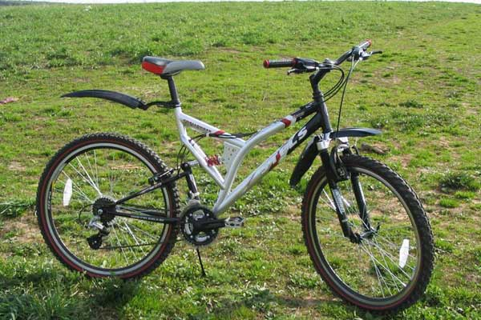
A bike

Slide 9
A train

Slide 10
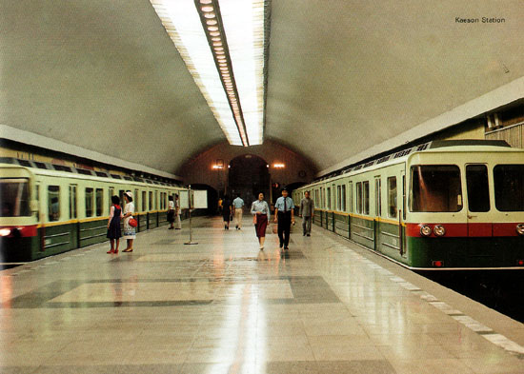
A subway

Slide 11
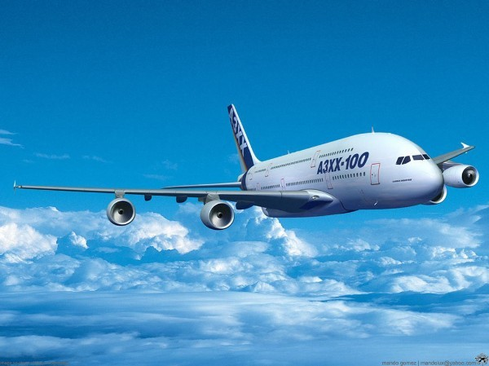
A plane

Slide 12
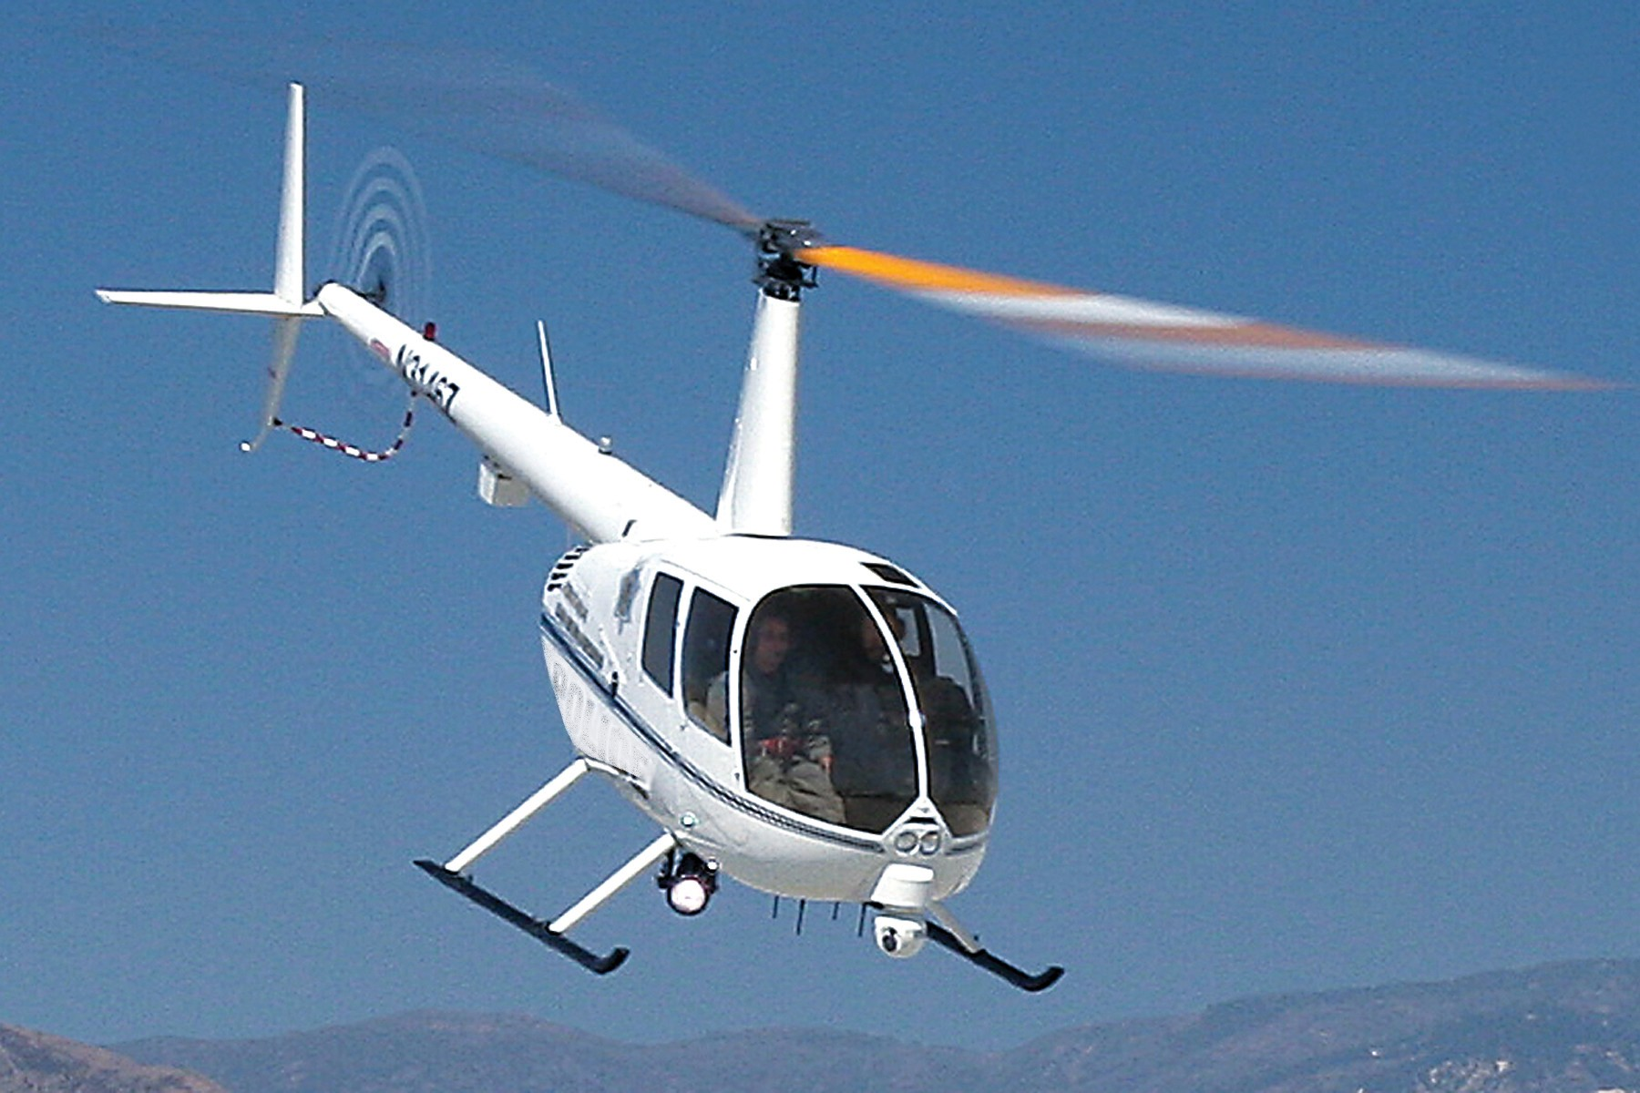
A helicopter

Slide 13
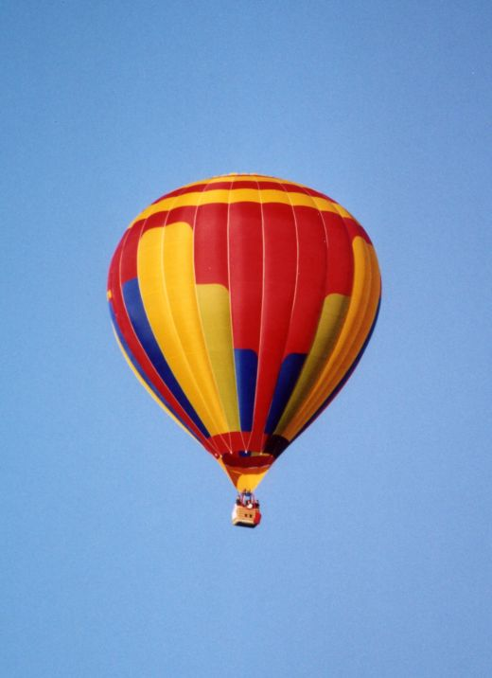
A hot-air balloon

Slide 14
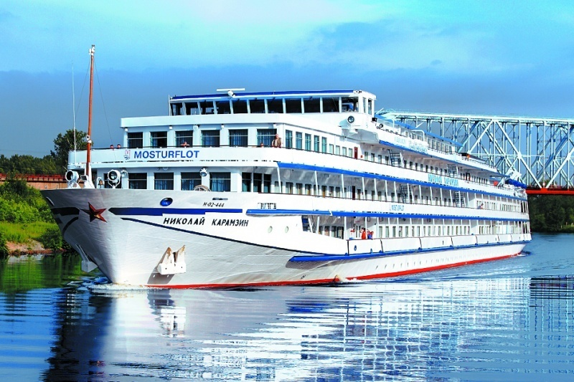
A ship

Slide 15
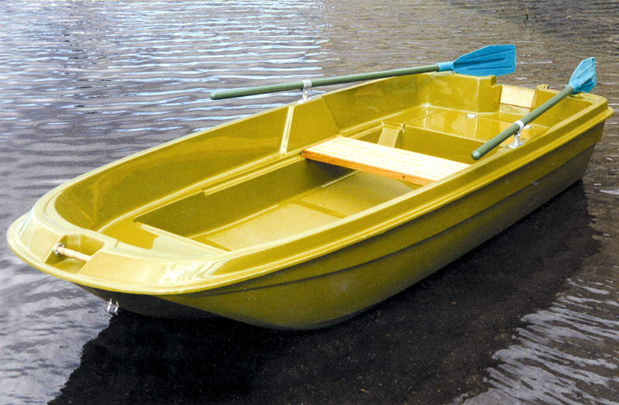
A boat

Slide 16
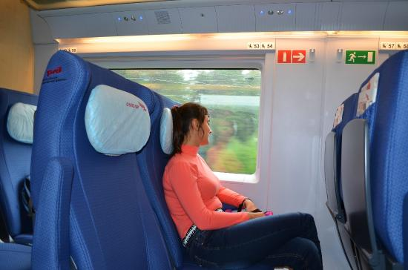
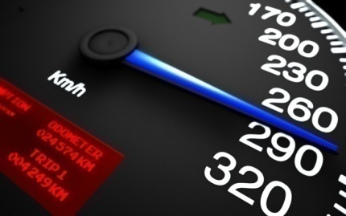
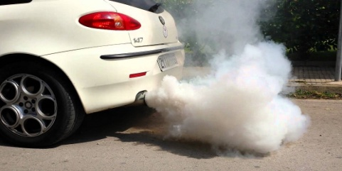
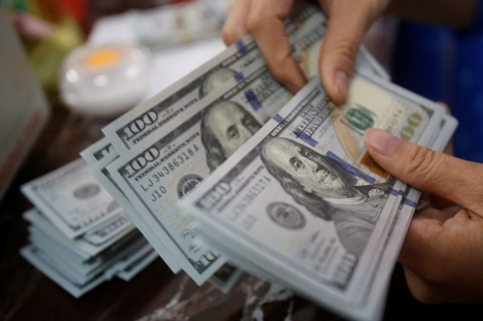
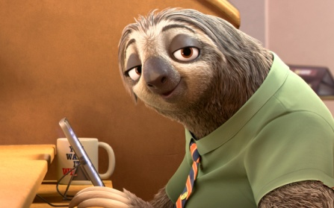
What can transport for travelling be like?
cheap
safe
comfortable
dangerous
polluting
fast
convenient
expensive
slow

Slide 17
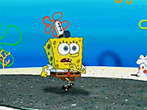
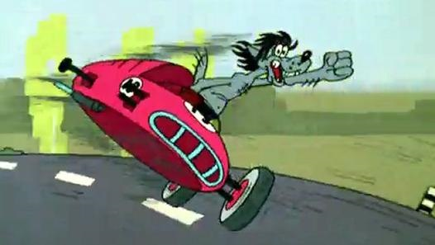
What can transport for travelling be like?
How do you like to travel? Why?
- I like travelling by car because it’s fast.
By car
By bus
By plane
By ship
By train
By bicycle
On foot
By metro
Comfortable
Polluting
Fast
Slow
Safe
Convenient
Cheap
Expensive
I like travelling …
I don’t like travelling …
because it’s…

Slide 18
comparison of adjectives
Образование степеней сравнения односложных прилагательных
Positive (положительная степень)
cheap
Cheap-
cheaper
-the cheapest
Comparative (сравнительная степень)
Прибавление суффикса -er к прилагательному.
Fast-
faster -
the fastest
cheap
er
cheaper
Slow-
slower-
the slowest
Superlative ( превосходная степень)
Safe-
safer -
the safest
Прибавление артикля the и суффикса -est
cheap
the …est
the cheapest

Slide 19
comparison of adjectives
Образование степеней сравнения многосложных прилагательных
Positive (положительная степень)
important
Comparative (сравнительная степень)
more
important
more important
Important -
more important -
the most important
Superlative ( превосходная степень)
the most
important
the most important
Dangerous -
more dangerous -
the most dangerous
Comfortable
- more comfortable -
the most comfortable

Slide 20
Make sentences comparing traveling by plane, train, boat, car and bicycle.
Example: Travelling by car is faster than on foot
- Travelling by …
car
train
boat
plane
bike
faster
slower
cheaper
expensive
safer
comfortable
by plane
by ship
on foot
by train
by car
is
is more
is less
than

Slide 21
Test Yourself
№1. Translate into English:
-Велосипед медленнее, чем автомобиль.
-Лодка- самый дешевый вид транспорта.
-Путешествие на самолете опаснее всего.

Slide 22
Test Yourself
№1. Translate into English:
-A bike is slower, than a car.
-A boat is the cheapest kind of transport.
-Travelling by plane is the most dangerous.

Slide 23
Test Yourself
1mistake – 5
2-3 mistakes – 4
4- 5 mistakes – 3
more than 5 mistakes - 2

Slide 24
Home task
Write down mini-project
“What kind of transport do you prefer and why?”

Slide 25
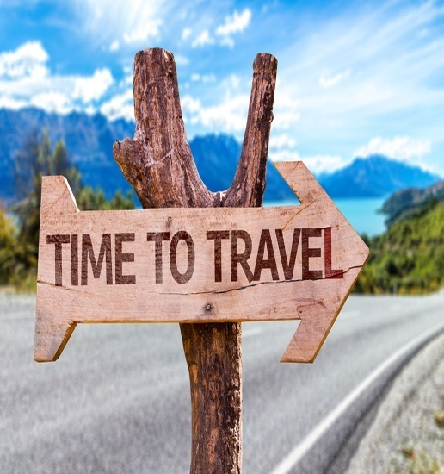
People like to travel…
With whom?
В одиночестве
С друзьями
С родителями
С питомцем
С дедушкой/бабушкой
Alone
With friends
With parents
With pets
With grandparents
They usually travel…
For what?
По делам
Для удовольствия
Изучать, практиковать иностранный язык
Чтобы увидеть новые места
On business
For pleasure
Learn, practice foreign language
To see new places
When they travel they like to
For what?
Ходить по магазинам
Заводить новых друзей
Узнавать больше о других странах
Go shopping
Make new friends
Learn more about other countries

