Slide 1
In harmony with others.

Slide 2
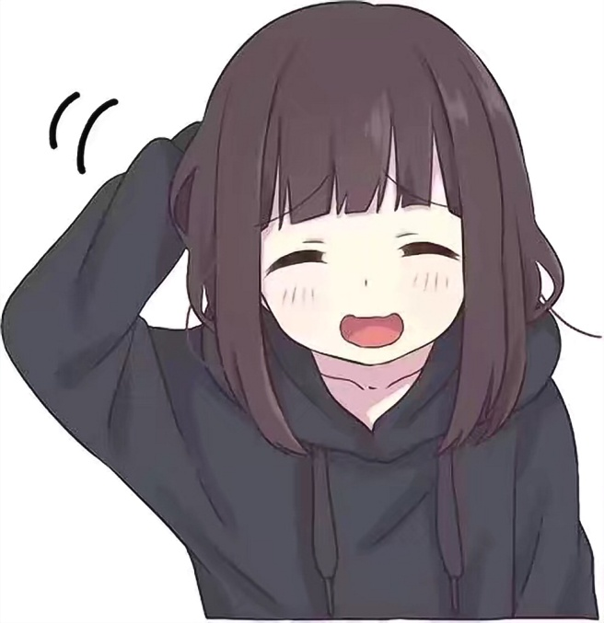
I try to treat others the way I want others to treat me. People are sometimes very touchy and do not always understand my jokes, so I try to avoid awkward situations, so as not to hurt other people's feelings.

Slide 3
I can't imagine my life without my family and friends. My family supports me in any situation, and my friends always cheer me up. Through their advice, I can also support others, and those people will help others and so on. It is a cycle of good in society.

Slide 4
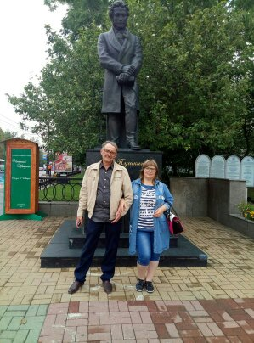
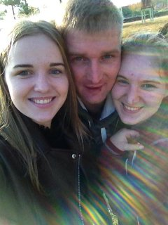
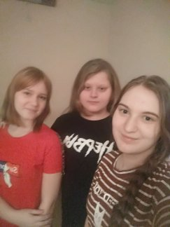
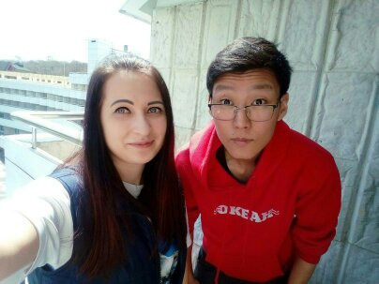
My family and friends:

Slide 5
Knowing how to avoid quarrels is the best way to be in harmony. How to do it?
It is necessary to observe the rules of etiquette and know the norms of morality;
In any case, do not insult or humiliate people!
Don't be too Intrusive;
Listen and understand other people;
Don't ignore other people's feelings;
Compromise ;
To be able to forgive, though it is sometimes difficult;

Slide 6
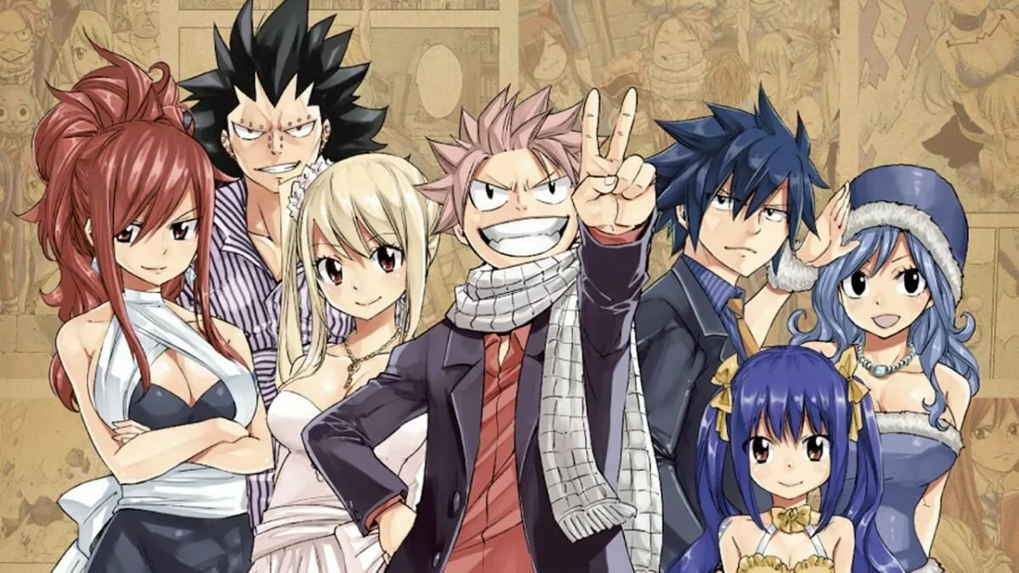
And the most important thing! Appreciate other people's support. Be in harmony not only with yourself, but also with others.

Slide 7
Thanks for your attention!

