Slide 1
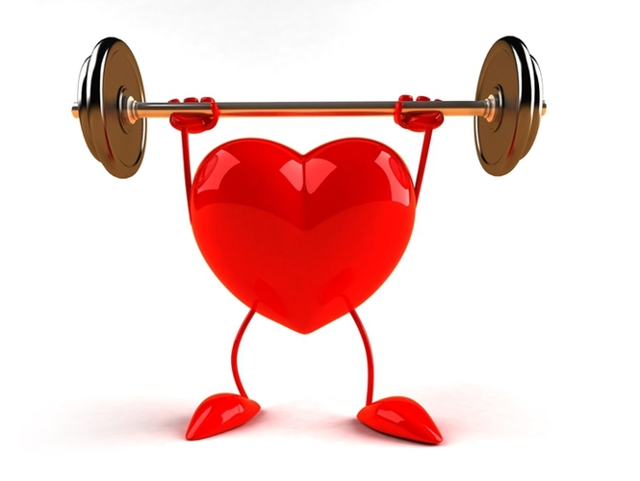
Health
Test

Slide 2
1. Соотнесите английское слово с русским эквивалентом:
1. to keep fit a) иметь больное горло
2. to have a backache b) быть в форме
3. to have a high temperature c) иметь высокую температуру
4. to have a sore throat d) зубной врач
5. to catch a cold e) простудиться
6. a dentist f) поправиться
7. to recover g) принимать лекарство
8. to take medicine h) побочный эффект
9. to cough i) иметь боль в спине
10. to examine j) кашлять
11. to prescribe k) осматривать
12. side effect l) прописывать лекарство

Slide 3
2. Заполните пропуски в тексте словами из рамочки
My little brother is a real… . Every morning he has a … because he doesn’t want to go to school. If he says he has a…, be sure that he has a test that day! When he starts doing his homework, he always has got a … or a… . To stay at home when his classmates sing at the concert he says he has a … or a … . But he always feels… when it is the time to watch TV or to play computer games!
Stomachache, troublemaker, toothache, fine, sore finger, cough, sore throat

Slide 4
3. Выберите подходящий ответ:
1. Doctor, I don’t feel well.
A) I’m sorry to hear that.
B) No problem.
C) Let me examine you.
2. I feel more dead than alive.
A) Take it easy.
B) I’m sorry to hear you.
C) Be patient! I haven’t touched your tooth yet.
3. I hate staying in bed and taking medicines.
A) I’m afraid you must do it.
B) Cheer up! Don’t worry.
C) Take it easy. Go for a walk.

Slide 5
4. Представьте себя доктором. Дайте инструкции своему пациенту. Используйте слова в двух колонках. Example: If you have flu, you should stay in bed.
Have a headache
Feel sick
Have temperature
Have a cough
Have a backache
Have a toothache
Have a sore eye
Don’t watch TV
Take your temperature
Give up food and drink much water
Take medicines
Drink hot milk
Visit a dentist
Stay in bed

Slide 6
5. Ответьте на вопросы:
1. What do you do when you fall ill?
2. What does the doctor do when he comes?
3. Who looks after you when you are sick?
4. What do you like doing when you are sick?
5. What do you hate doing when you are sick?
6. Do you take care of your parents when they are sick?
7. Would you like to become a doctor?

