Slide 1
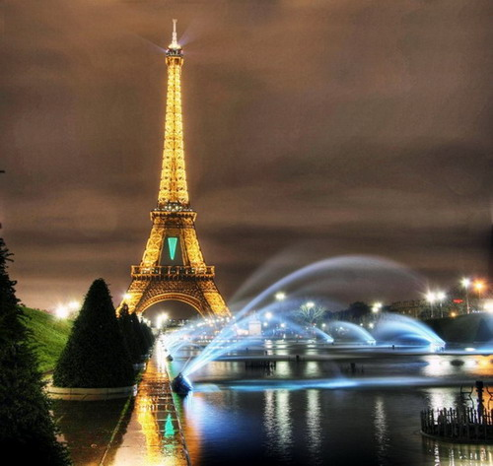
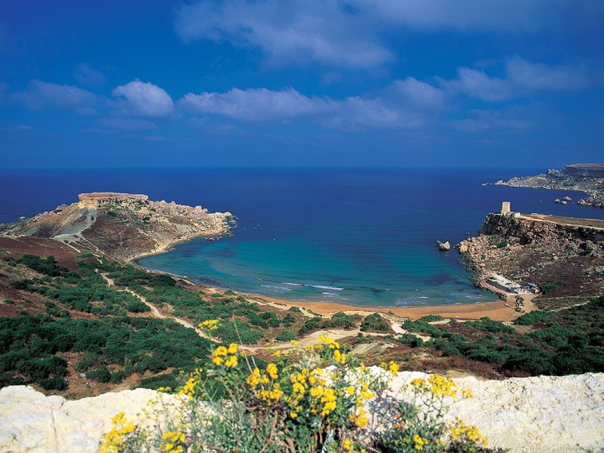
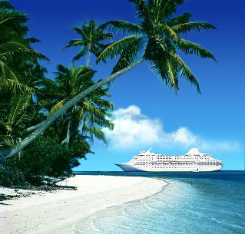
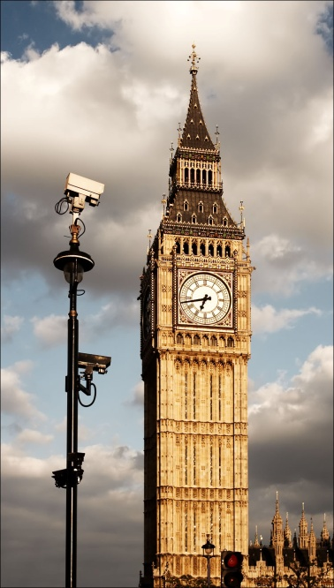
Travelling

Slide 2
Travelling by plane
Hiking and hitch-hiking
Travelling by car
Travelling by ship
Travelling by train
Travelling by bicycle

Slide 3
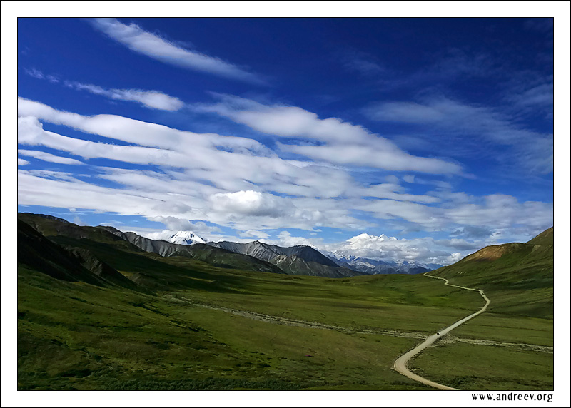
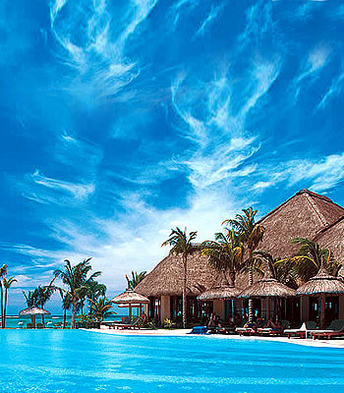
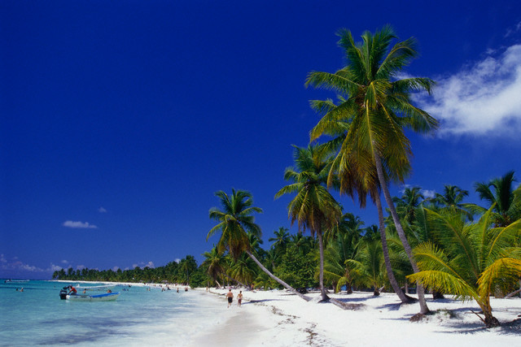
Almost all people are fond of travelling. It is very interesting to see new places, another towns and countries. People may travel either for pleasure or on business. There are various methods of travelling.

Slide 4
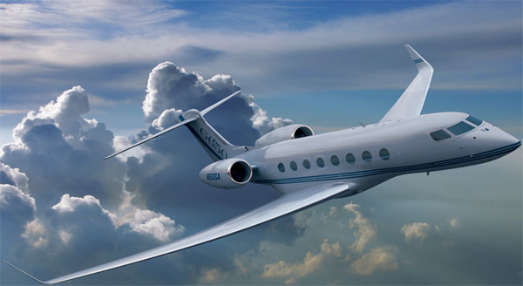
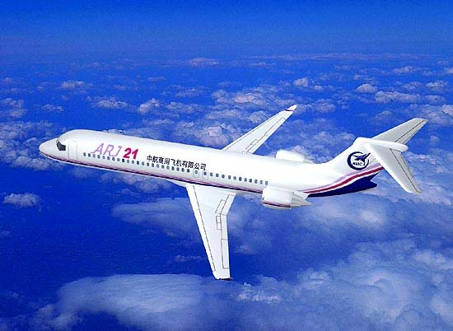
travelling by plane
For me there is nothing like travel by air; it is more comfortable, more convenient and, of course, far quicker than any other method. There is none of the dust and dirt of a railway or car journey, none of the trouble of changing from train to steamer and then to another train.

Slide 5
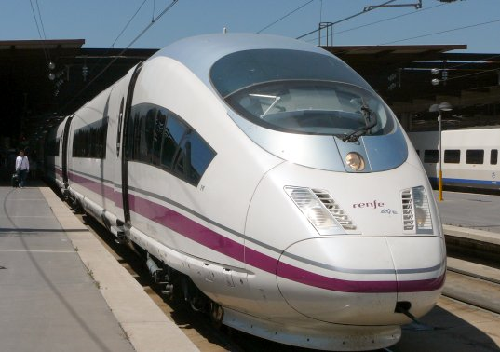
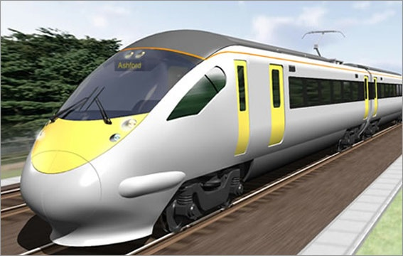
travelling by train
With a train you have speed, comfort and pleasure combined. From the comfortable seat of a railway carriage you have a splendid view of the whole country-side. If you are hungry, you can have a meal in the dining-car; and if a journey is a long one you can have a wonderful bed in a sleeper.

Slide 6
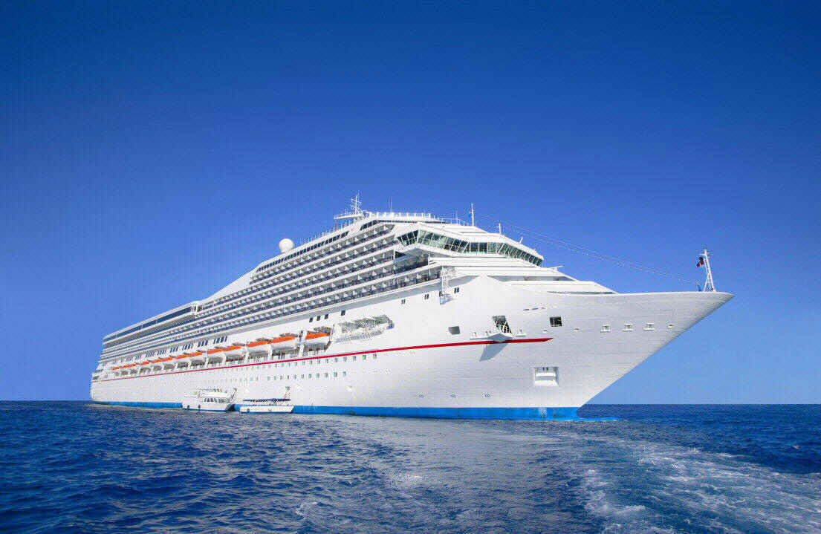
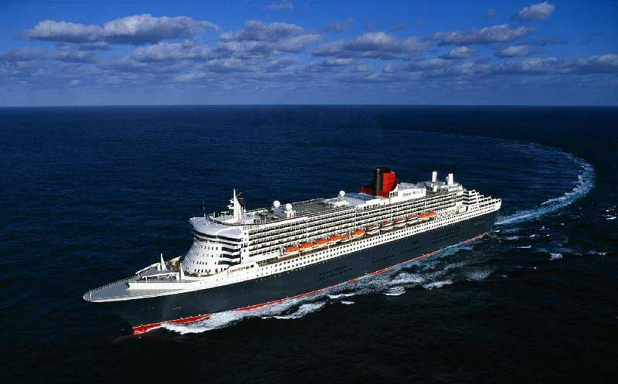
travelling by ship
Travelling by ship is also very popular now. It is very pleasant to feel the deck of the ship under the feet, to see the rise and fall of the waves, to feel the fresh sea wind blowing in the face and hear the cry of the seagulls.

Slide 7
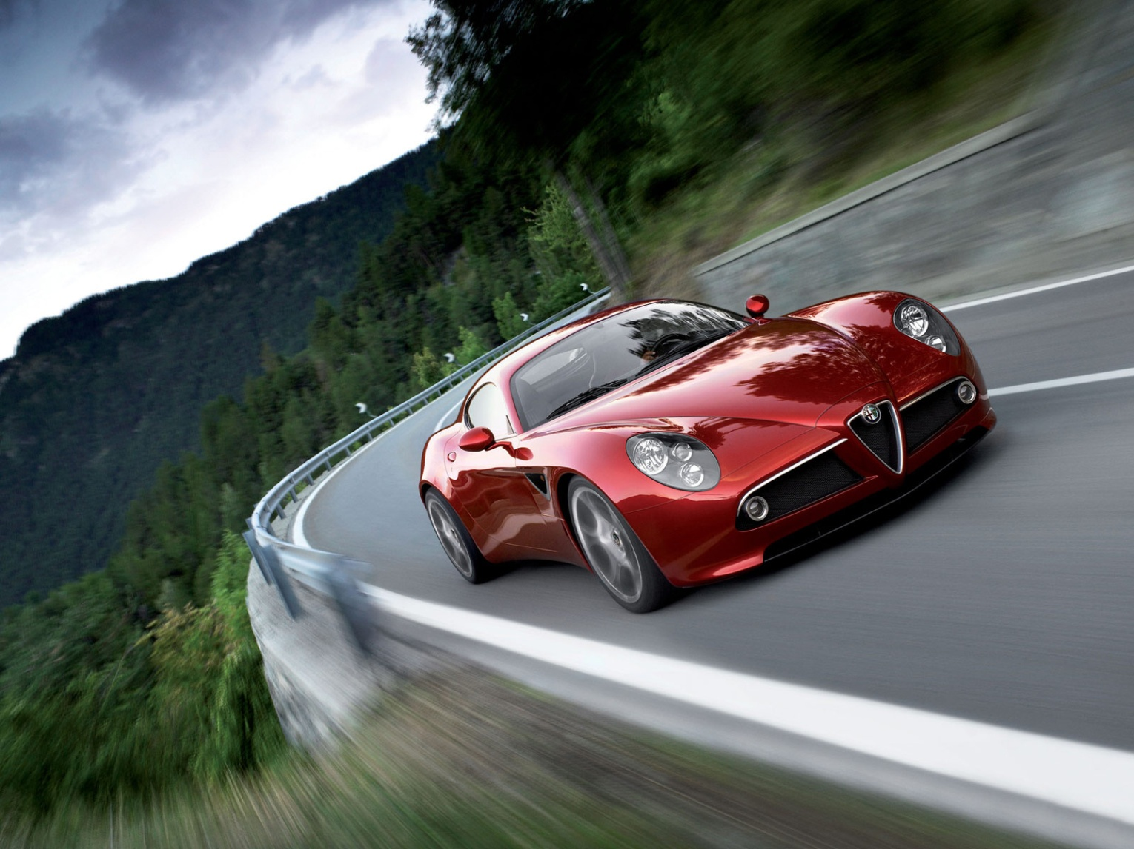
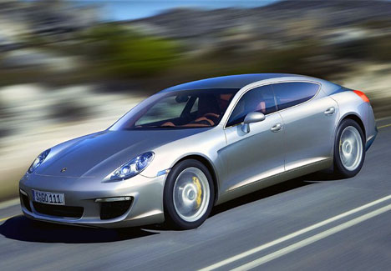
travelling by car
Many people like to traveling by car. It is interesting too, because you can see many filings in a short time, you can stop when and where you like, you do not have to buy tickets or carry your suitcases.

Slide 8
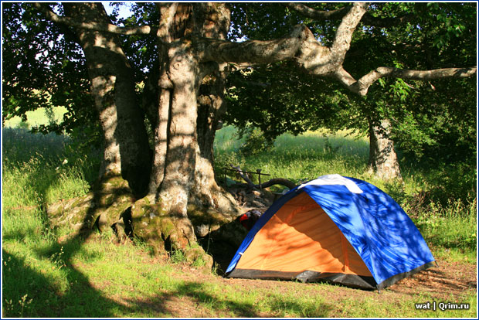
hiking and Hitch-hiking
A very popular method of travelling is hiking. It is travelling on foot. Walking tours are very interesting. Hitch-hiking is a very popular method of travelling among young people. But it is not so popular in our country as abroad.

Slide 9
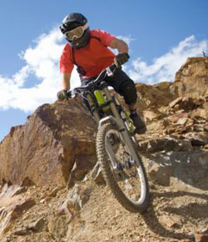
travelling by bicycle
Traveling by bicycle can be one of the most fullfilling ways to get from one place to another as it is healthy, stimulating, eco-friendly, and allows the traveler to experience more of the places that he/she travels through.

Slide 10
the end!

