Slide 1
THE MONTHS OF A YEAR.

Slide 2
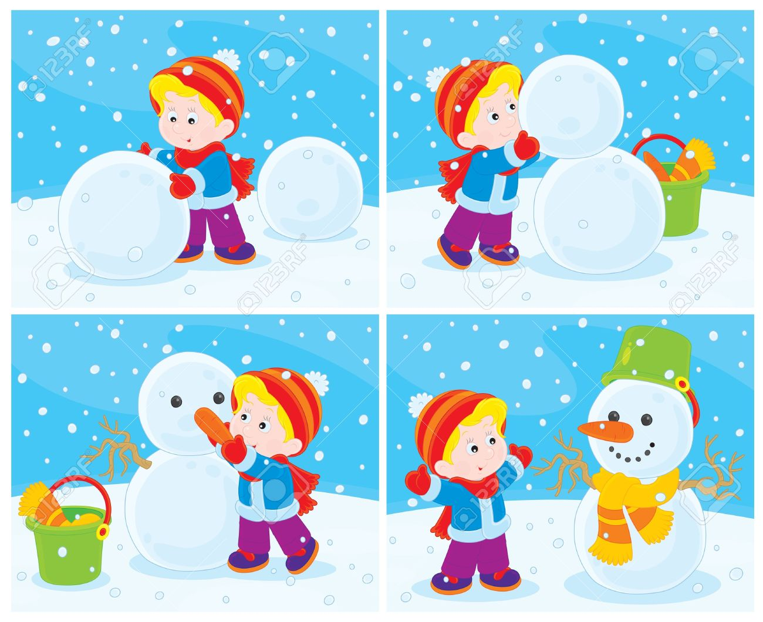
JANUARY
In January, Jack is going to make a snowman.

Slide 3
FEBRUARY
WATCH TV

Slide 4
MARCH
Ride a bike

Slide 5
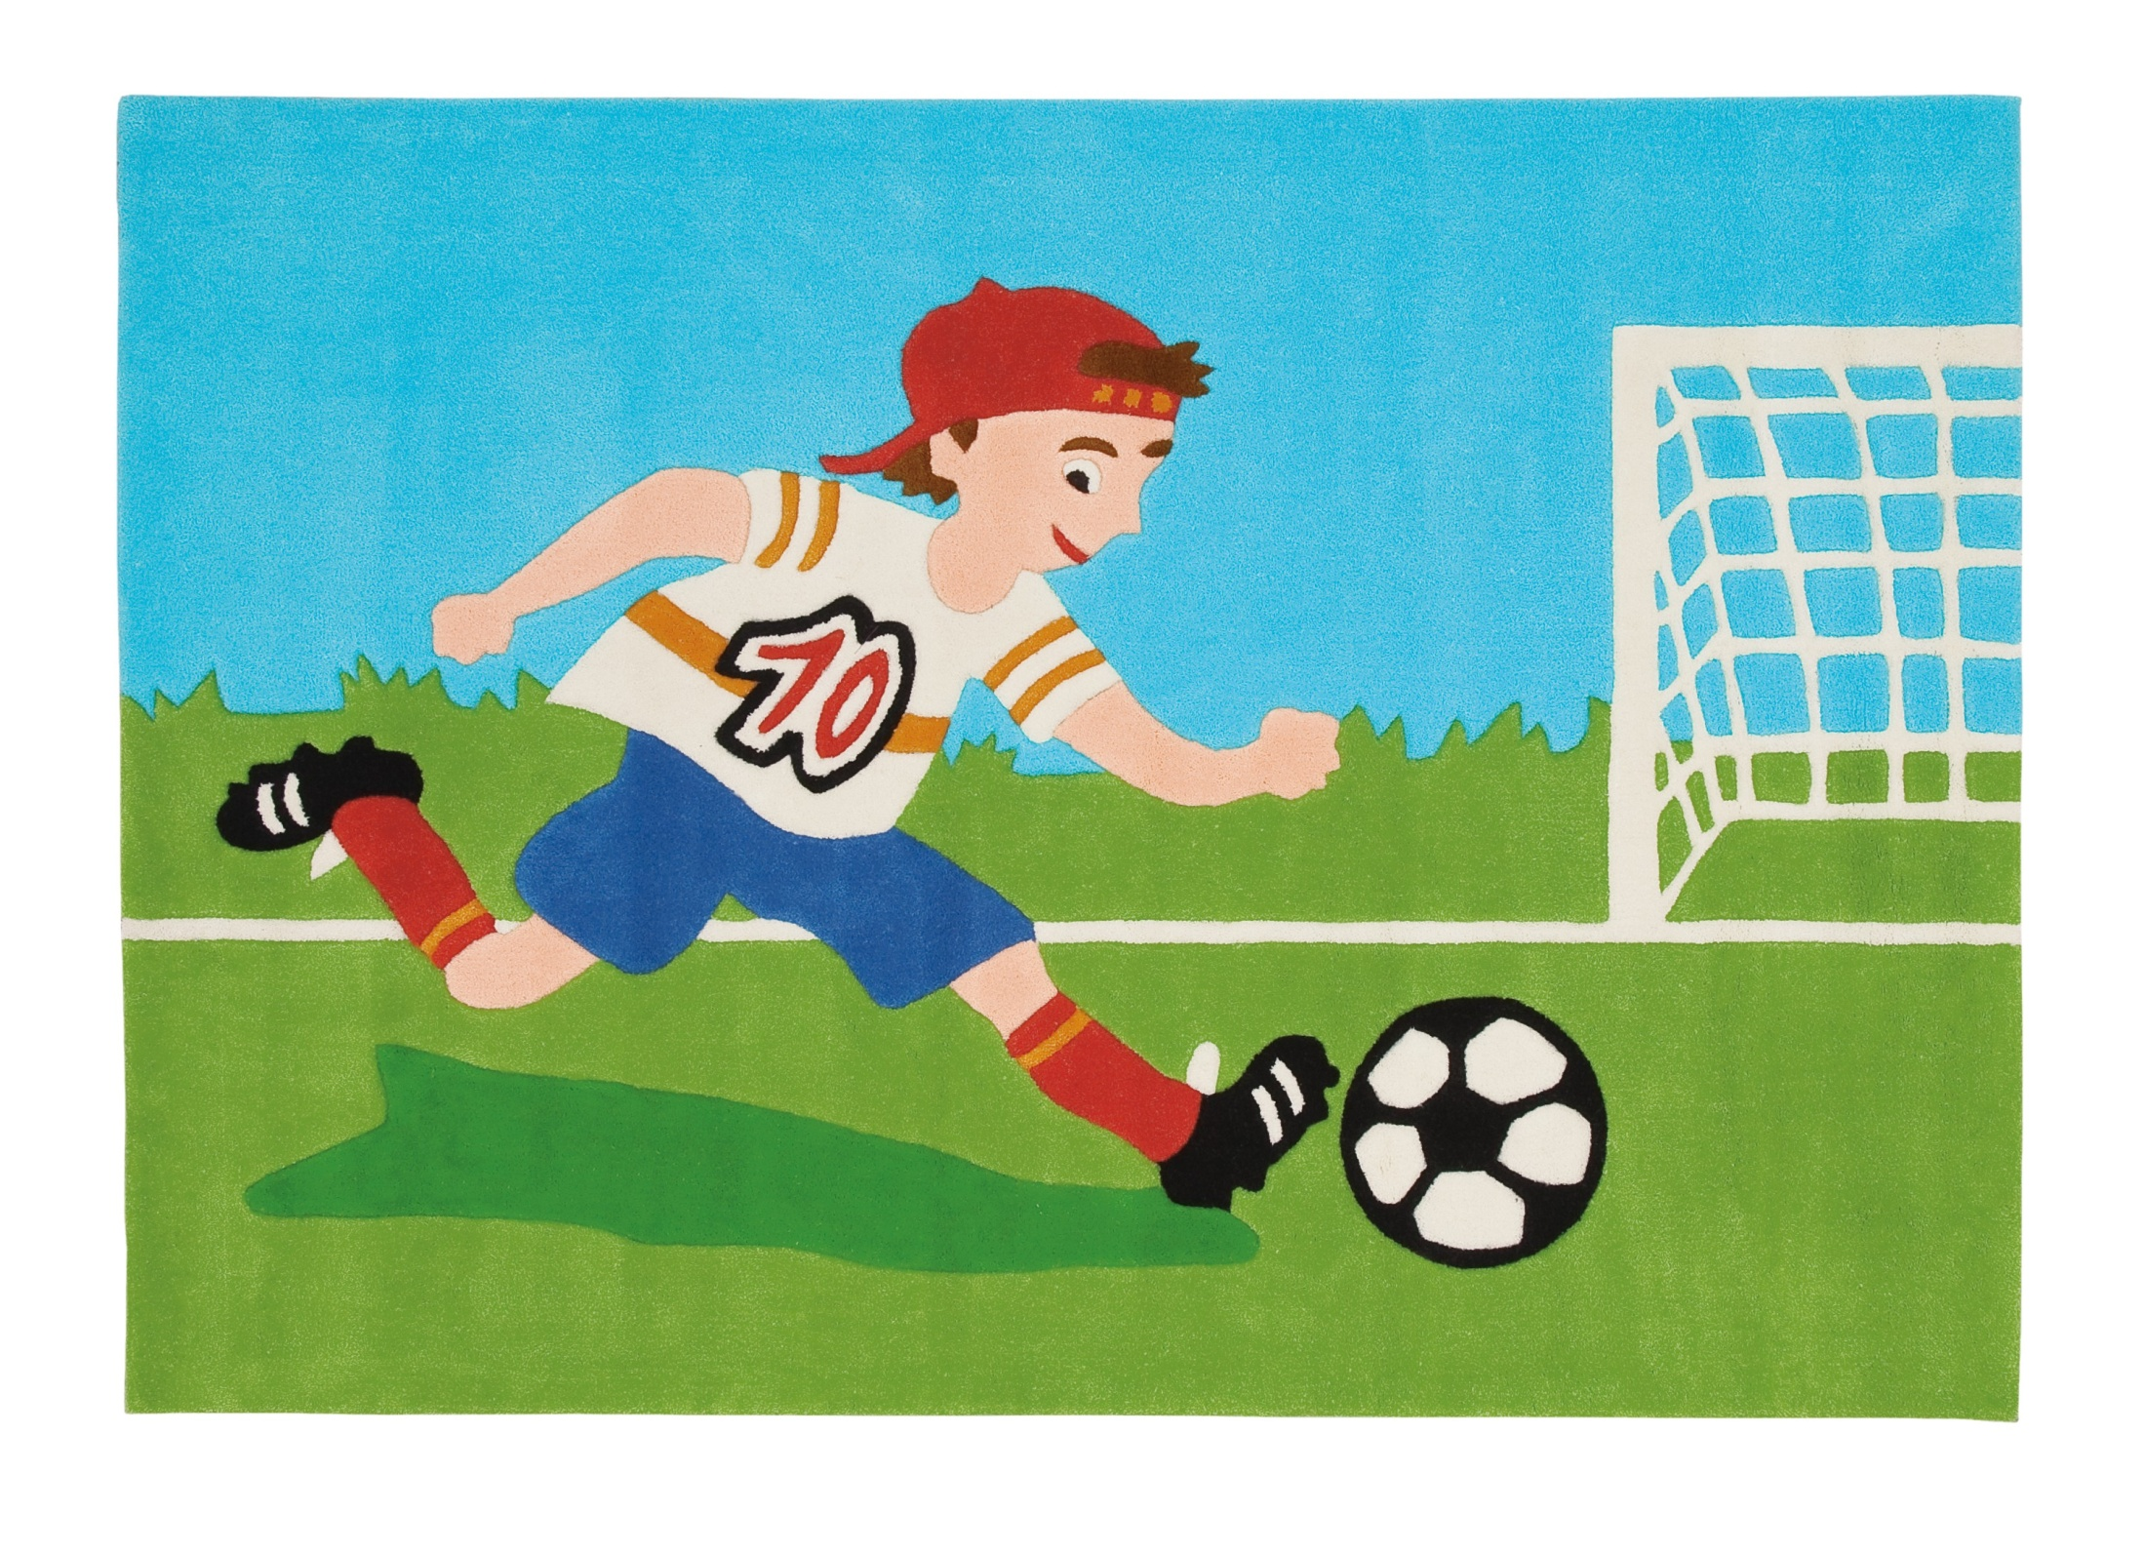
APRIL
Play football

Slide 6
MAY
Play volleyball

Slide 7
JUNE
DO homework

Slide 8
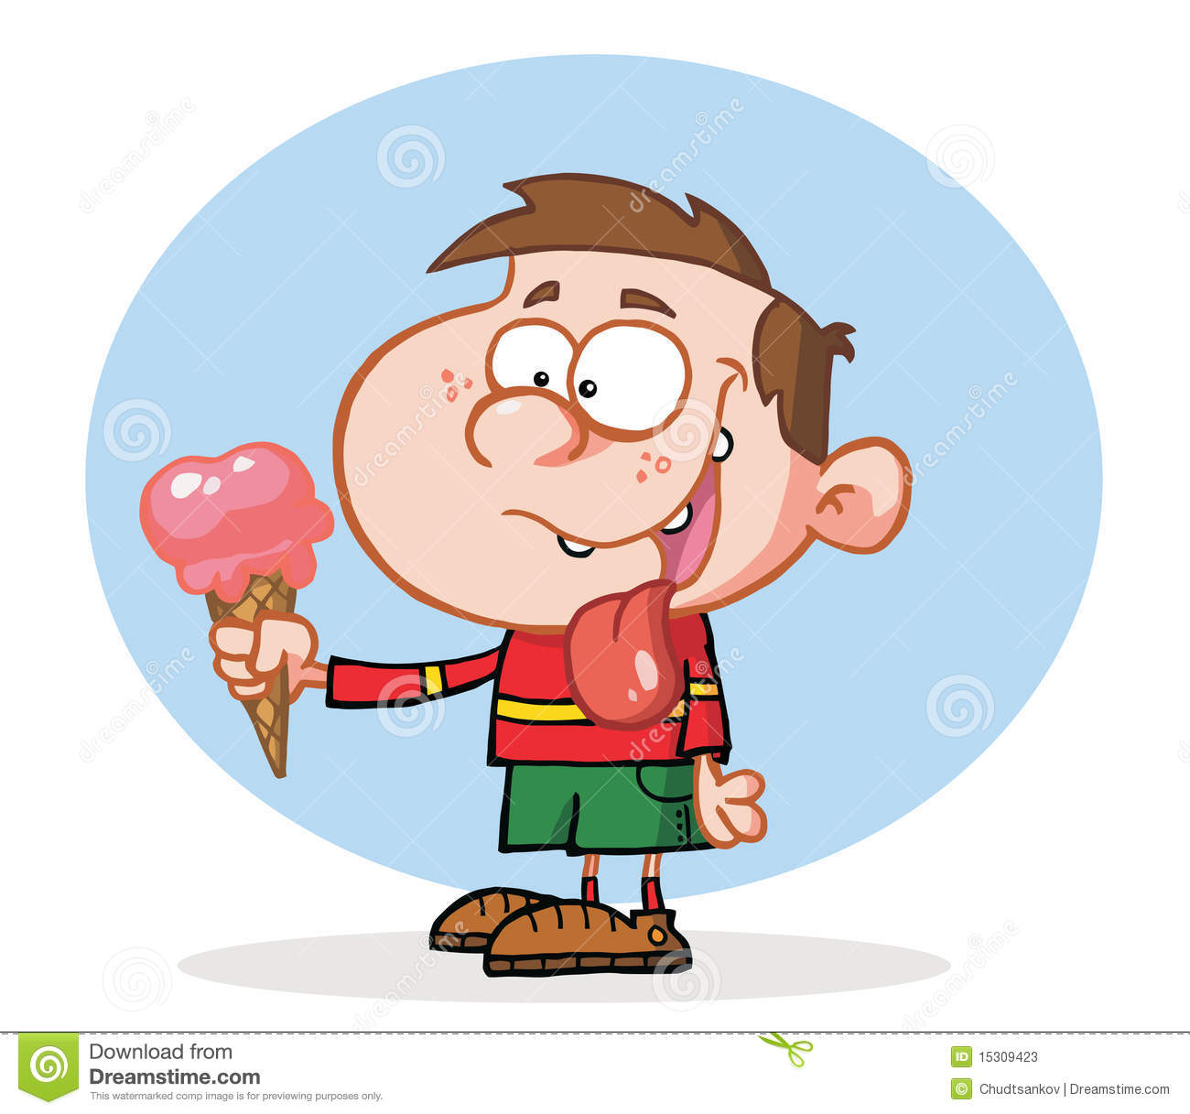
JULY
Eat ice cream

Slide 9
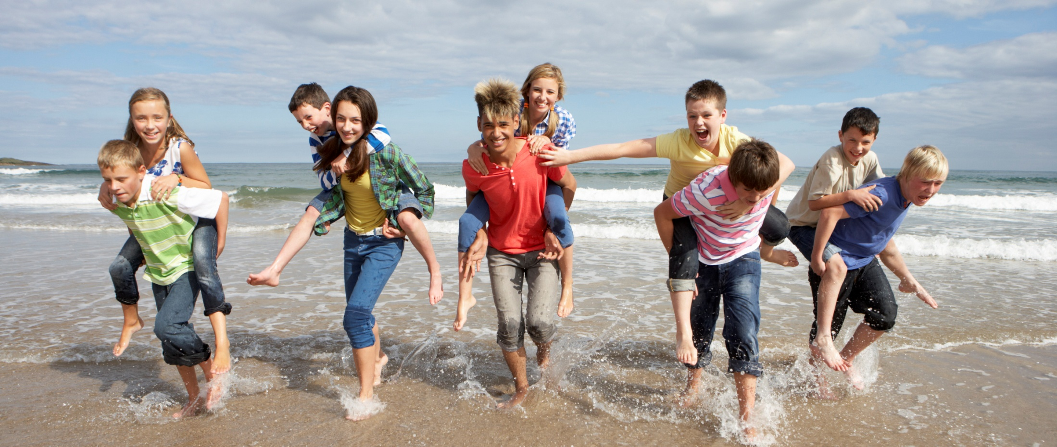
AUGUST
Go on holiday

Slide 10
SEPTEMBER
Go to school

Slide 11
OCTOBER
Play basketball

Slide 12
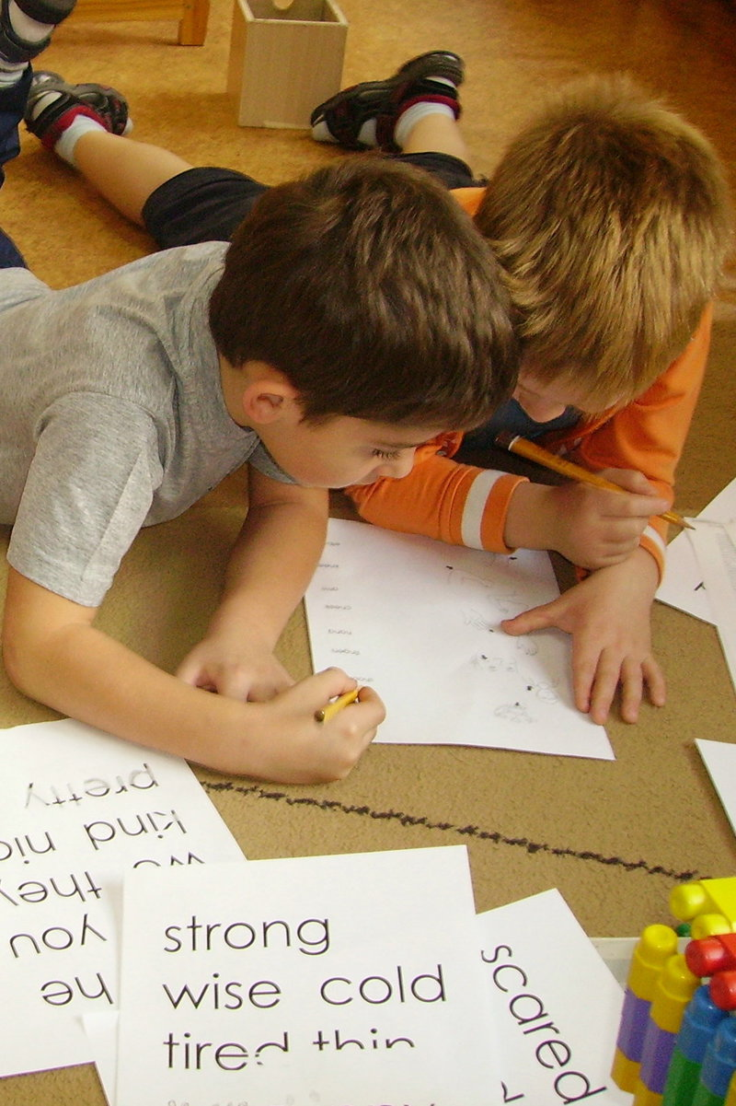
NOVEMBER
Learn English

Slide 13
DECEMBER
Go skiing

