Slide 1
Animals Of Russia

Slide 2
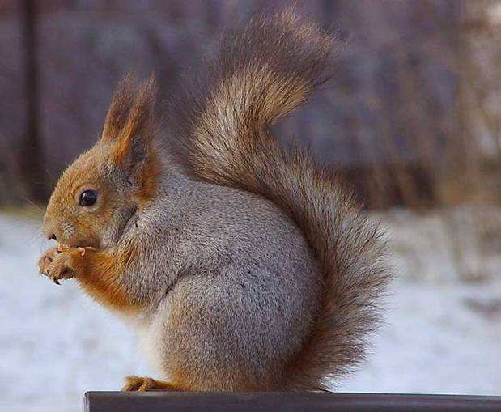
squirrel

Slide 3
squirrel
This is small animal with an elongated slender body and bushy tail. The length of her body 19,5-28 cm, tail - 13-19 cm, weight 250-340 g
The head is rounded, with large black eyes. The ears are long, with brushes, particularly pronounced in the winter. Hind legs longer than the front. It changes its summer coat on winter.

Slide 4
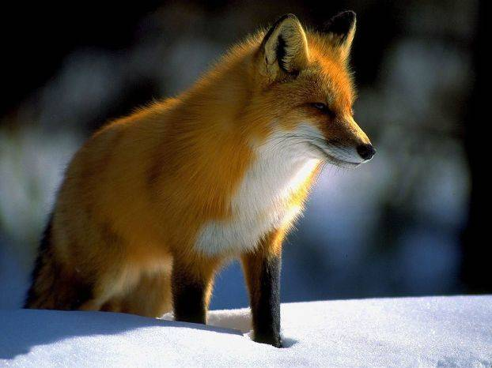
fox

Slide 5
fox
Fox-largest carnivorous mammal canine, the most common and most species of the genus foxes. The body length of 60-90 cm, tail - 40-60 cm, weight - 6.10 kg.

Slide 6
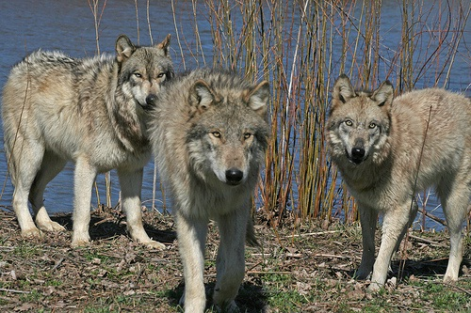
wolf

Slide 7
wolf
Wolf-view carnivorous mammals of the family dogs. Along with the coyote and jackal is a small genus of wolves. Furthermore, as the resultsstudy of the DNA sequence and genetic drift is a direct ancestor of the domestic dog, which is usually regarded as a subspecies of wolf .Volk - one of the largestmodern animals in his family: his body length (excluding tail) can reach 160 cm, tail length - 52 cm, height at the withers - 90 cm; body weight canas high as 80 pounds.

Slide 8
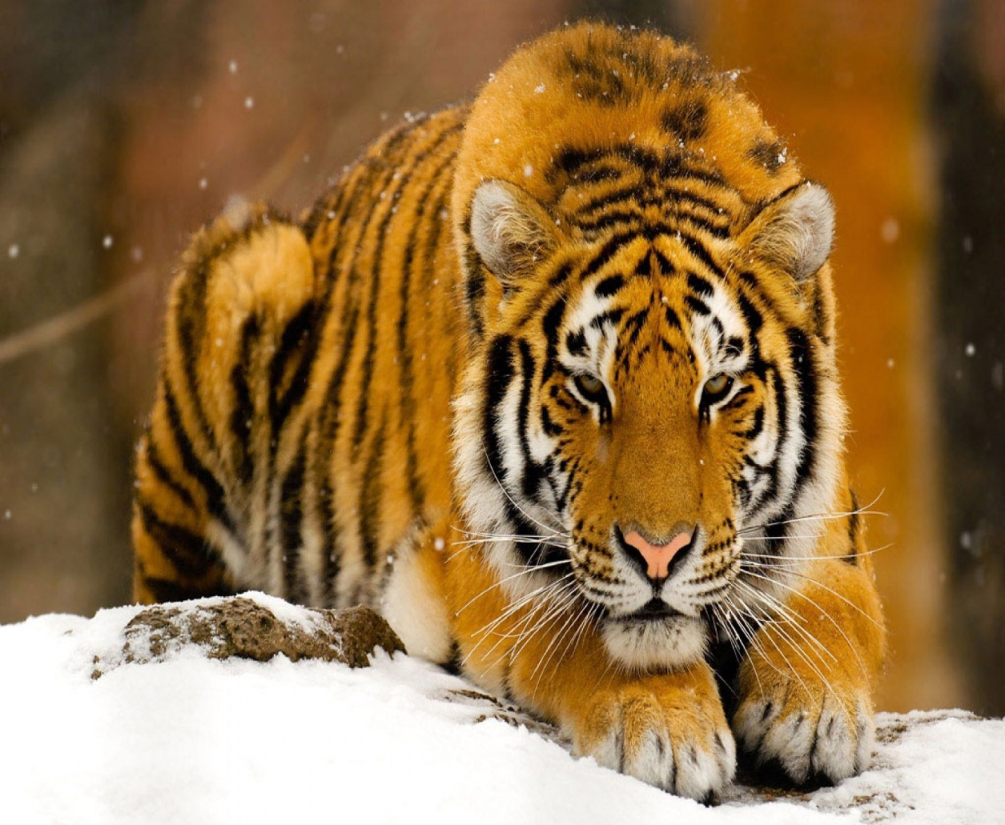
Amur Tiger

Slide 9
Amur Tiger
The body length in male Siberian tiger to the tip of the tail reaches 2,7-3,8 m, females less. Height at the withers to 115 cm, weight 160-270 kg. The greatest weight of individuals of the Amur tiger living in the wild, does not exceed 250 kg. Normal adult male weighs 180-200 kg when height at withers in the 90-106 cm [3]. The largest Siberian tiger had a body length of 317 cm, 114 cm tail.

Slide 10
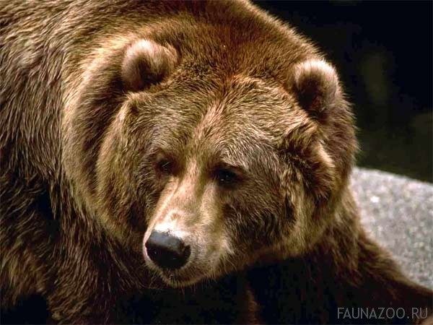
Bear

Slide 11
Bear
Brown Bear forms several subspecies (geographic races), which vary in size and color. The smallest specimens are found in Europe, the largest - in Alaska and Kamchatka - they weigh 500 kg or more; across giants weighing 700-1000 kg. The maximum recorded weight of male Kamchatka bear was 600 kg, average - 350-450 kg. There is evidence that in the autumn weight of large-Kamchatka individuals exceed 700 kg. The largest bear, caught on Kodiak Island to Berlin Zoo, weighed 1134 kg. European brown bear length typically 1.2-2 m and a height at withers of about 1 m and a weight of 300 to 400 kg; Grizzly much larger -some individuals, standing on his hind legs, reaching growth of 2.8-3 m; bears living in central Russia, weigh 400-600 kg. Adult males, on average, 1.6 times larger than females.

Slide 12
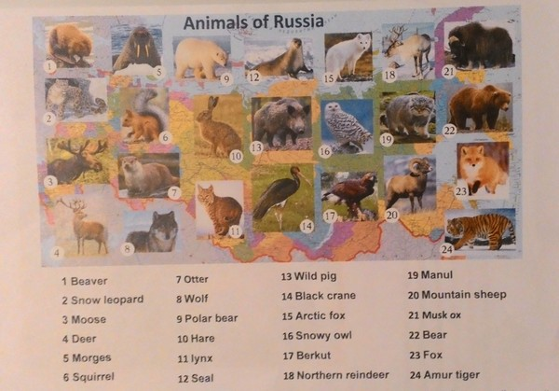

Slide 15
Home work ex.5 p. 98-99

