Slide 1
Today is the …^{th} of April

Slide 2
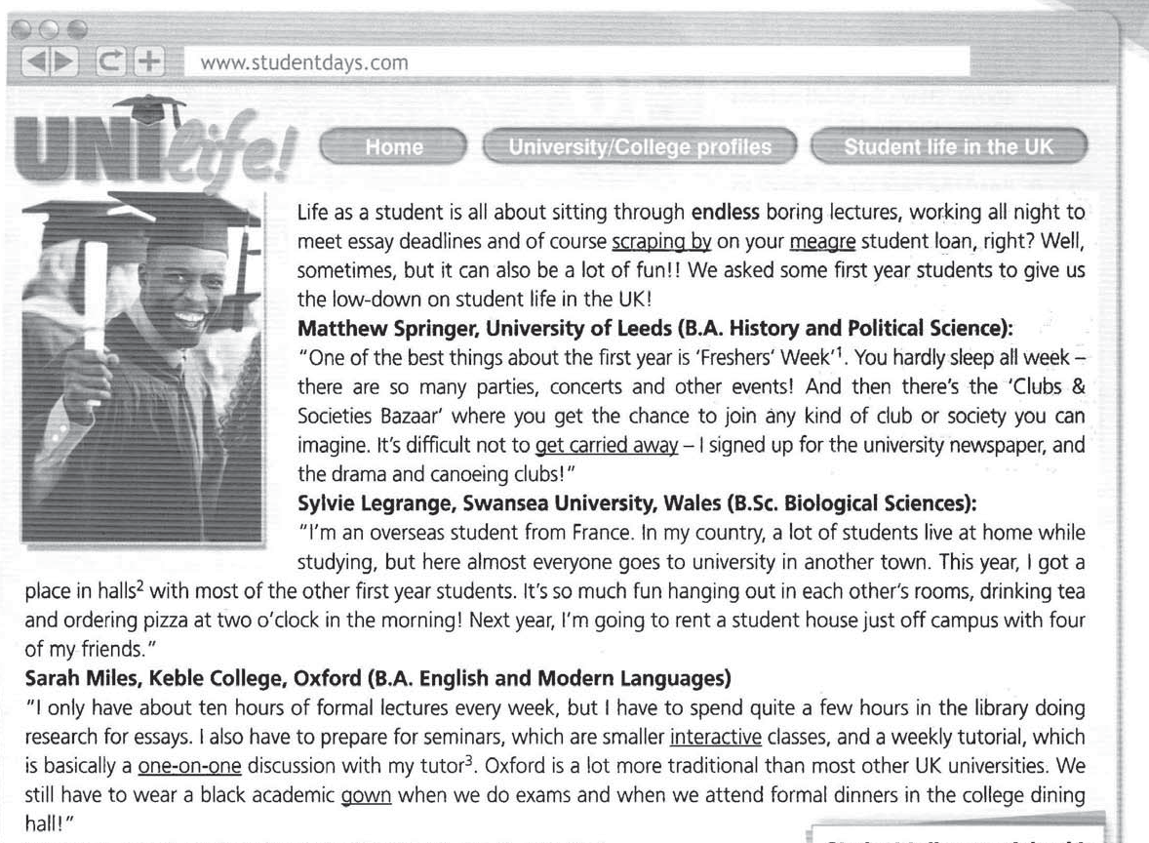
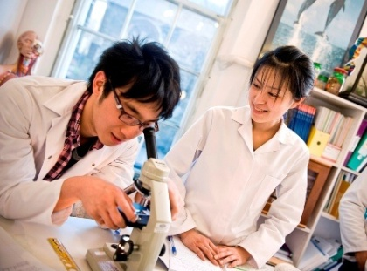
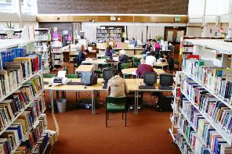
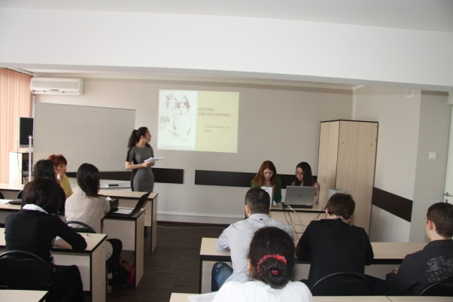
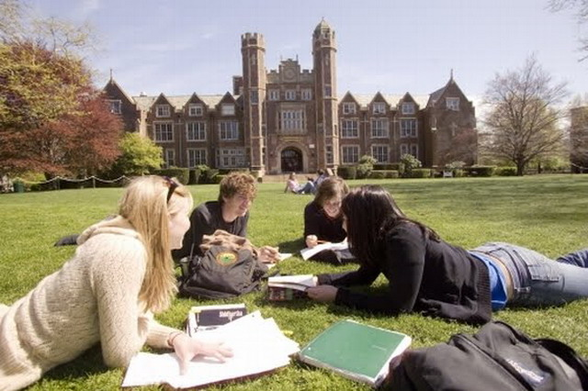

Slide 3
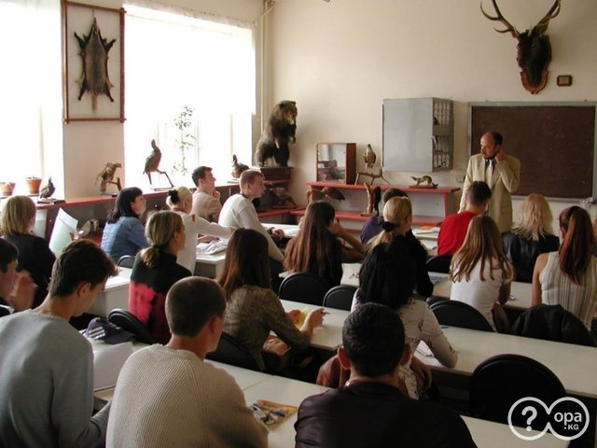
Uni Life
"Education is a progressive
discovery of our own ignorance."

Slide 4
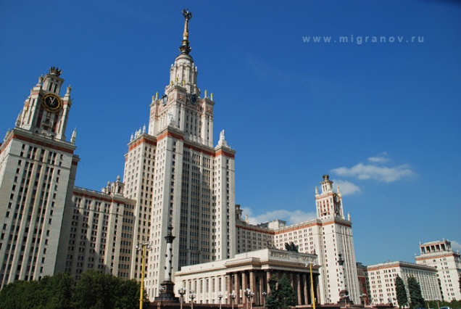
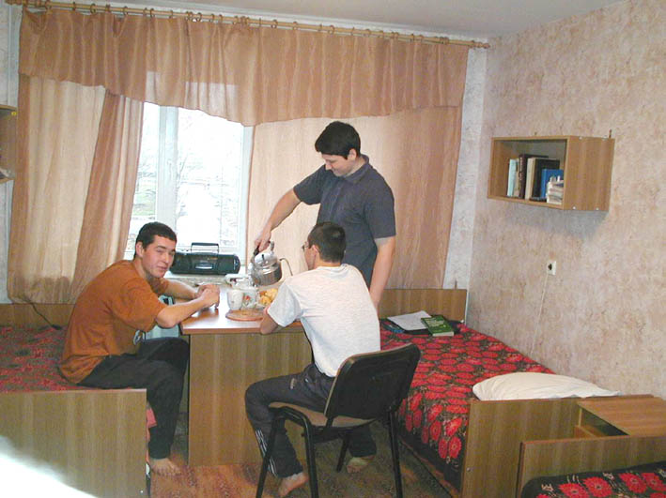
Choosing a university

Slide 5
Choosing a university
City/place accommodation free time activities
teachers

Slide 6
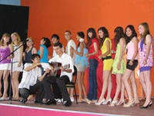
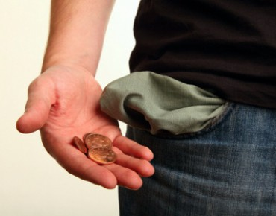
Listening
Which student(s) mention(s):
- getting involved in
organized activities?
- lack of money?

Slide 7
Listening
Which student(s) mention(s):
- getting involved in
organized activities?
- lack of money?

Slide 8
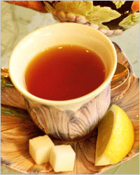
Reading
Which student(s) mention(s)
- a special dress code? - a nighttime snack?
- self-study?

Slide 9
Reading
Find all words in the text related to the headings
Places | Lessons | Accommodation | Teachers | After-school activities

Slide 10
Reading
Find all words in the text related to the headings
Places | Lessons | Accommodation | Teachers | After-school activities
campus, Student Union, library, college dining hall | lectures, essay deadlines, private research, seminars, tutorial | halls, student house | tutor | university newspaper, drama club, canoeing club, parties, concerts, hanging out, formal dinners, social life, band, theme night

Slide 11
Speaking
Imagine you are studying at Oxford University. Use the words to talk about university life.
Places | Lessons | Accommodation | Teachers | After-school activities
campus, Student Union, library, college dining hall | lectures, essay deadlines, private research, seminars, tutorial | halls, student house | tutor | university newspaper, drama club, canoeing club, parties, concerts, hanging out, formal dinners, social life, band, theme night

Slide 12
Hometask
Think of the most prestigious university in our country. Write a short article about it. Include:
were students live;
academic life;
social life.

