Slide 1
TRANSPORT
the activity or process
of moving things or
people from one
place to another

Slide 2
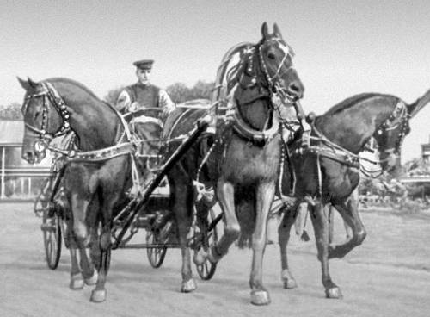
Early humans dreamed of going faster and further than they could on foot. For many centuries the fastest and most popular means of transport was the horse, which can run at about fifty-five kilometers an hour.

Slide 3
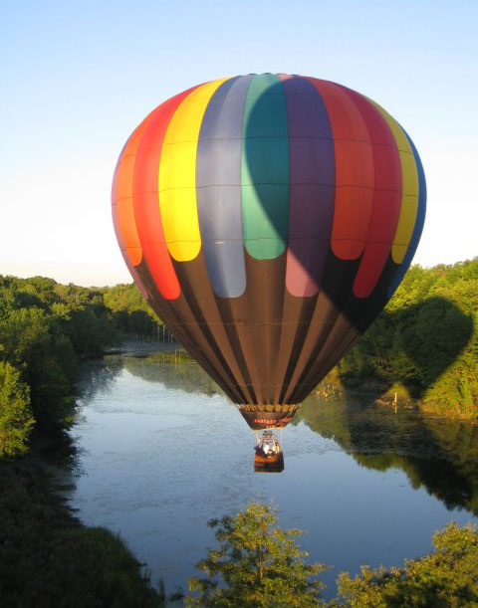
Hot-air balloon
At the end of eighteenth
century the hot-air balloon
began to develop. It made
the first free flight in 1783.
Two Frenchmen, the
Montgolfier brothers, had
the idea for the balloon. A
fire heated the air, making
the balloon rise.

Slide 4
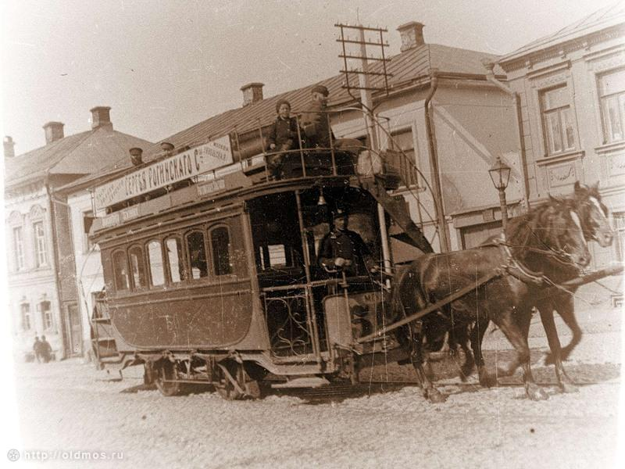
The railway developed gradually from carts on tracks. The first vehicle with an engine to run on tracks was developed in 1803 by an Englishman, Richard Trevithick.
Carts on tracks

Slide 5
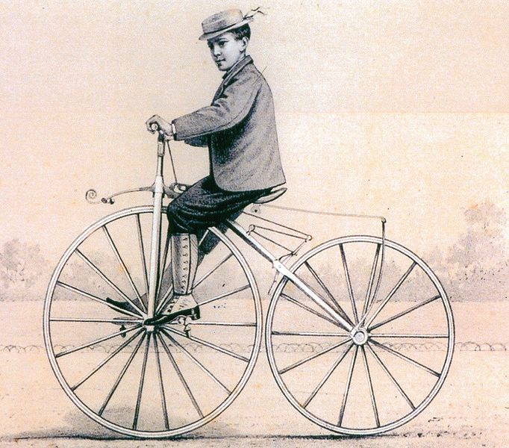
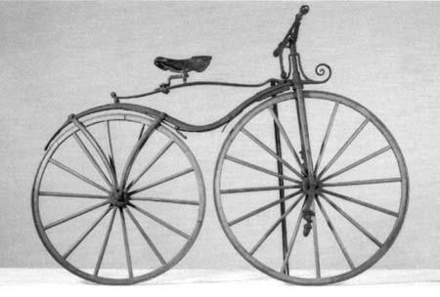
Bicycle
In 1840 a Scotsman, Kirkpatrick McMillan, created the first bicycle with pedals. It took around 140 years for McMillan`s design to develop into modern mountain bikes.

Slide 6
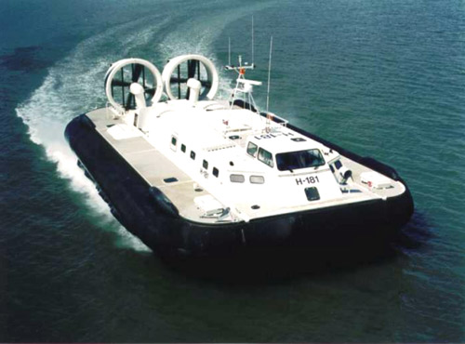
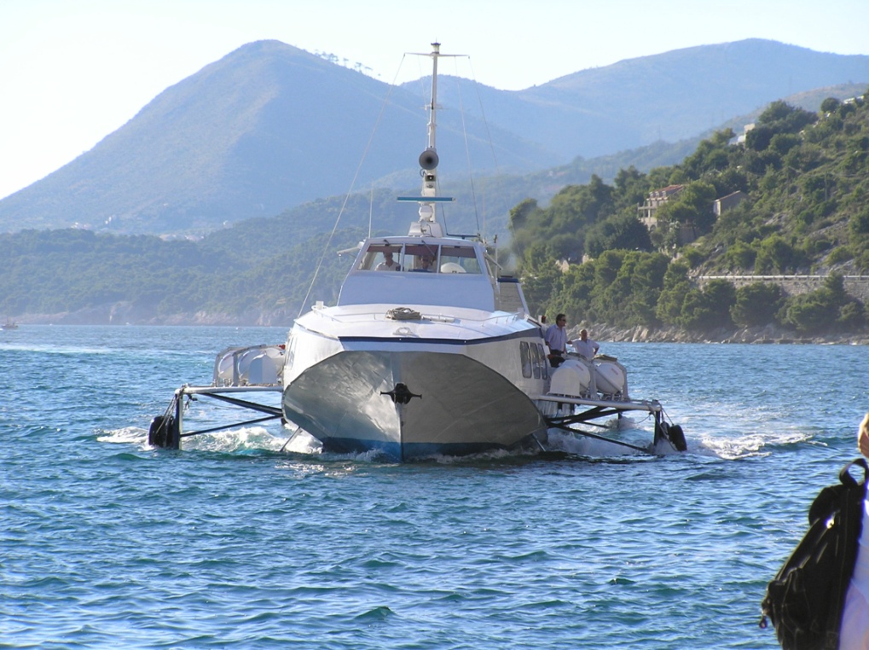
The twentieth century saw the development of many other means of transport, including the hydrofoil and the hovercraft.

Slide 7
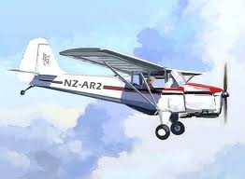
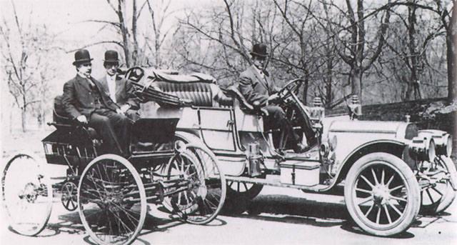
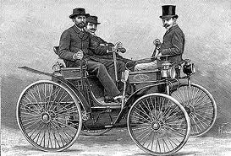
Cars
The petrol- driven car (invented in 1885 in Germany) completely changes the way people thought about transport. And so did the aeroplane.

Slide 8
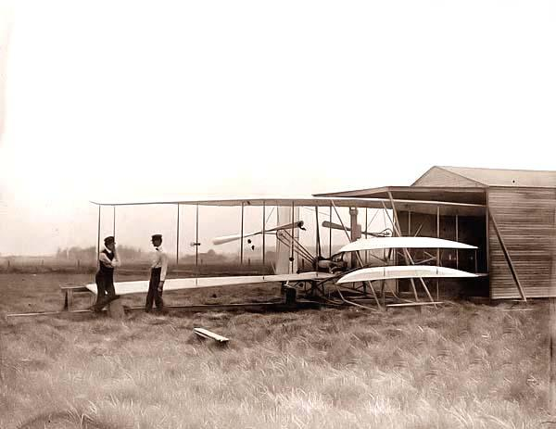
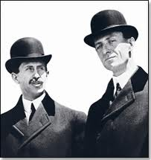
Flying
People have always dreamed of flying. One day, in 1903, that dream became a reality. Two American brothers, Wilbur and Oliver Wright, managed to make a short flight in their aircraft, the Flyer.

Slide 9
Home Task Переписать и перевести слайды Упр. 8 стр.179

