Slide 1
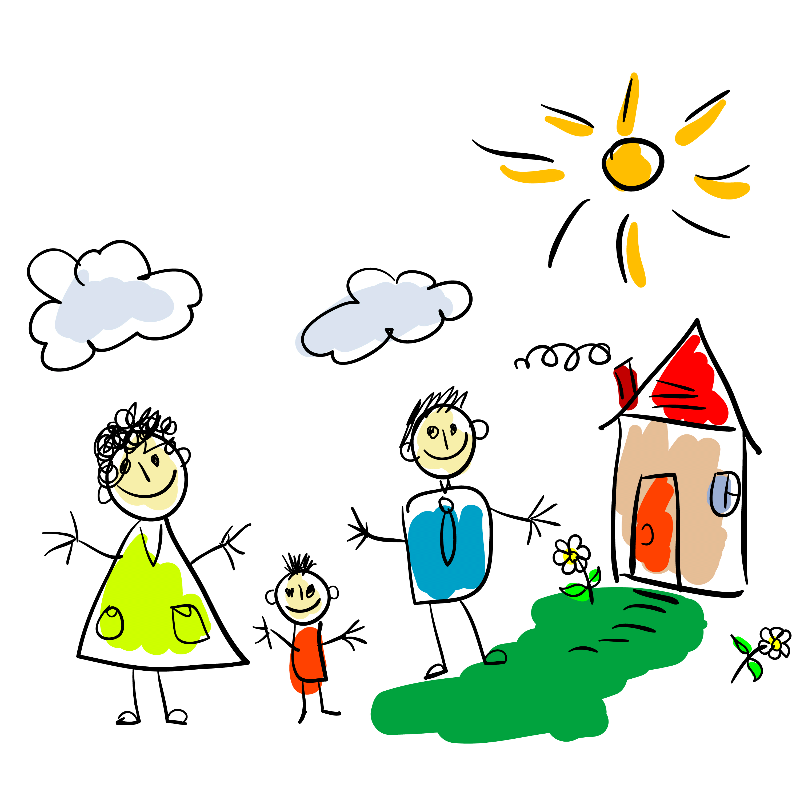
LAND
FATHER
HOME
MOTHER

Slide 2
HOMELAND
FATHERLAND
MOTHERLAND
РОДИНА

Slide 3
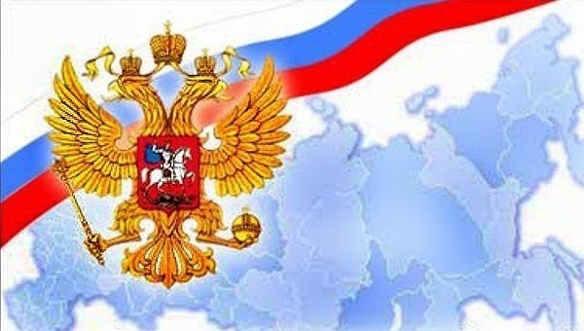
Russia/the Russian Federation

Slide 4
beauty
visitor
climate
territory
tourist
riches
size
large
warm
low
deep
fresh
long
extend

Slide 5
THE PACIFIC OCEAN
THE ARCTIC OCEAN
THE CAUCASUS MOUNTAINS
THE BLACK SEA
THE URAL MOUNTAINS (THE URALS)
SIBERIA
THE FAR EAST
LAKE BAIKAL

Slide 6
A TRIP AROUND RUSSIA

Slide 7
THE SIZE OF THE COUNTRY
WHERE DOES OUR COUNTRY EXTEND TO IN THE EAST?
WHERE DOEST OUR COUNTRY EXTEND TO IN THE NORTH?
WHERE DOES OUR COUNTRY EXTEND TO IN THE SOUTH?
WHAT TERRITORY IS BEHIND THE URALS?

Slide 8
WHAT TERRITORY IS NEAR THE PACIFIC OCEAN?
HOW LONG DOES IT TAKE TO GET FROM THE EAST TO THE WEST OF THE COUNTRY BY PLANE?
IS RUSSIA THE LARGEST COUNTRY IN THE WORLD?

Slide 9
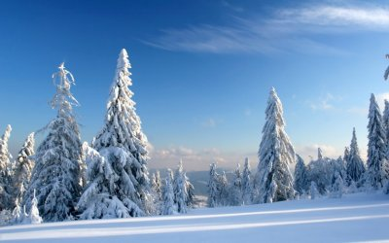
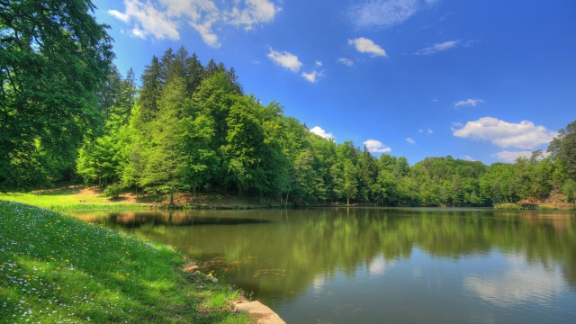
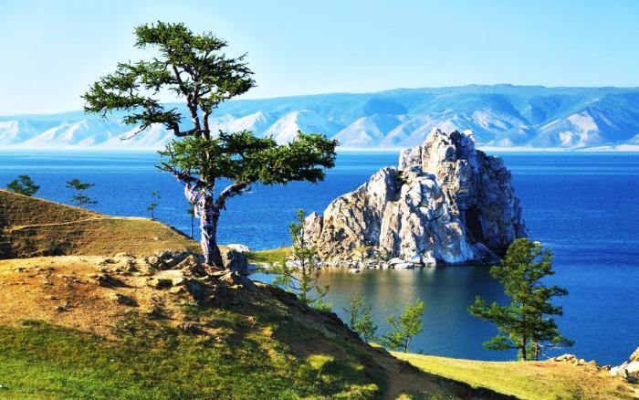
THE CLIMATE AND THE RICHES OF OUR COUNTRY

Slide 10
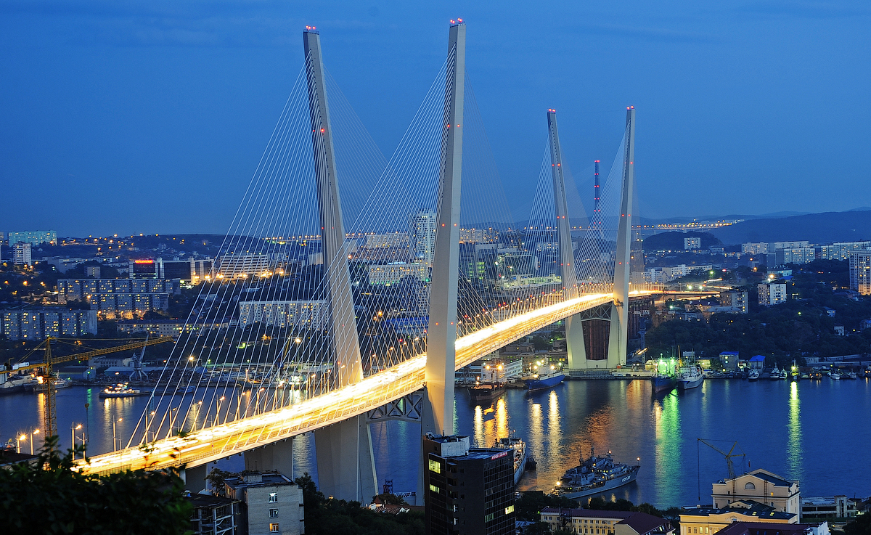
VLADIVOSTOK

Slide 11
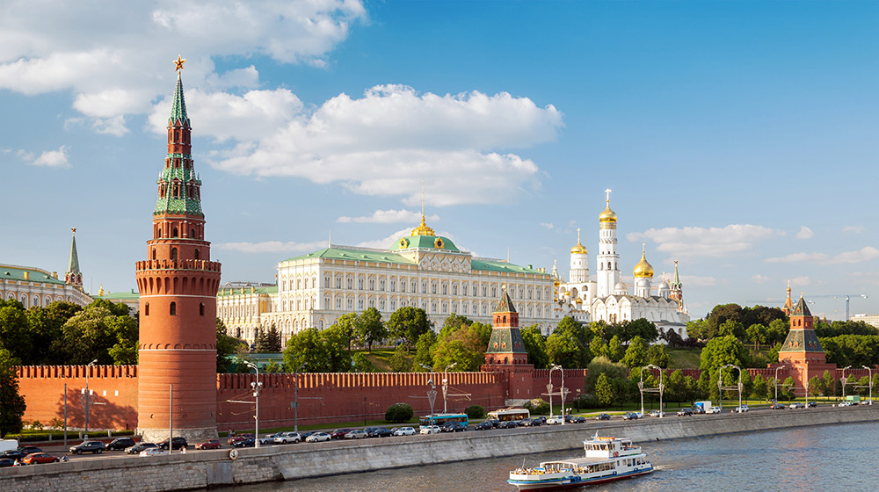
MOSCOW

Slide 12
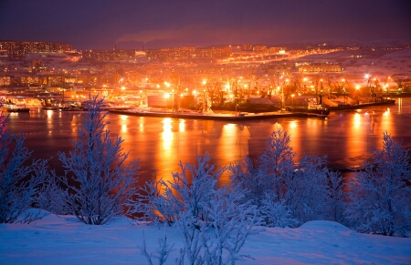
MURMANSK

Slide 13
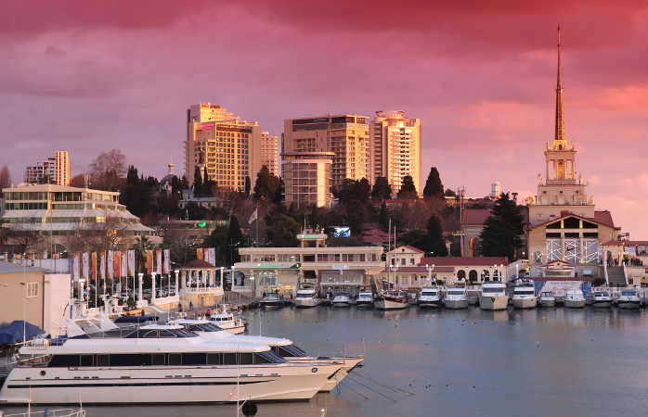
SOCHI

Slide 14
Home work Ex.6 p.98-99

