Slide 1
«In Harmony with Nature» Wonders of nature!

Slide 2
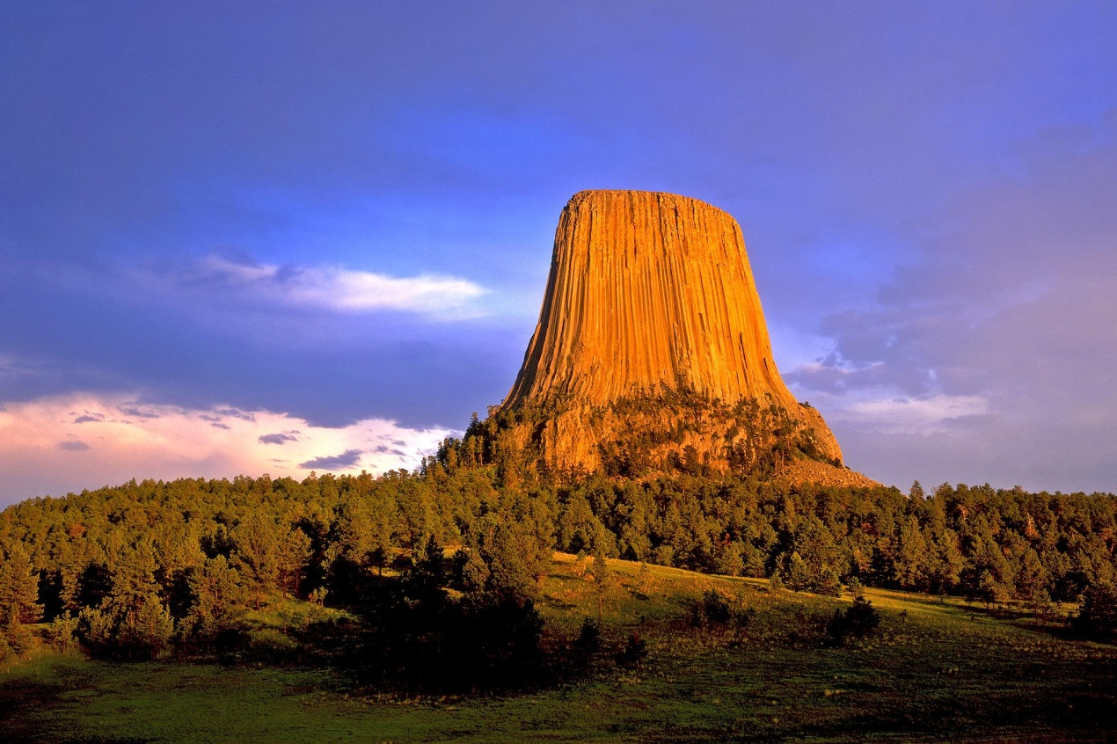
Devil’s tower
In the United States, in the state of Wyoming in the heart of the Great plains, there is a mysterious tower called Devil's Tower, over the origin of which scientists still argue. In addition, this natural monument is striking in its size, its relief is no less mysterious.

Slide 3
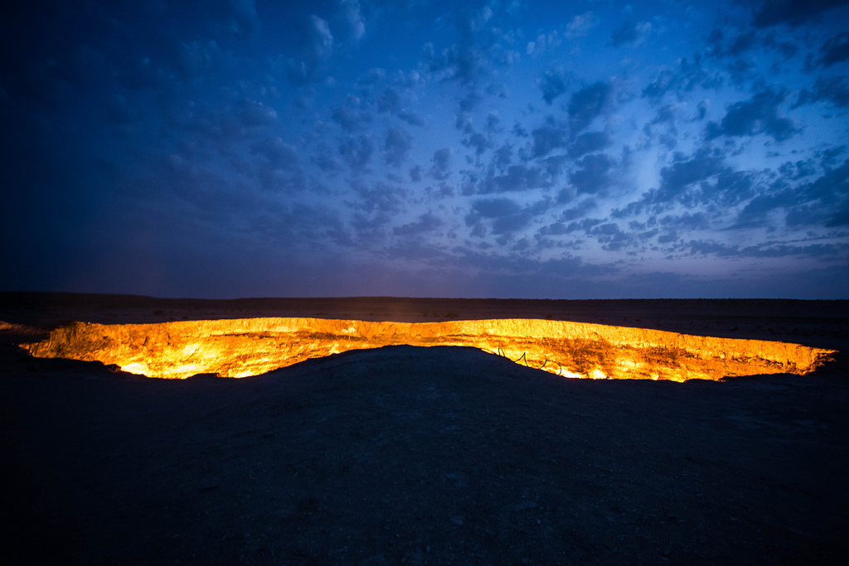
Gates of hell
Another mystical natural wonder is located on the territory of Turkmenistan in the Kara-Kum desert. This is a truly exciting and terrifying sight! In the middle of a flat desert a huge hole spewing flames! This phenomenon appeared relatively recently, it is about 40 years old.

Slide 4
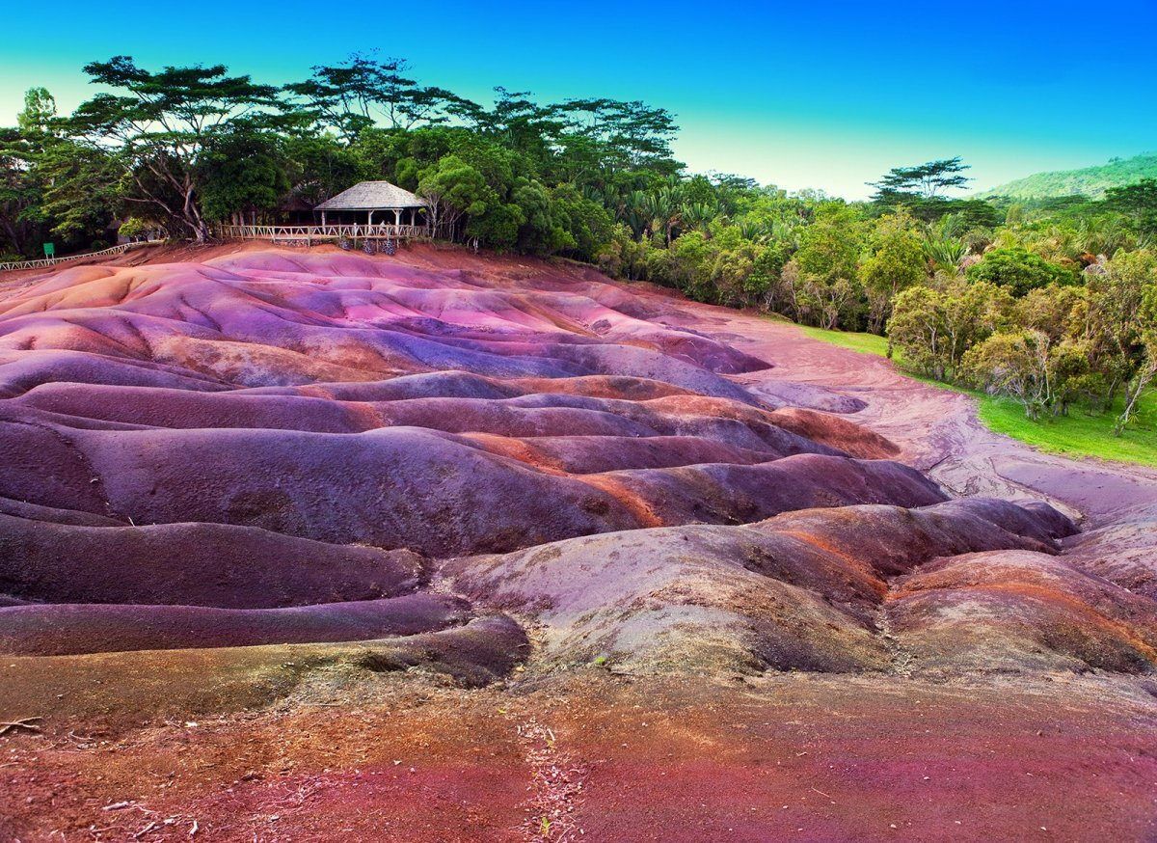
The seven coloured earth Chamarel
On the island of Mauritius, near the village of Charmel, there are colorful sand dunes, looking at which it is difficult to believe that they were created by nature without human intervention. It is still a mystery how the Sands of the seven colors manage to create various bizarre patterns, while maintaining the mandatory condition-not to mix with each other.

Slide 5
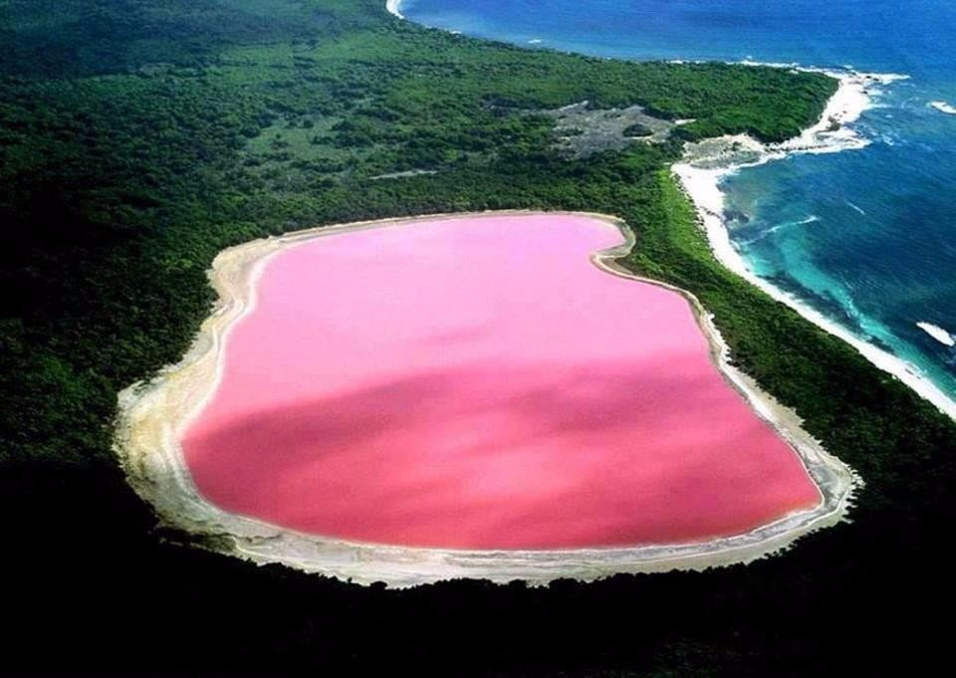
Hiller Lake
The pink pearl of Australia – this lake is beautiful! It is located on Middle island, near the Western coast of Australia. Framed by white openwork crystals of white salt, the lake resembles a large gem. Until now, scientists can not solve the mystery of this lake – why it has such an unusual pink color?

Slide 6
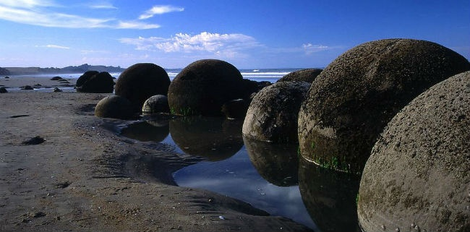
Balls of the gods
More than one scientist has puzzled over the mystery of the origin of these balls. What versions were not put forward! Perhaps these are fossilized dinosaur eggs, the impact of glaciers, geological formations, man-made creations of our ancestors, the creation of aliens. This natural wonder can be found in China, Brazil, Israel, Romania, Kazakhstan, and even in Russia.

Slide 7
That's it... Thank you for your attention and take care of nature!

