Slide 1
“Travel is the only thing you buy that makes you richer”
"Путешествие - это единственная вещь, отдавая деньги за которую, вы становитесь богаче"

Slide 2
I like to ride in a bright red tram
On a fine and sunny day
And hear it going clang, clang, clang
When someone is in the way
I like to ride in a railway train
Through tunnels dark and wide
Over the bridges crossing the river
I feel so safe inside.

Slide 3
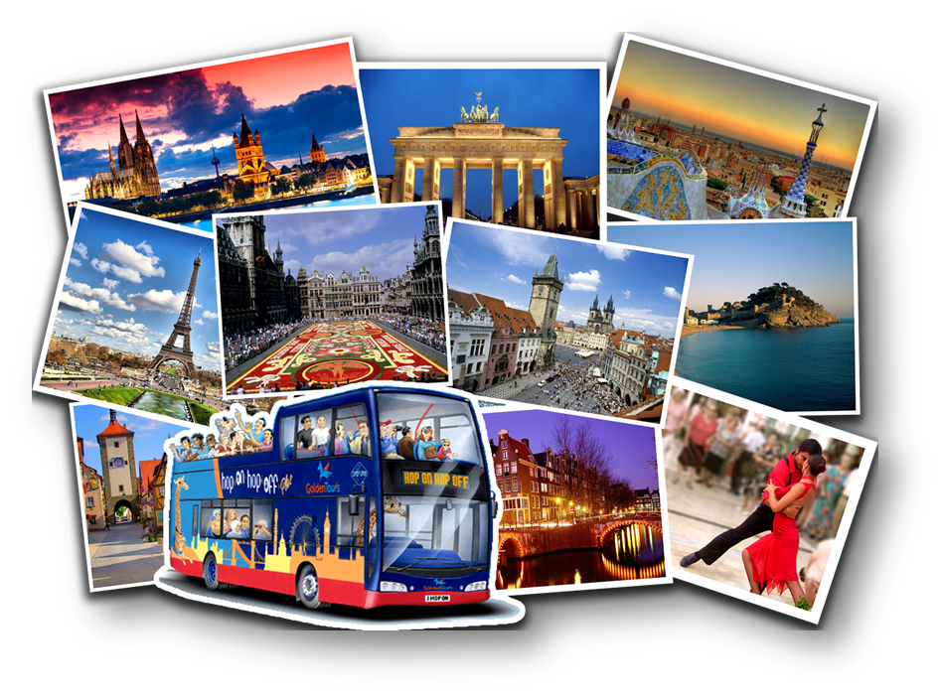
TRAVELLING and MEANS OF TRAVELLING

Slide 4
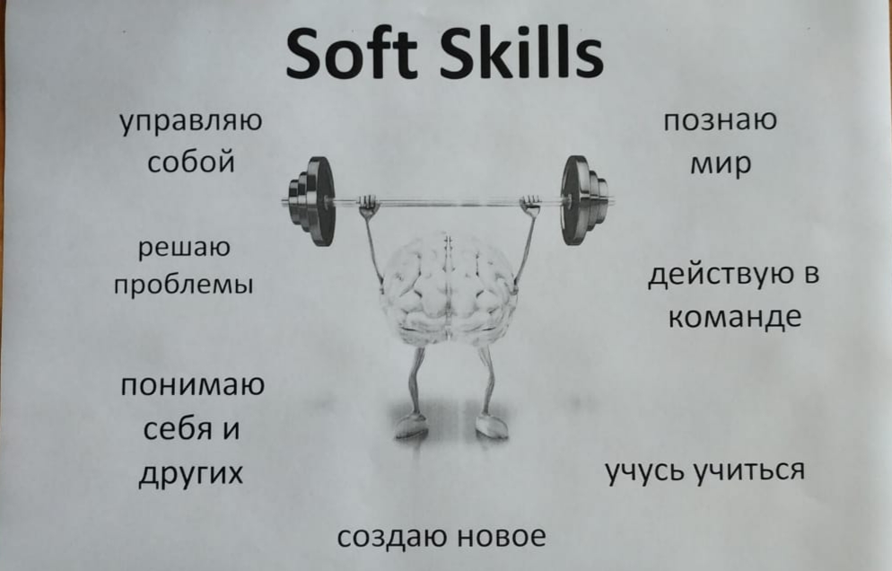

Slide 5
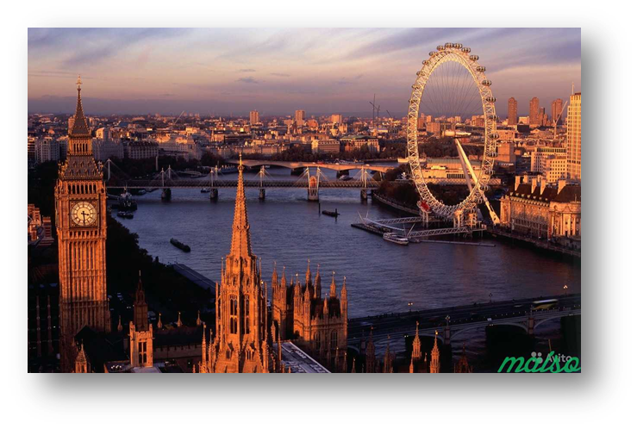
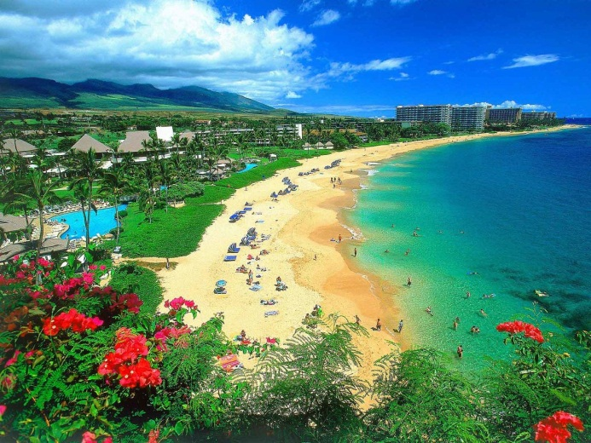
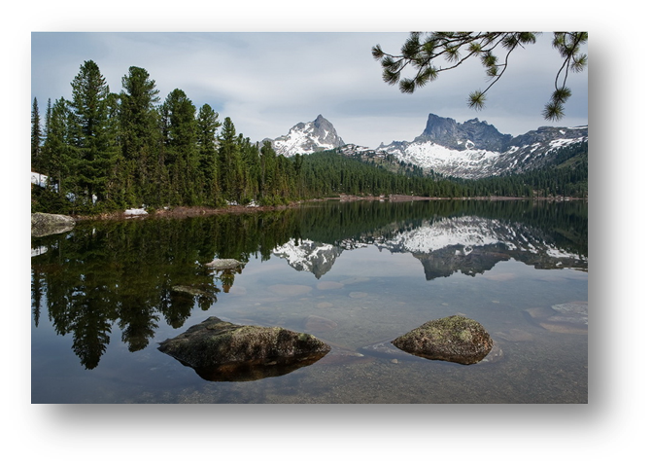
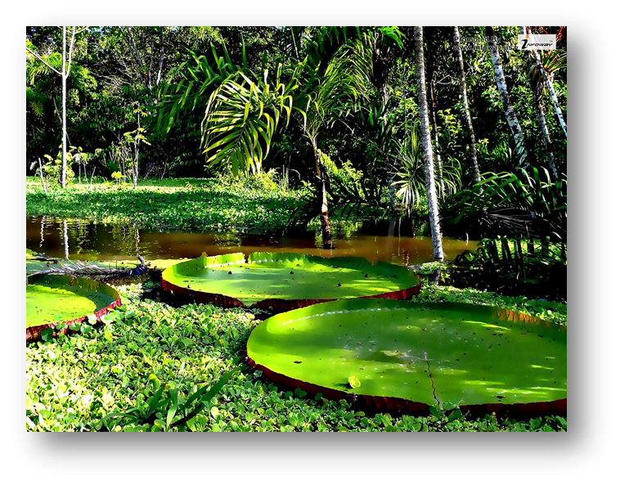

Slide 6
1.What would (wouldn't) you be able to do?
2.What it would look like?
3.What would the weather be like?
4.Would you have a good time?
5.What would you eat and drink?
6.What would people look like?

Slide 7
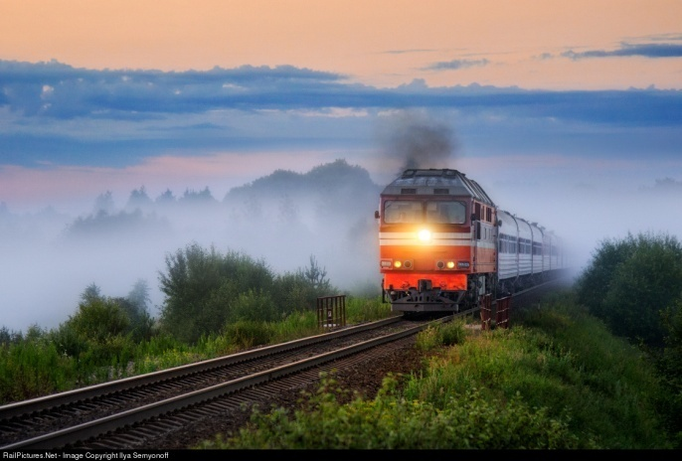
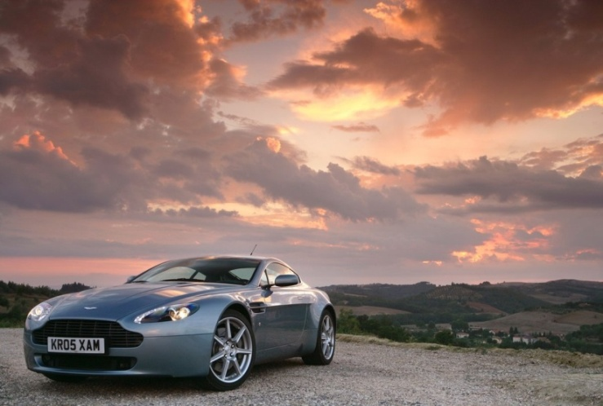
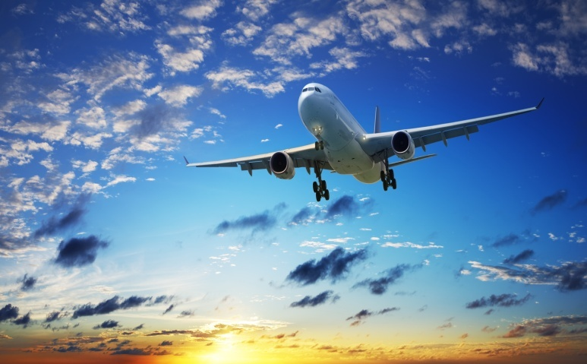
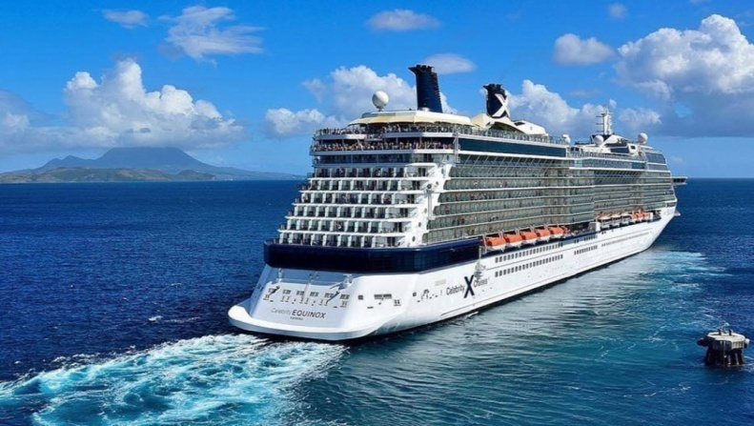
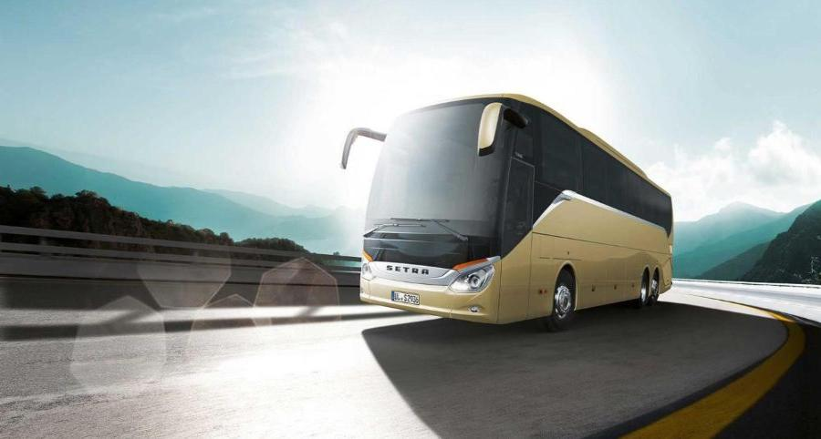
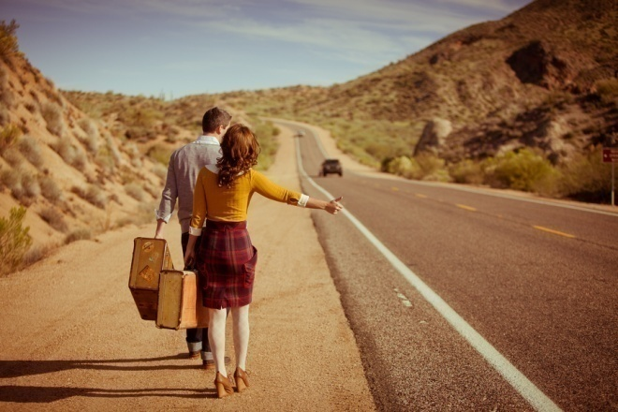

Slide 8
№1 Which means of transport is dangerous?
№2 Which means of transport is cheap?
№3 Which means of transport is comfortable? №4 Which means of transport is fast/slow?

Slide 9
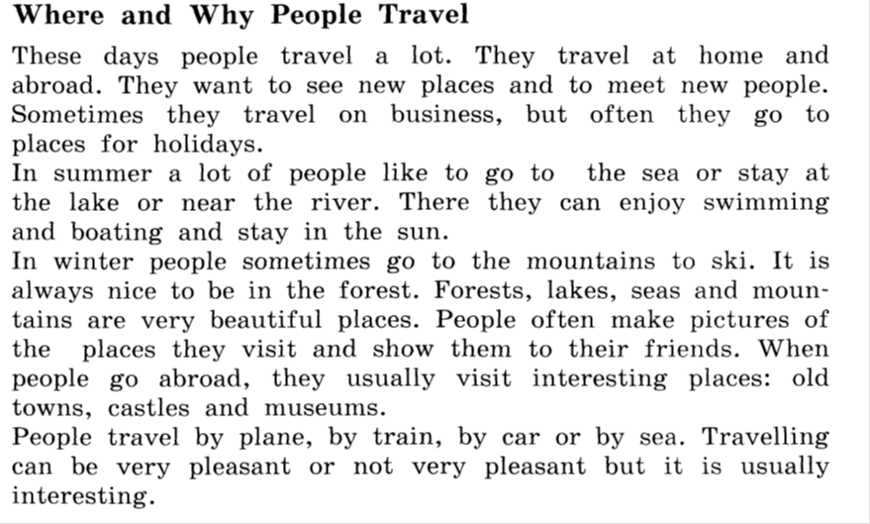

Slide 10
1.fast train | a)стойка регистрации
2.arrival | b)таможня
3.departure | c)плата за проезд
4.check-in | d)отправление
5.to check in | e)билетная касса
6.fare | f)скорый поезд
7.booking office | g)бронировать
8.to book | h)таможенник
9.customs | i)прибытие
10.customs officer | j)регистрироваться

Slide 11
1.F
2.I
3.D
4.A
5.J
6.C
7.E
8.G
9.B
10.H

Slide 12
2.0 Я ПОНИМАЮ И УМЕЮ ОБРАЗОВЫВАТЬ PRESENT PERFECT
3.0 Я МОГУ ПРИМЕНИТЬ ПРАВИЛО НА ПРАКТИКЕ И СОСТАВЛЯТЬ ПРЕДЛОЖЕНИЯ

Slide 13
Do you like your work at the lesson?
1. Урок полезен, мне все понятно
2. Лишь кое-что чуть-чуть неясно
3. Еще придется потрудиться
4. Да, трудно все-таки учиться ...

Slide 15
Home task
Упр. 8 стр. 184

