Slide 1
The USA

Slide 3
1. State of Idaho[ˈaidəhəu]
2. State of Iowa[ˈaɪəwə]
3. State of Alabama |ˌaləˈbamə|
4. State of Alaska|əˈlaskə|
5. State of Arizona[ærɪˈzoʊnə]
6. State of Arkansas[ˈärˊkənsô] 7. State of Wyoming|wʌɪˈəʊmɪ ŋ|
8. State of Washington[ ˈwɒʃɪ ŋtən ]
9. State of Vermont[vərˈmɒnt]
10. Commonwealth of Virginia [ˈkɑːmənwelθ vɚˈdʒɪnjə]
11. State of Wisconsin[wɪˈskɒnsɨn]
12. State of Hawai`i |həˈwʌɪi| 13. State of Delaware |ˈdeləwer|
14. State of Georgia |ˈdʒɔːrdʒə|
15. State of West Virginia |west vəˈdʒɪnɪə|
16. State of Illinois |ˌɪlɪˈnɔɪ|
17. State of Indiana |ˌɪndɪˈanə|
18. State of California |ˌkalɪˈfɔːnɪə|
19. State of Kansas |ˈkanzəs|
20. Commonwealth of Kentucky | kɑːmənwelθ kɛnˈtʌki|
21. State of Colorado |ˌkɒləˈrɑːdəʊ|
22. State of Connecticut |kəˈnɛtɪkət|
23. State of Louisiana |luːˌiːzɪˈanə|
24. Commonwealth of Massachusetts | kɑːmənwelθ masəˈtʃuːsɪts|
25. State of Minnesota |ˌmɪnɪˈsəʊtə|
26. State of Mississippi [ mɪsɪˈsɪpɪ ]
27. State of Missouri |mɪˈzʊəri|
28. State of Michigan |ˈmɪʃɪɡ(ə)n|
29. State of Montana |mɒnˈtanə|

Slide 4
30. State of Maine |meɪ n|
31. State of Maryland |ˈmɛːrɪˌland|
32. State of Nebraska |nɪˈbraskə|
33. State of Nevada |nɪˈvɑːdə|
34. State of New Hampshire | njuːˈhampʃ(ɪ)ə|
35. State of New Jersey | njuːˈdʒəːzi|
36. State of New York | njuːjɔːk|
37. State of New Mexico | njuːˈmɛksɪkəʊ|
38. State of Ohio |əʊˈhʌɪəʊ|
39. State of Oklahoma |ˌəʊkləˈhəʊmə|
40. State of Oregon |ˈɒrɪɡ(ə)n|
41. Commonwealth of Pennsylvania | kɑːmənwelθ ˌpɛnsɪlˈveɪnɪə|
42. State of Rhode Island and Providence Plantations | rəʊd ˈaɪlənd |
43. State of North Dakota |nɔːθ dəˈkəʊtə | 44. State of North Carolina |nɔːθ ˌkærəˈlaɪnə |ˌ 45. State of Tennesseeˌ |tenəˈsiː |
46. State of Texas |ˈteksəs |
47. State of Florida |ˈflɒrɪdə | 48. State of South Dakota |saʊθ dəˈkəʊtə|
49. State of South Carolina |saʊθ ˌkærəˈlaɪnə |
50. State of Utah |ˈjuː tɑː |

Slide 5
State of Idaho

Slide 6
State of Iowa

Slide 7
State of Alabama

Slide 8
State of Alaska

Slide 9
State of Arizona

Slide 10
State of Arkansas

Slide 11
State of Wyoming

Slide 12
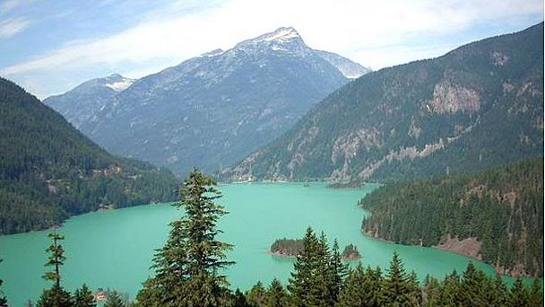
State of Washington

Slide 13
State of Vermont

Slide 14
Commonwealth of Virginia

Slide 15
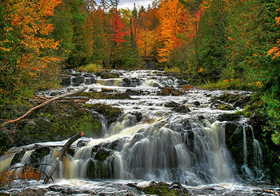
State of Wisconsin

Slide 16
State of Hawai`i

Slide 17
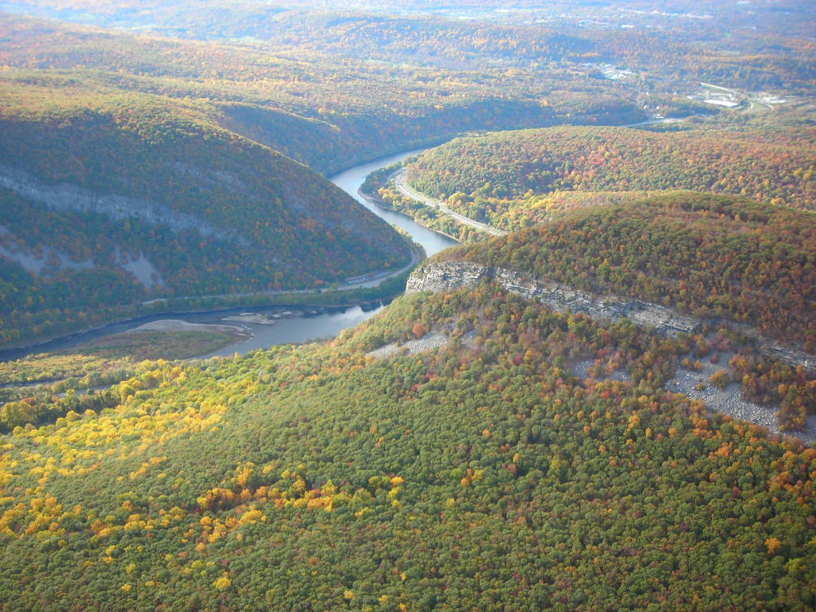
State of Delaware

Slide 18
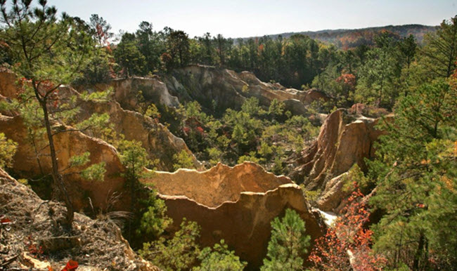
State of Georgia

Slide 19
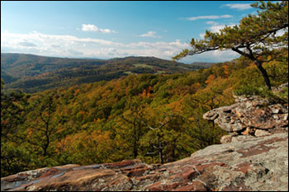
State of West Virginia

Slide 20
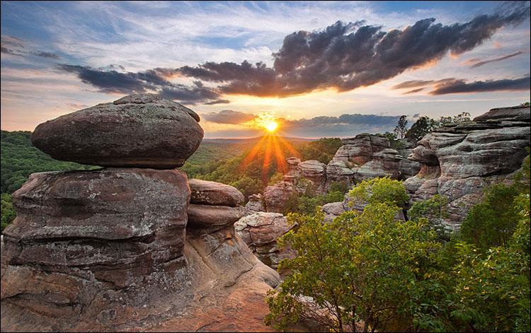
State of Illinois

Slide 21
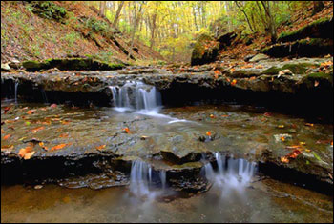
State of Indiana

Slide 22
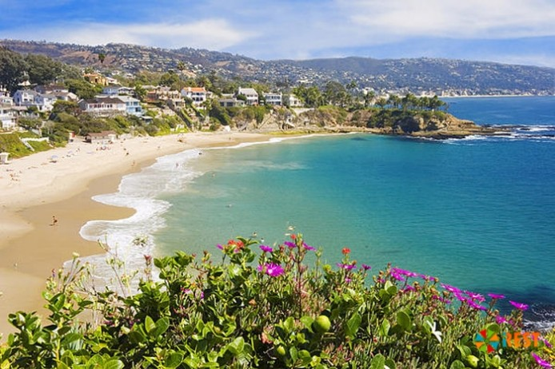
State of California

Slide 23
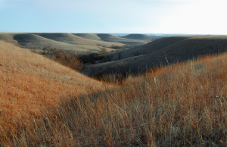
State of Kansas

Slide 24
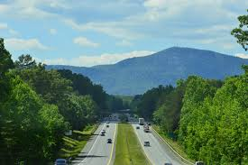
Commonwealth of Kentucky

Slide 25
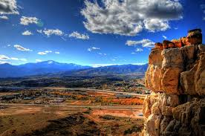
State of Colorado

Slide 26
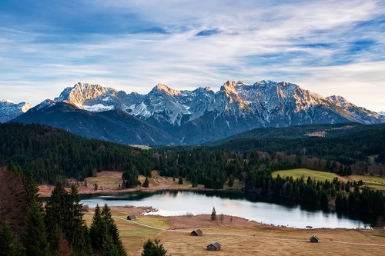
State of Connecticut

Slide 27
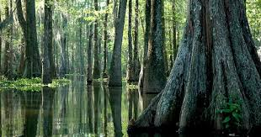
State of Louisiana

Slide 28
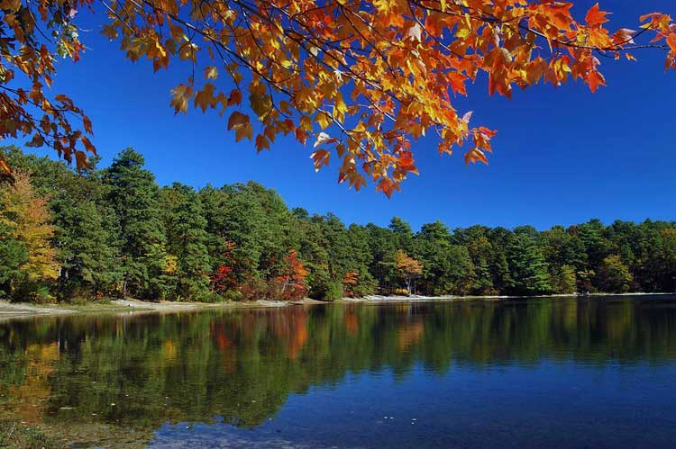
Commonwealth of Massachusetts

Slide 29
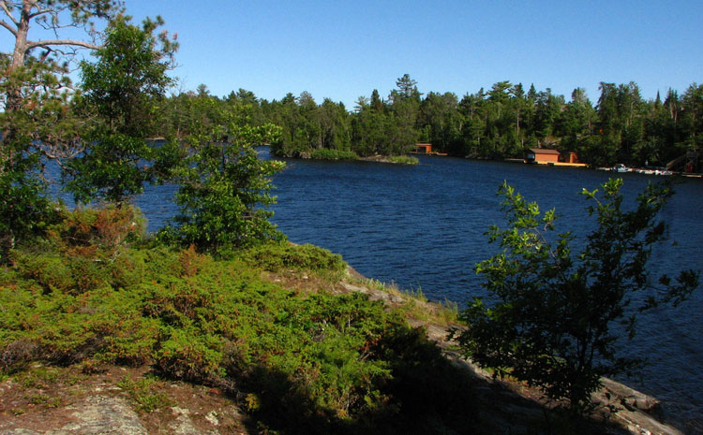
State of Minnesota

Slide 30
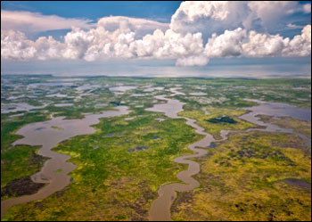
State of Mississippi

Slide 31
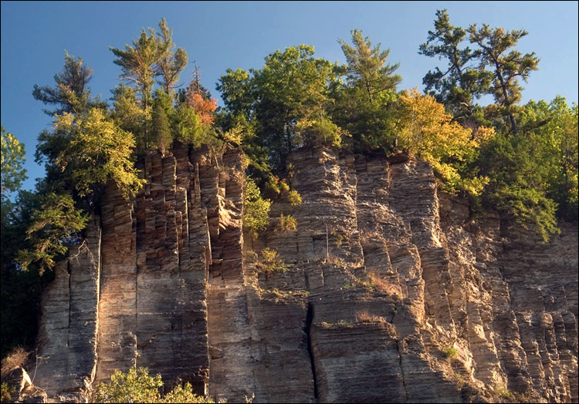
State of Missouri

Slide 32
State of Michigan

Slide 33
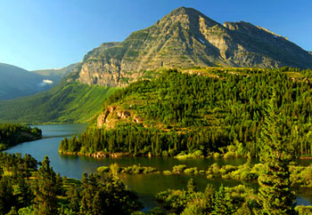
State of Montana

Slide 34
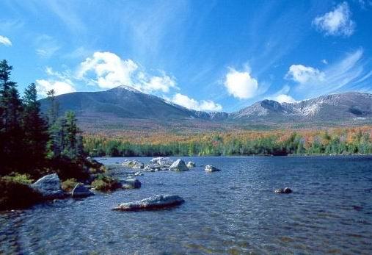
State of Maine

Slide 35
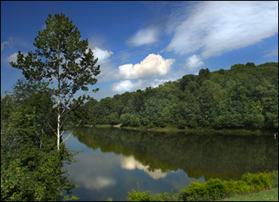
State of Maryland

Slide 36
State of Nebraska

Slide 37
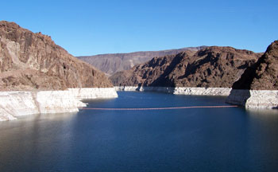
State of Nevada

Slide 38
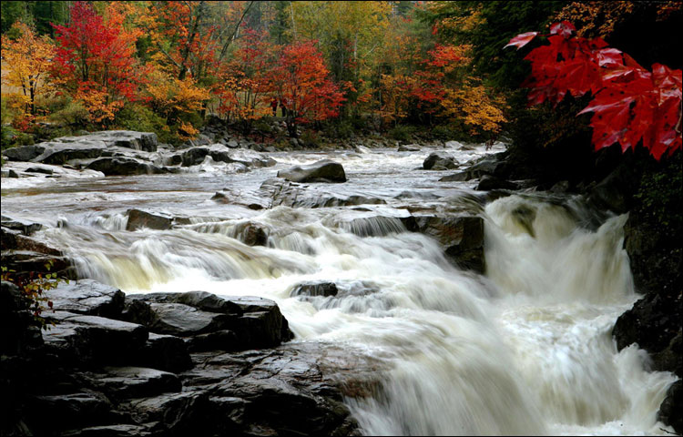
State of New Hampshire

Slide 39
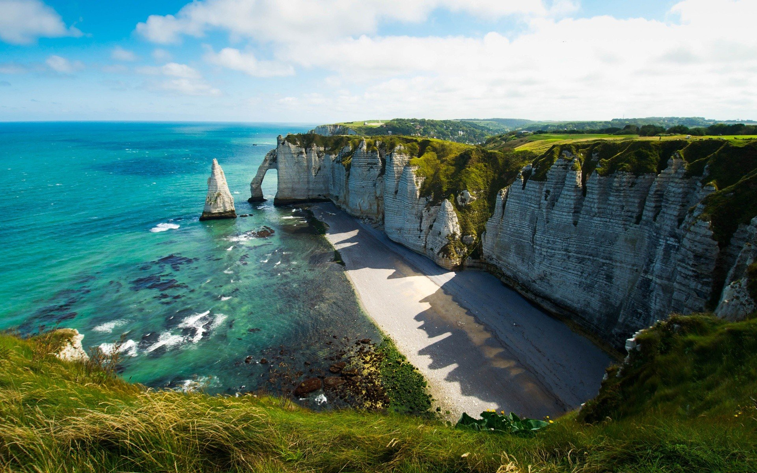
State of New Jersey

Slide 40
State of New York

Slide 41
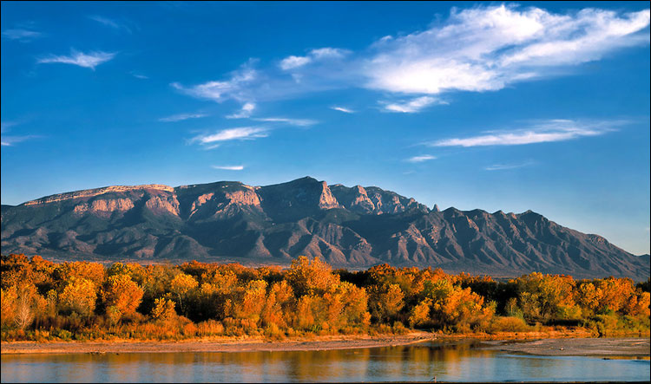
State of New Mexico

Slide 42
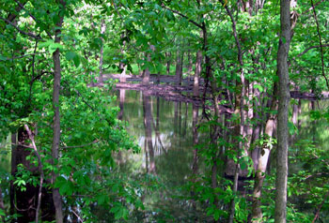
State of Ohio

Slide 43
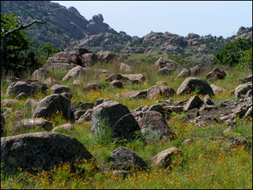
State of Oklahoma

Slide 44
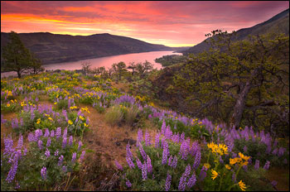
State of Oregon

Slide 45
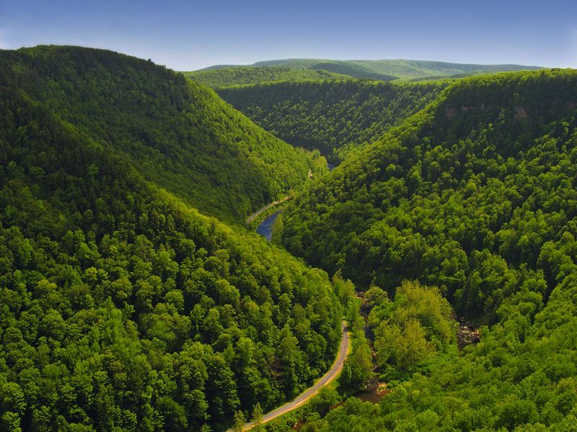
Commonwealth of Pennsylvania

Slide 46
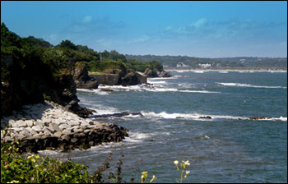
State of Rhode Island and Providence Plantations

Slide 47
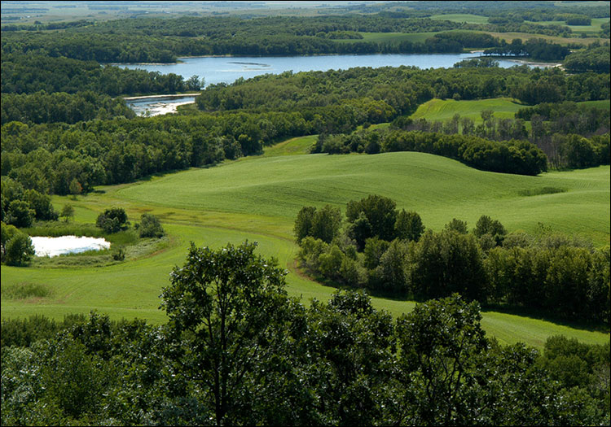
State of North Dakota

Slide 48
State of North Carolina

Slide 49
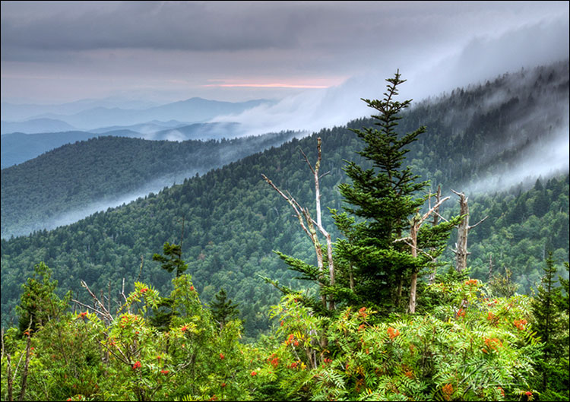
State of Tennessee

Slide 50
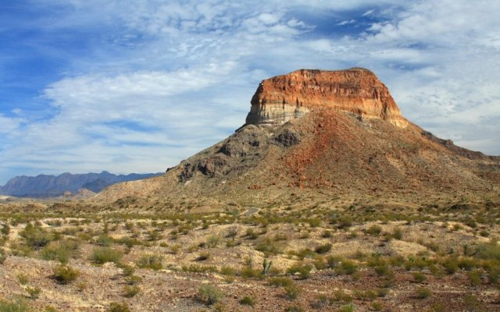
State of Texas

Slide 51
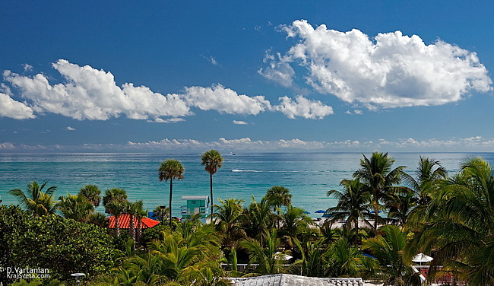
State of Florida

Slide 52
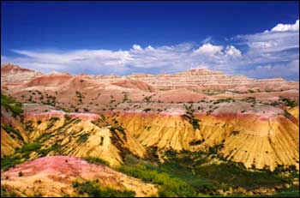
State of South Dakota

Slide 53
State of South Carolina

Slide 54
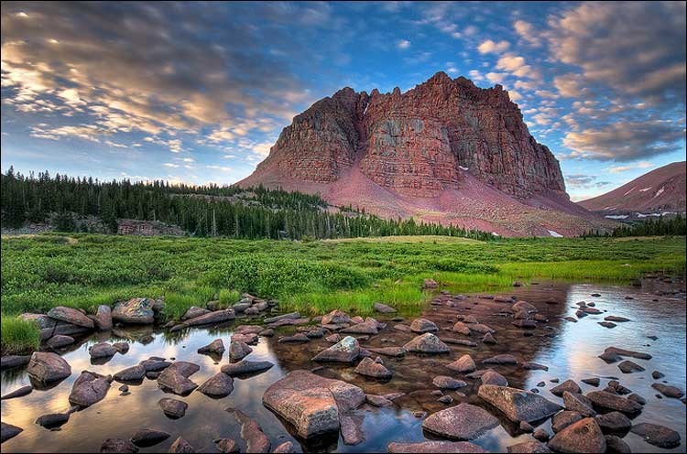
State of Utah

