Slide 2
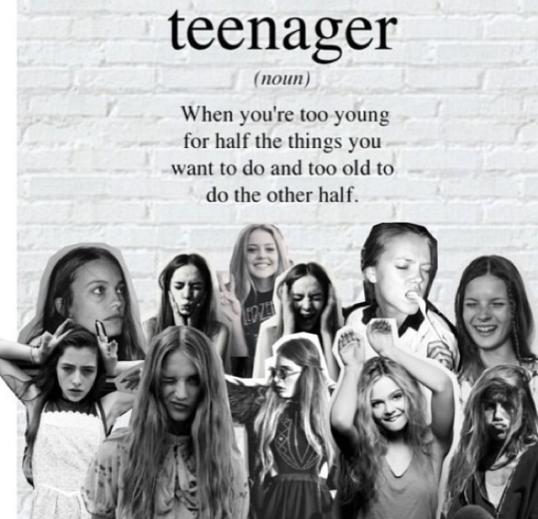

Slide 3
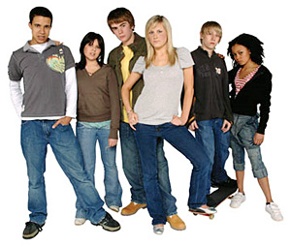
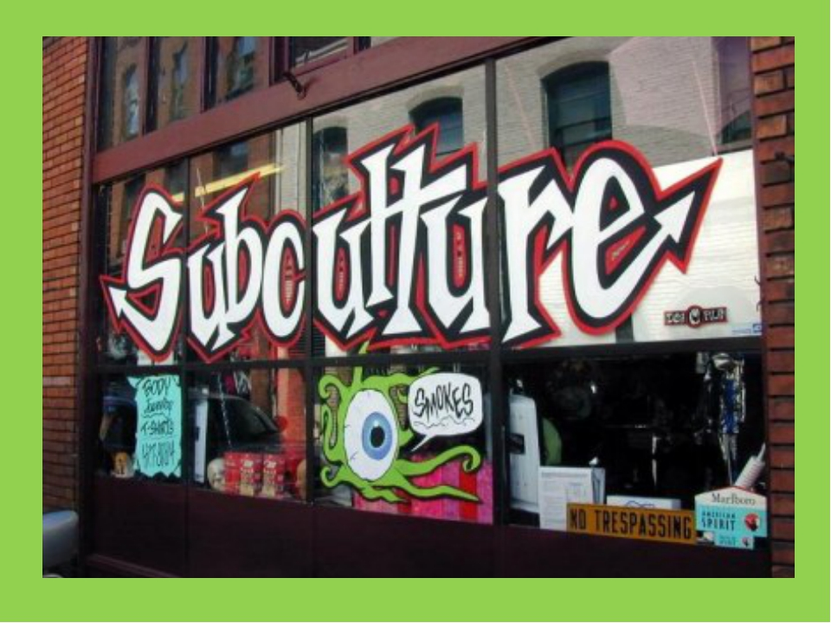
Teenagers
1
What are they like?
3
Subcultures
4
You are only a Teenager once. What to do?
2.
What problems do teens have?

Slide 4
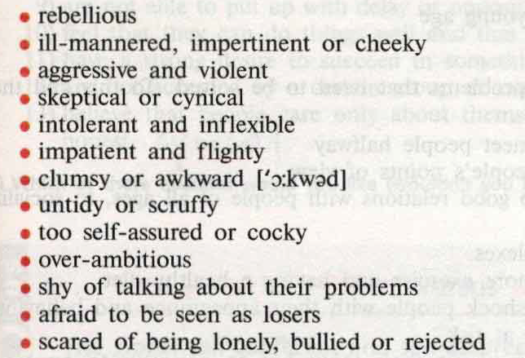

Slide 5
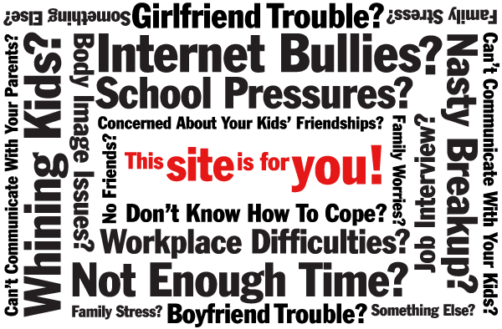
PROBLEMS

Slide 6
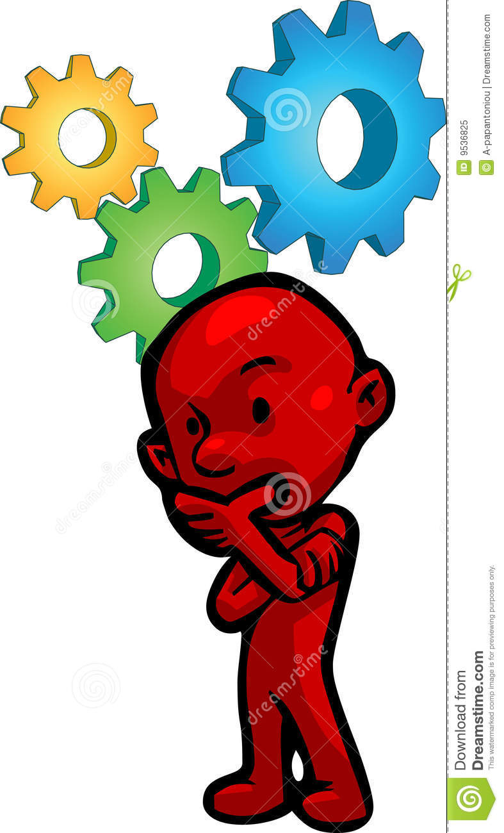
1. Name the problem 2. Give 2 ways of solving the problem you have mentioned

Slide 7
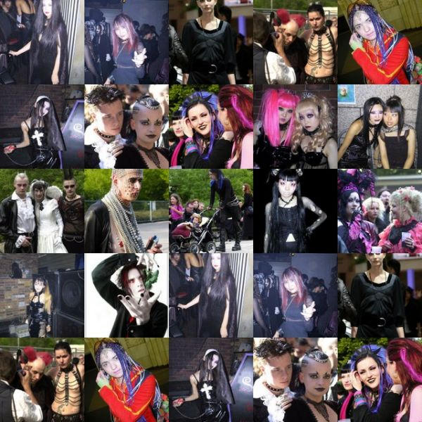
A subculture is a group with a distinct style and identity. Different subcultures have their own beliefs, value systems, fashion, and favourite music.

Slide 8
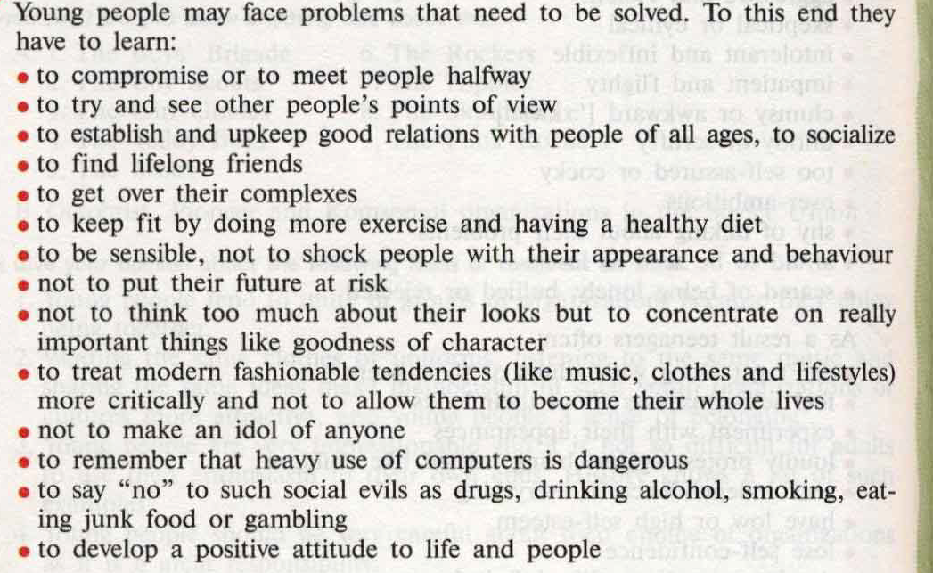

Slide 9
CINQUAIN 5 Line Poetry

Slide 10
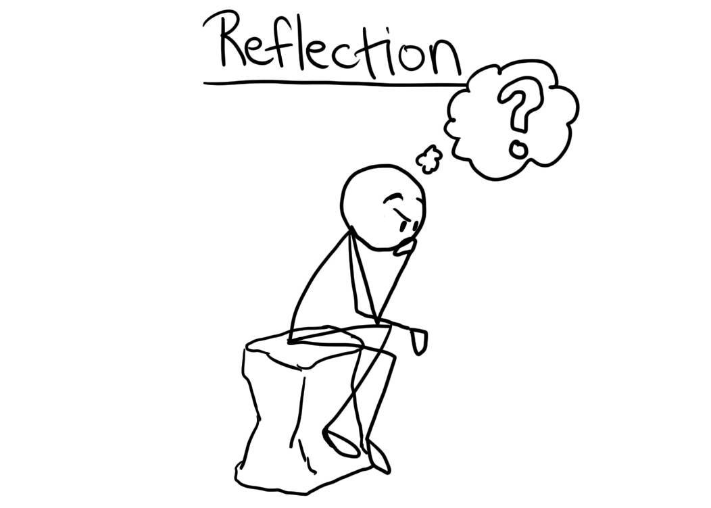
Did you like the lesson? Did you find the topic interesting? Why? Which part opf the lesson did you like most? Why? On a scale of 10 how would you evaluate your work?

