Slide 2
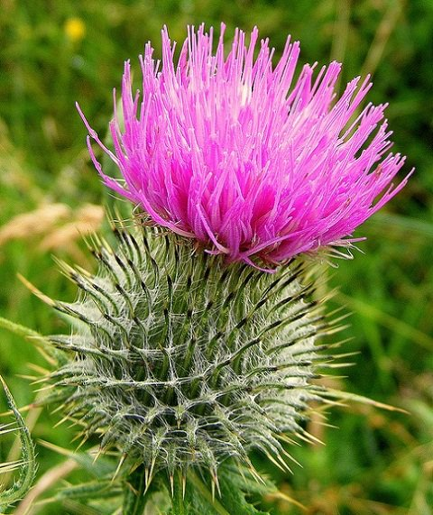
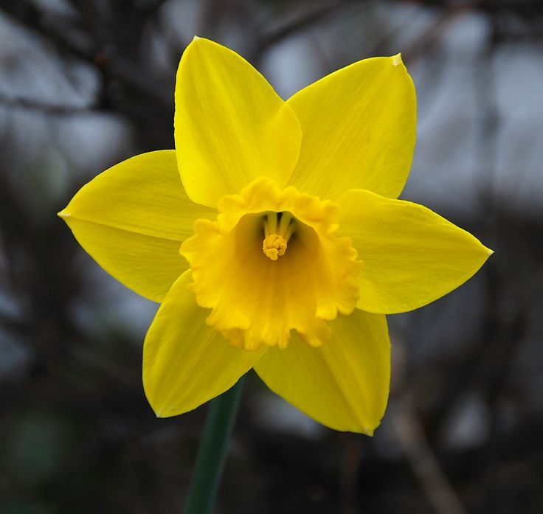
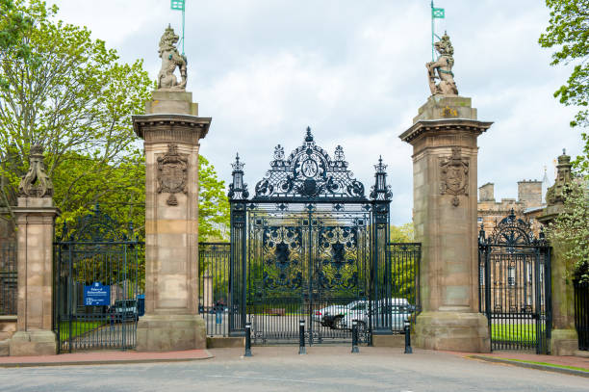

Slide 3
Scotland

Slide 4
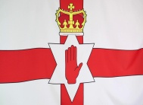
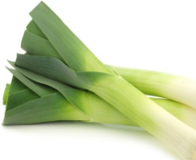
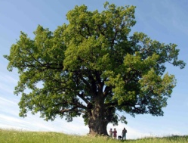
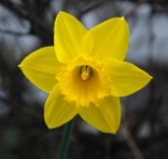

Slide 6
Dictation
_____ is the process of buying, selling or exchanging goods between countries.
A person who is ____ is wealthy and successful.
The ____ was so high that we couldn’t climb it.
You can easily see their ____ to their children.
If he is as ____ as he says, why have they caught him?
The most ____ character in “Alice in Wonderland” is the Queen.
My uncle has got a lot of medals but he is too ___ to wear them.
The traffic in High Street is so ___that I never let my son cross it alone.
To ____ is to put a dead body into a grave.
On May, 9 there is usually a _____ parade in Moscow.
The boy was looking through the window and couldn’t ______ on the work.
There is a great _____ between life in the country and life in the city.
_____ your coat on the hook.
The most _____ part of the Royal Mile is the Cannongate, which gives a good idea of what the Old Town was like.
When Linda came to Edinburgh, she was immediately _____ by romantic beauty of the city.

Slide 7
My Bonnie Lies Over the Ocean

Slide 8
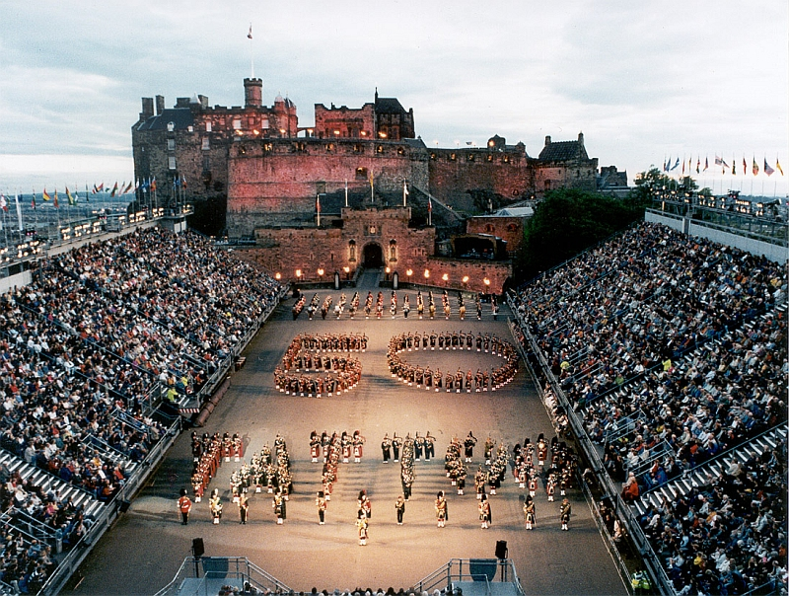
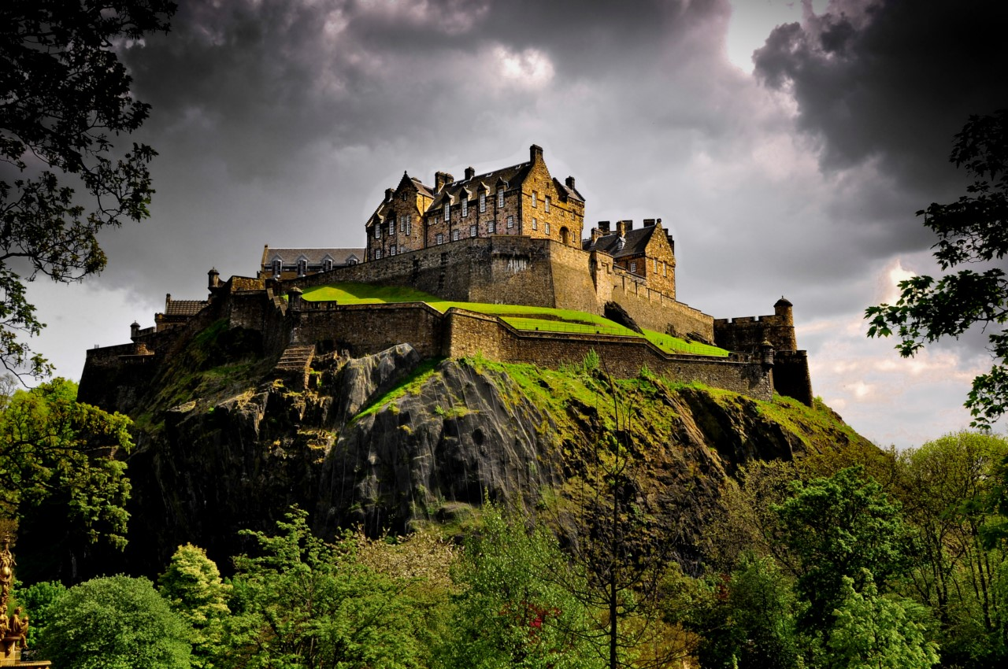
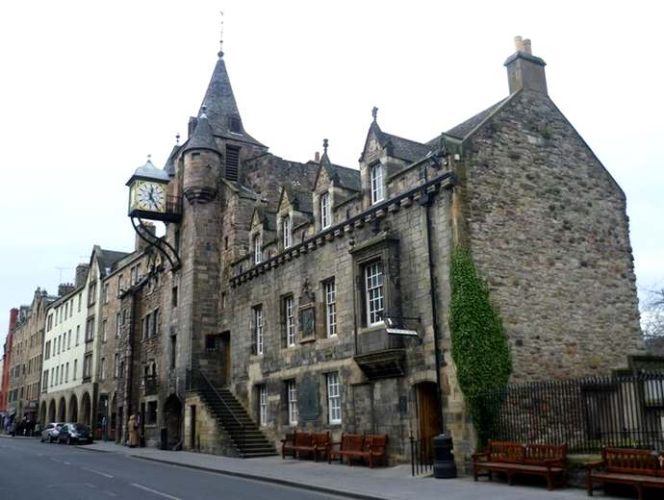
P.42 Ex-s. 25, 26, 27
Edinburgh Castle
The Edinburgh military tattoo
The Cannongate

Slide 9
P.45 EX. 29
Mike
Duncan

Slide 10
Scotland is divided into two parts: ……and …..

Slide 11
Ex. 21 P. 41

Slide 12
MY HEART’S IN THE HIGHLANDS

Slide 13
Robert Burns (1759-1796)
Robert Burns was a famous Scottish poet and lyricist. Burns is often credited as the national poet of Scotland and is the best known Scottish language poet till date .

Slide 14
Samuil Yakovlevich Marshak (1887-1934)
He was a Russian writer, translator and children's poet.

Slide 15
В горах моё сердце

Slide 16
I would like to visit Scotland…

Slide 17
Rate yourselves!

